Slide 1
ORCID case study: Hong Kong Baptist University
Chris Chan
Head of Information Services, HKBU Library
https://orcid.org/0000-0003-4240-5455 @Chris_HKBU

Slide 2
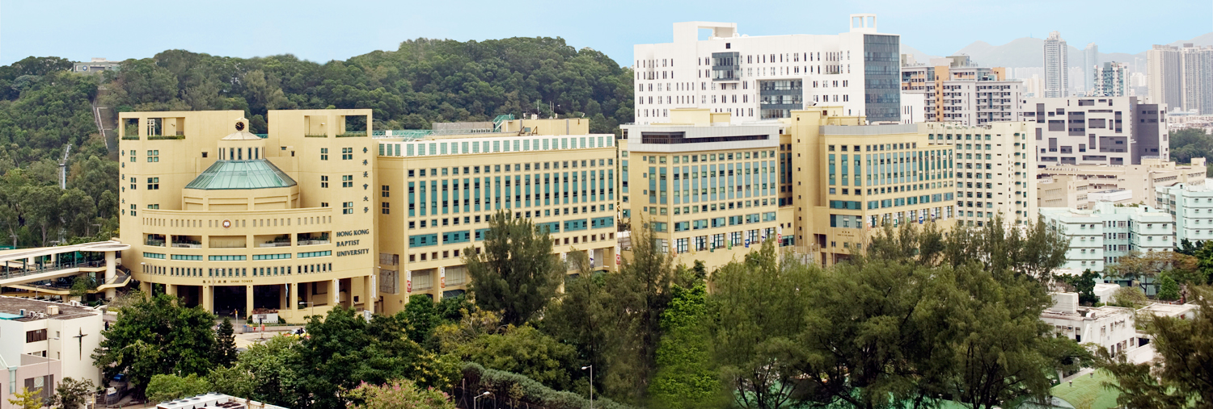
HKBU at a glance

Slide 3
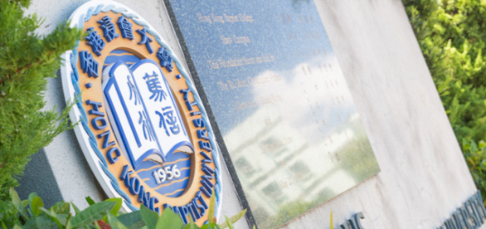
Hong Kong Baptist University
Founded in 1956 as Hong Kong Baptist College and granted University status in 1994
One of eight public universities in Hong Kong
3 Faculties, 4 Schools & 1 Academy
11,000+ students*
800+ Full-time academic/teaching staff
* University-based, excluding School of Continuing Education
Notes:
https://flic.kr/p/9FY3Va

Slide 4
Outline
Background
Our integration
Where we are now
Where we are heading

Slide 5
Background
How we got started

Slide 6
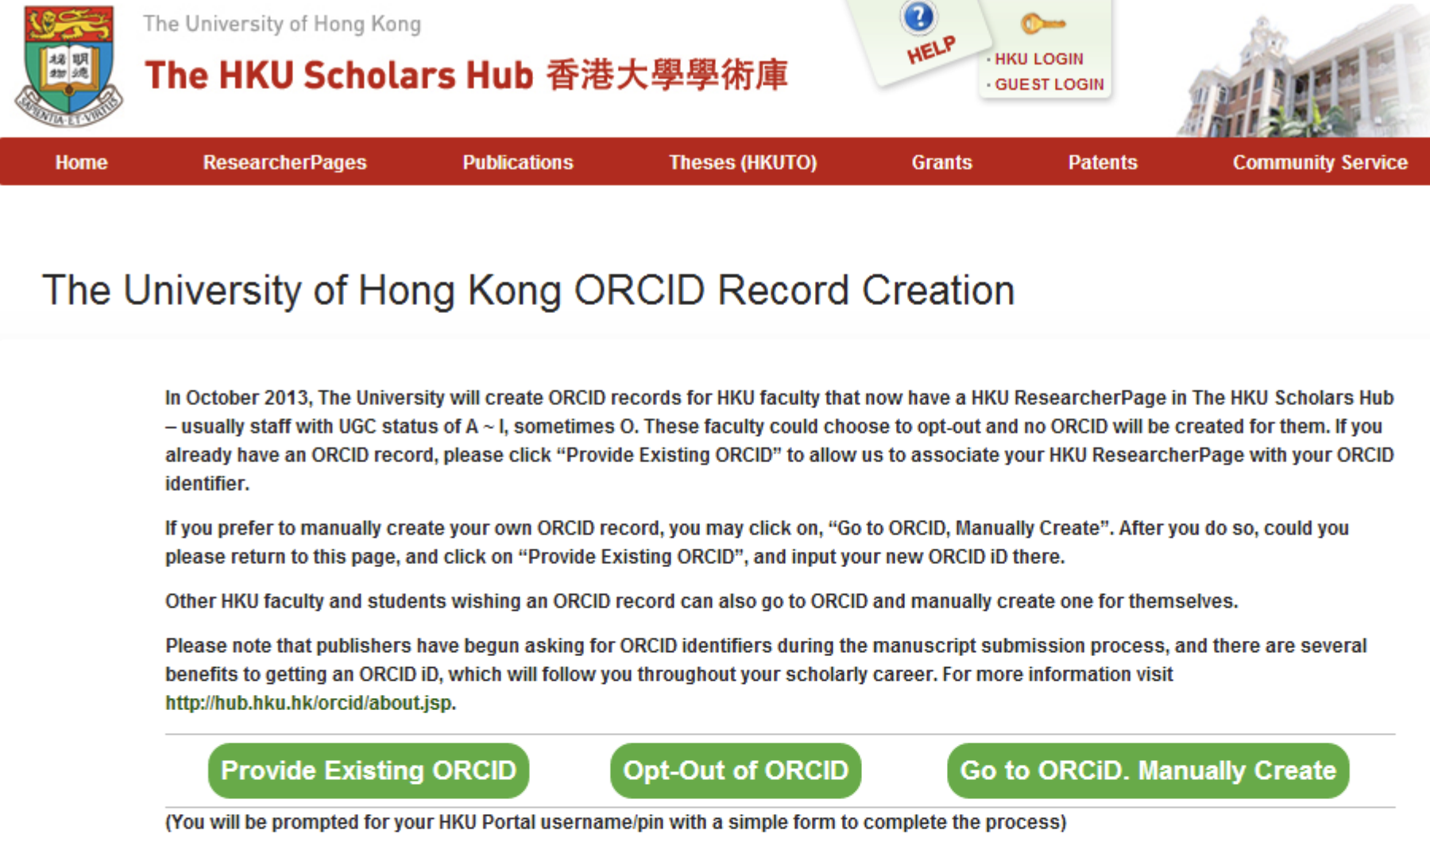
On the shoulders of giants…
“ORCID is a game changer”
David Palmer, HKU Libraries
ORCID & its HKU implementation
2013 PRDLA Conference
http://hub.hku.hk/handle/10722/191175
The University of Hong Kong (HKU) first to recognize importance of ORCID
Support at institutional level
They learned what worked and what didn’t – we benefitted
2013
Create-on-behalf initiative launched October 2013

Slide 7
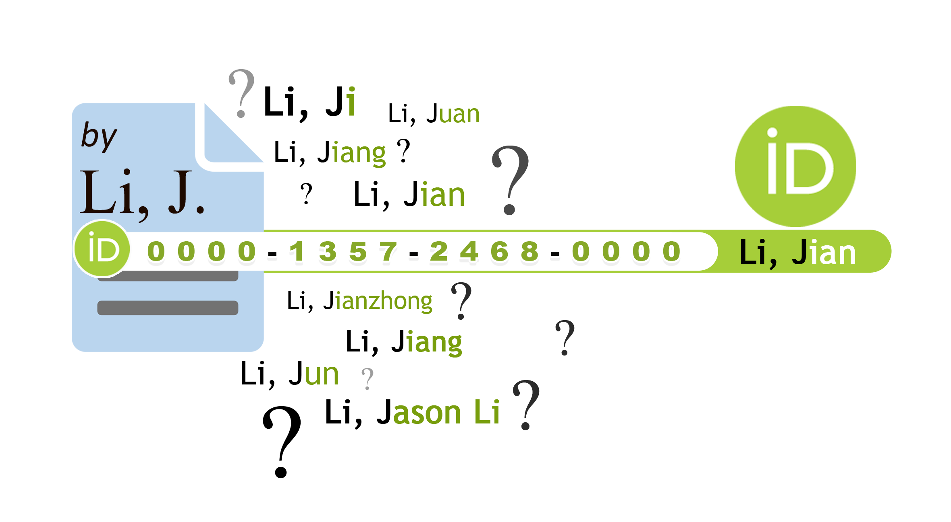
Research Visibility @ HKBU
In 2015, the Library at HKBU proposed a “Research Visibility Project”
Chief among its goals was to support institutional adoption of ORCID
Goal: Equip all HKBU faculty with an ORCID iD, and be able to modify on their behalf
The team in 2015
Name disambiguation particularly relevant in Chinese cultural context

Slide 8
Our ORCID integration
Development and structure

Slide 9
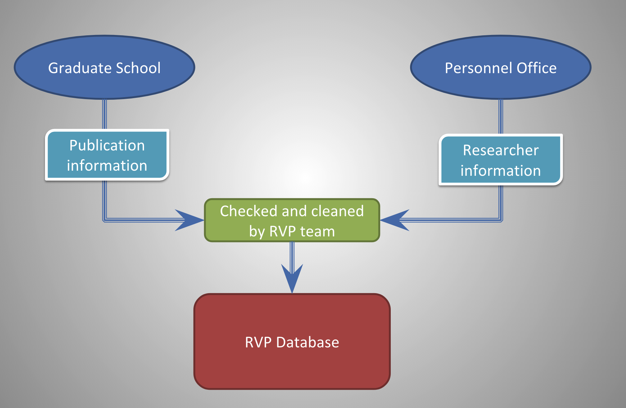
Research visibility database
Developed in-house by the Library’s Systems Section
Involves large amount of manual data entry
Works with the ORCID Member API

Slide 10
ORCID integration structure

Slide 11
Where we are now
Current workflows and challenges

Slide 12
Maintenance
Annual upload of research output metadata received from Graduate School
Annual invitation to new faculty to create/link ORCID to our system
Handle ad hoc requests from faculty to add data to their ORCID account

Slide 13
Challenges
“I already have a Google Scholar profile / ResearchGate account / Academia.edu account / personal homepage so….”
Time delay between submission to University and upload to ORCID
Ongoing outreach effort to ensure faculty know what ORCID is and why they need one
“Why do I need an ORCID iD?”

Slide 14
Where we are heading
Road to a centralized research information system &
Role of University in asserting to ORCID

Slide 15
Which CRIS for HKBU?
University moving to establish single current research information system
Most have ORCID integrations, and will likely make our existing system redundant
?
?
?

Slide 16
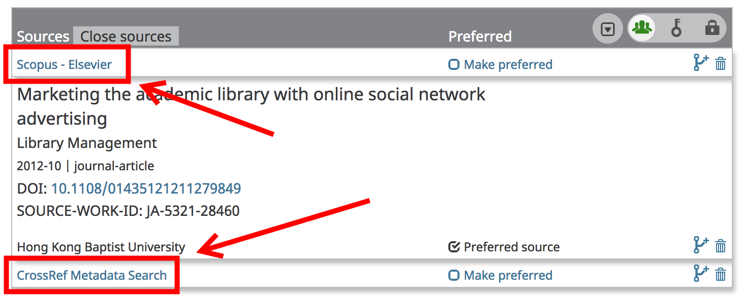
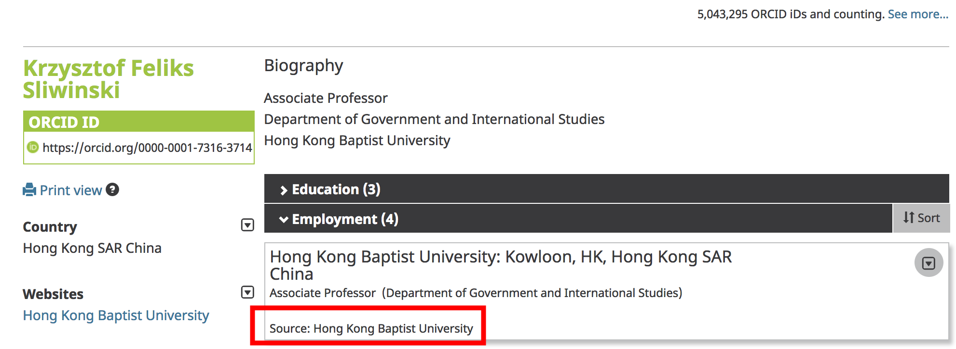
University’s role in ORCID assertions?
Currently, we help to assert publications into ORCID records
Duplication of effort as more publishers/vendors support ORCID
Going forward, may focus exclusively on asserting affiliation with HKBU

Slide 17
Questions?

Slide 18
Acknowledgements
Images and graphics:
Slide 12 “Men at Work” by Nat Lockwood (2007), available from http://flic.kr/p/2wVPb5 via a CC BY-NC-ND 2.0 license
Pictures of HKBU Library were taken by the Library staff at HKBU
Presentation:
Created by Chris Chan using a template designed by Jennifer Gu (HKBU Library)

