Slide 1
Peer Review Week 2018
ORCID Peer review Updates
September 14, 2018
Alainna Therese Wrigley
Senior Community Manager (Asia-Pacific)
community@orcid.org | https://orcid.org/0000-0002-6138-0903

Slide 2
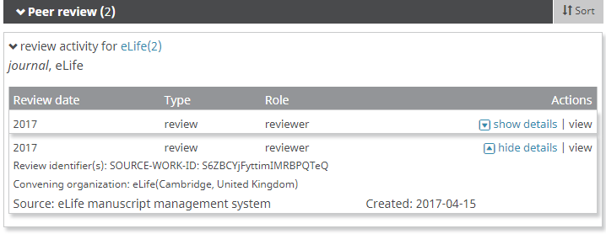
Peer review on ORCID
Peer review section
Based on CASRAI Peer Review Services data profile
Reviews can be added only by a trusted organization using API – users cannot self-assert
Service affiliation
Expanded affiliations in user interface and in API 3.0_RC1
Recognize significant donations of time to an organization as reviewer, e.g. expert review panel, conference panel chair.
Source: https://orcid.org/0000-0001-7079-7973
Source: Testing data
ORCID Peer review workflow: https://members.orcid.org/api/workflow/peer-review
ORCID service et al affiliation tutorial: https://github.com/ORCID/ORCID-Source/blob/master/orcid-api-web/tutorial/affiliations.md
Notes:
Peer review is a fundamental component of the research lifecycle, but reviewers’ contributions can often go unrecognized in a process where anonymity remains the standard. For researchers, using your ORCID iD to enable connections with the organizations for which you perform reviews raises the visibility of your efforts and contributions.
For publishers, funders, research institutions, associations, and others involved in review, asking your reviewers for their ORCID iD and embedding it in your workflows can help streamline your processes, improve the management of your reviewer databases, and provide your reviewers with public – and discoverable – acknowledgement of their service.
ORCID introduced functionality in 2015 to facilitate the recognition and exchange of data about peer review activities, and several organizations worked with us as launch partners to test the functionality and our new API v.2.0. See more about their experiences at: https://vimeo.com/album/4159316
Since the launch of the API 2.0 in February 2017, all ORCID members have the ability to post peer review activities. It is possible to acknowledge the full range of peer review contributions, from double blind to open – and not just for peer review for publications.
We follow the CASRAI Peer Review Services data profile developed by the Peer Review Services Working Group.

Slide 3
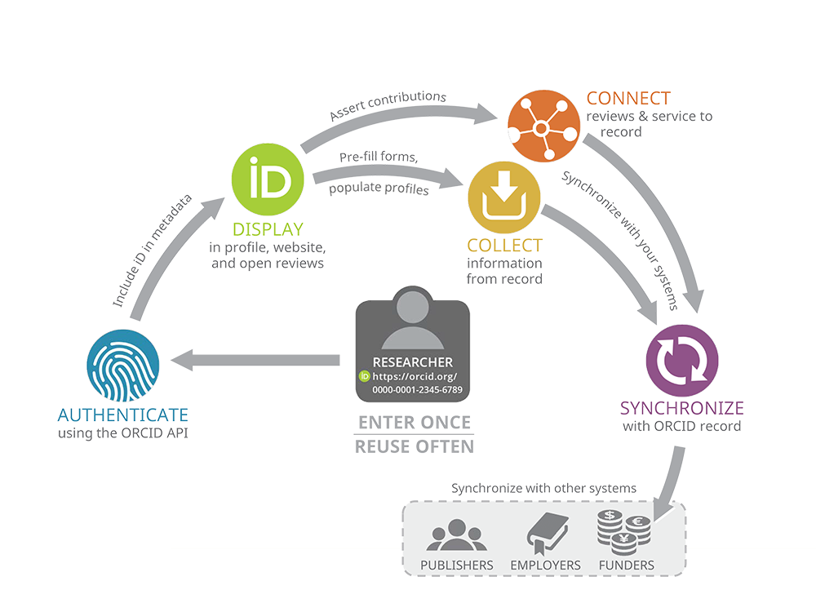
AUTHENTICATE
Verified iDs using OAuth
DISPLAY
In metadata
In reviewer profiles
CONNECT
Review activity or review service to records
Use unique reference ID
COLLECT
Affiliations, works, review history, &c from records
SYNCHRONIZE
Auto-update records and your databases
Peer review workflow: https://members.orcid.org/api/workflow/peer-review

Slide 4
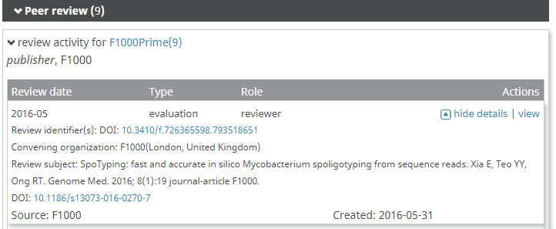
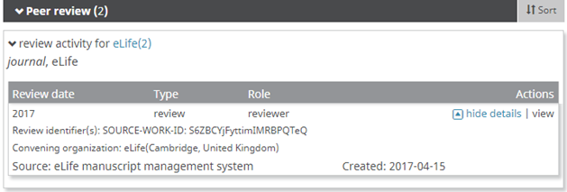
Peer review on ORCID
Peer review activity
Standard citation elements:
Person
Role
Group
Review
Type
Review identifier(s)
Review date
Review URL
Subject
Subject title
Subject identifier(s)
Subject URL
Convening organization
Organization identifier
Source: https://orcid.org/0000-0002-7199-7747
Source: https://orcid.org/0000-0001-7079-7973
Mandatory elements
Optional elements
Notes:
A peer review citation combines three elements: information about the reviewer, about the organization sponsoring the review, and about the review itself. Importantly, each of these components involves a persistent identifier.
Information about the reviewer
Role: The individual’s role in the review process, e.g. chair, editor, member, organizer, reviewer.
Identifier: The reviewer’s ORCID iD
Information about the organizer
Convening organization: This describes the organization which organized the review - a journal publisher, conference organizer, funding agency, faculty, etc.
Identifier: The persistent identifier for the organization
Information about the review
Group: An identifier used for aggregation purposes that describes the group of which the review is part. This could be the name of a journal (Journal of Scientific Investigations) or a publisher (Scholarly Publisher), or a non-specific description (Biology Journal).
Type: The type of review activity, e.g., a review, evaluation.
Date: When the review was completed. This can be broad (2008) or specific (2010-12-10).
Identifier: A unique resolvable identifier provided by the source for the review itself. This is used to prevent duplication of review activity.
There are several optional fields, which allow the organizer flexibility to acknowledge a range of review types. Many of these fields would not be used in a double blind review, but would be used in an open review:
URL: A link to the representation of the review online;
Name: The title of the item reviewed; Type: The type of item that was reviewed, e.g. article, grant, monograph;
Container name: The name of main object of which the review is part, e.g. journal, conference, grant review panel, etc.;
Item Identifier: A unique resolvable identifier for the reviewed item, e.g. a DOI.
URL: A link to the item reviewed online.

Slide 5
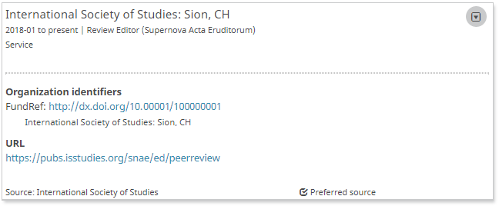
Peer review on ORCID
Service affiliation – NEW!
Standard citation elements:
Service organization
City
State, province, prefecture
Country or region
Organization identifier
Service duration
Start date
End date
Service identifier
Service role or title
Service department, committee, journal, etc.
Service URL
Source: Testing data
Mandatory elements
Optional elements
Notes:
A service affiliation combines three elements: information about the researcher, information about the organization, and information about their service affiliation.
Information about the researcher
Type of affiliation: Service
Identifier: The reviewer’s ORCID iD
Role: The role that the researcher played, e.g. Review Editor.
Information about the organization
Organization: This describes the organization for whom the researcher performed the service - a journal publisher, conference organizer, scholarly society, funding agency, faculty, etc.
Identifier: The persistent identifier for the organization
Information about the service
Duration: The start date of the duration is mandatory.
Department: The journal, committee, panel, department, etc. the service
URL: URL where more information about the service can be found.
Identifier: Persistent identifier with more complete metadata about the service affiliation.

Slide 6
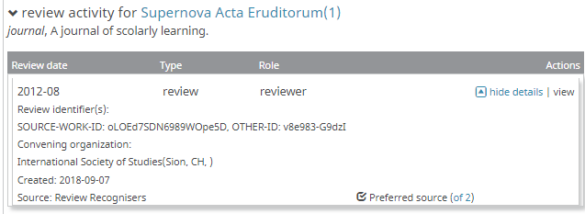
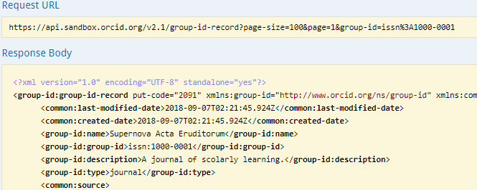
Peer review on ORCID
Peer review activity – Grouping by review identifier – NEW!
Multiple organizations can recognize the same review
Review grouping by shared identifier as in other sections of ORCID record
Peer review activity – Search by GRoUP ID – NEW!
Organizations recognizing reviews should use the same Group-ID to ensure all reviews appear under same header
The organization can search for an existing group-ID to keep from creating duplicates

Slide 7
Peer review: Facts & Figures
 | Sept 2017 | Sept 2018
Number of iDs with peer reviews | 10,837 | 25,415
Number of peer review items | 148,060 | 537,556
Visible to everyone | 124,709 | 454,523
Visible to trusted parties | 5,660 | 23,901
Visible to only the user | 17,691 | 59,132
Number of peer review groups | 10,108 | 18,474
Number of unique DOIs | 6,948 | 12,989
Top five organizations posting peer reviews (number of reviews posted) | Publons (135,752) F1000 (7,080) American Geophysical Union (4,365) eLife (257) The Society for Neuroscience (257) | Publons (514,322) F1000 (13,151) GEMS (7,939) The Society for Neuroscience (503) eLife manuscript management system (414)

Slide 8
Peer review: Facts & Figures
How are organizations recognizing reviews?
ORCID-enabled service provider platforms which can directly recognize reviews to ORCID records
EditorialManager (Aries Systems)
eJournalPress (eJournalPress)
Open Research (F1000)
ReView (RiverValley Technologies)

Slide 9
Webinars and resources
Upcoming webinars October 10 (Asia-Pacific): Publishing community user group webinars (Dec 11 next webinar for Americas/EMEA) https://orcid.org/about/events
ORCID in Publishing User Group https://orcid.org/blog/2018/08/14/orcid-publishing
Members Support Center: Tutorials, workflows https://members.orcid.org/api
ORCID peer review guide https://members.orcid.org/api/workflow/peer-review
ORCID new service (et al) affiliations tutorial https://github.com/ORCID/ORCID-Source/blob/master/orcid-api-web/tutorial/affiliations.md
ORCID API users group https://groups.google.com/group/orcid-api-users

