Slide 1
COMMUNITIES OF PRACTICE MATTER
NETHERLANDS WORKSHOP, UTRECHT| SEPTEMBER 28, 2018
Laurel L Haak, PhD
Executive Director, ORCID
l.haak@orcid.org
https://0000-0001-5109-3700

Slide 2
ORCID is charged by the community with making real the vision of identifier-enabled research information infrastructure
https://orcid.org/about/what-is-orcid/mission

Slide 3
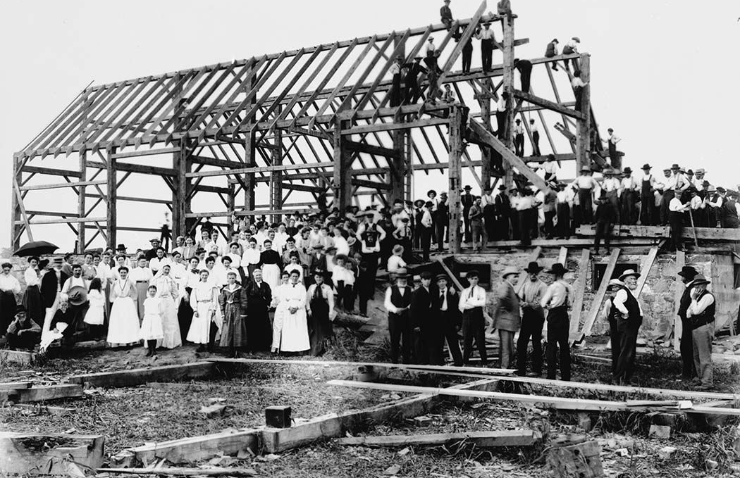
Source; Wikimedia

Slide 4
PRINCIPLES OF ENGAGEMENT
TRANSPARENT
OPEN
TRUSTED
NON-PROPRIETARY
RESEARCHER CONTROL
SUSTAINABLE
PERSISTENT
https://orcid.org/about/what-is-orcid/mission

Slide 5
VISION: WHAT ARE WE BUILDING
A world where all who participate in research, scholarship, and innovation are uniquely identified and connected to their contributions across disciplines, borders, and time.
https://orcid.org/about/what-is-orcid/mission

Slide 6
MAKING CONNECTIONS
ORCID enables connections between individual researchers (via their ORCID iD) and their activities and affiliations (via other identifiers and APIs), which are asserted either by the researcher, or with their permission, by ORCID members.
https://orcid.org/blog/2018/06/13/assertion-assurance-pathways-what-are-they-and-why-do-they-matter

Slide 7
ANATOMY OF AN ASSERTION
Who is the person (ORCID iD)
What is the item (and its PID) the person is connected to?
Who made this connection (and what is their PID)?
Who added this information to the ORCID record (and what is their PID)?
Who is responsible for maintaining the item metadata (and what is their PID)?
https://orcid.org/blog/2018/06/13/assertion-assurance-pathways-what-are-they-and-why-do-they-matter

Slide 8
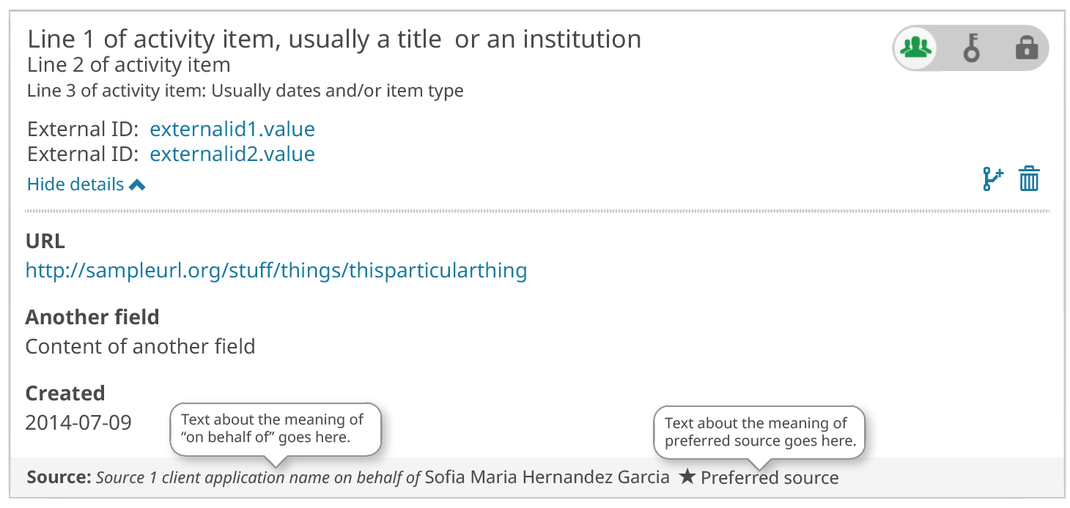
ON BEHALF OF USER
Distinguishes between user assertions and member assertions.

Slide 9
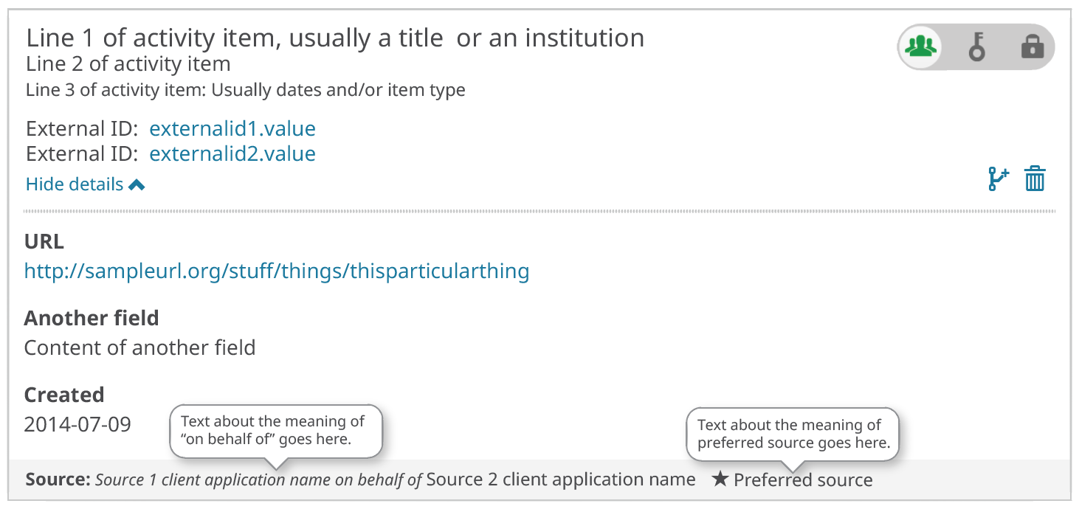
On Behalf Of Token Delegation
Enables one member to pass permissions to another member that they work with. Distinguishes which member is responsible for the assertion and which member wrote to the record.
Notes:
OBO see https://docs.google.com/presentation/d/1RwMRjd_SUTFKtV6-kYAddx7FuipxZ19cLOO2LHxCV6o/edit?usp=sharing
Enables simple integrations from members to pass off complex processing to service providers.
Tom

Slide 10
PILOT PROGRAMS
API 3.0_rc1 is available now and supports new affiliation types and section for research resources. Test program launching in October
API 3.0_rc2 will support On Behalf Of workflows (User and Token Delegation). Soliciting interest in pilot project 4Q 2019

Slide 11
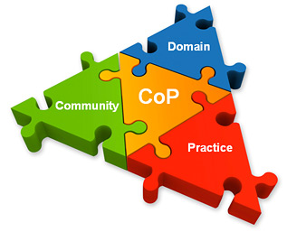
COMMUNITY OF PRACTICE

