Slide 1
Exploring ORCID Use at VIVA Institutions
December 11, 2018

Slide 2
Agenda
Intro to ORCID
ORCID US Community
ORCID Case studies:
Virginia Commonwealth University
Virginia Tech
University of Virginia
Discussion & Questions

Slide 3
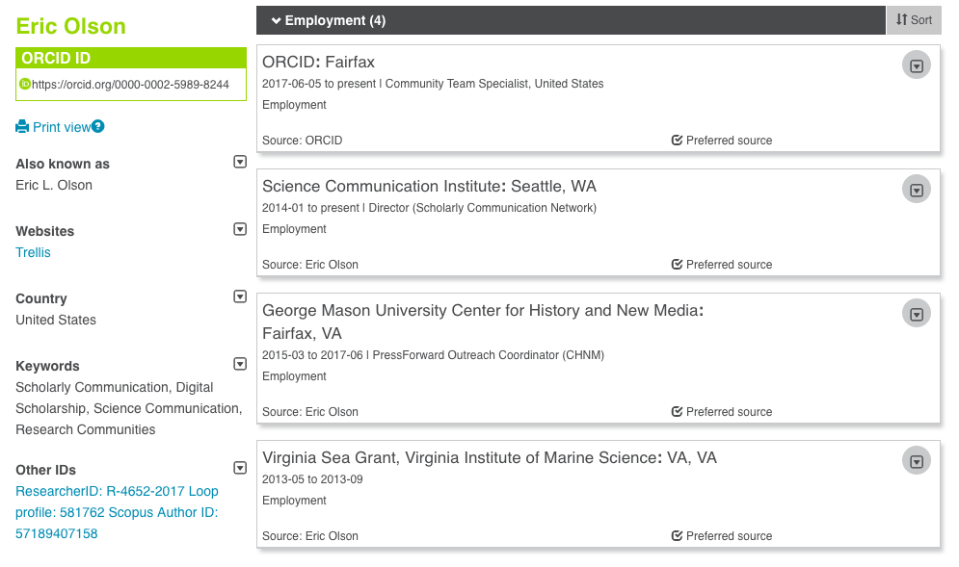
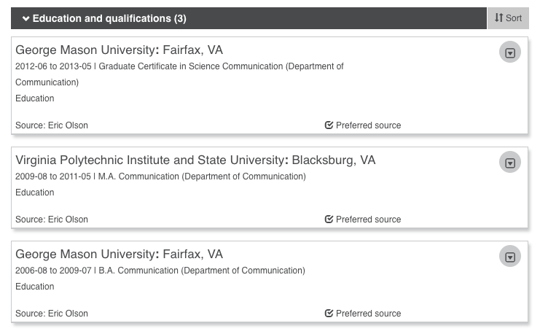

Slide 4
Names are messy!

Slide 5
PIDS FOR PEOPLE, PLACES, & THINGS
Coming soon…
Onyar!

Slide 6
WHAT IS ORCID?
An identifier for researchers
A registry
A set of standard procedures (APIs) for connecting researchers to their affiliations and activities
A committed community building connectors
An international-scale open research effort
Notes:
ORCID is many things
We are an identifier for researchers. This 16-character identifier can be used by researchers and scholars with their name to uniquely identify them. It is free and easy to get, and stays with the person throughout his or her career. Throughout this presentation we will refer to the identifier as the ORCID iD, which is our preference, though occasionally you may hear people talk about the identifier as the “ORCID”
ORCID is a registry. We provide an online registry for researchers to obtain an ORCID iD. The registry also stores an ORCID record which includes references to activities associated with the individual’s ORCID iD, such as a grant award, a publication, a data set or a research institution affiliation. The use of the registry is also free to individuals, and there they are able to control the visibility and access to the information associated to their iD.
ORCID is a set of standard procedures, or APIs) for connecting researchers to their affiliations and activities. I mentioned the ORCID record that is contained in the registry with the iD. This record is generally populated by ORCID members using these standard procedures or APIs. This approach enables automated, machine-to-machine additions and updates of important research activity and affiliation information.
ORCID is a committed community that is building connectors. The machine-to-machine additions and updates are made possible through “connectors” that are built by member organizations and the system vendors that they use. With explicit consent from the individual researchers and scholars, the ORCID community is building a connected web of trusted information that can be reliably exchanged.
ORCID is an international-scale open research effort. We accomplish all of these things through collaboration among the international research community of individuals and organizations. Researchers enable this information flow, allowing for global exchange of information regardless of where they are and who they collaborate with.

Slide 7
‹#›
Notes:
In general, ORCID’s vision is a world where all who participate in research, scholarship and innovation and uniquely identified and connected to their contributions and affiliations across time, disciplines, and borders.

Slide 8
These connections matter because research progress, programs, and careers are based on the communication of ideas.
The connections are made possible by a network of partners working together with the purpose of improving how we share research information.

Slide 9
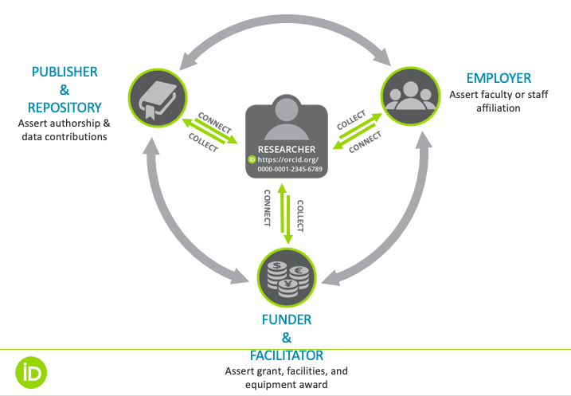
Cross-sector Partner Network

Slide 10
WHY PERSISTENT IDs?
Challenges for the individual:
Multiple profile systems
Manual data entry
Administrative burden
No control of personal data
Name ambiguity
Recognition/credit
Many output formats
Challenges for the organisations:
Name ambiguity
Trust in metadata
Reporting latency
Silo systems
Return on investment
Discoverability

Slide 11
OUR GLOBAL COMMUNITY
5.6m researchers have registered for an iD. 2.3m have connected their iD with other information: 35m works, ~600K grants, ~600K reviews, ~2.9m education and 2.0m employment items
933+ member organizations in 47 countries have built ORCID into more than 500 system integrations across all sectors of the research community
18 national ORCID consortia in the UK, Finland, Sweden, Norway, Denmark, Netherlands, Belgium, Germany, Italy, South Africa, Taiwan, Australia, New Zealand, Brazil, Canada, and US
https://orcid.org/statistics

Slide 12
ORCID US Community
Notes:
Sheila

Slide 13
ORCID Benefits for Research Institutions
Mitigate confusion caused by name ambiguity
Assess & track individual contributions & measure institutional impact
Assert trustworthy & accurate affiliations
Save time & reduce administrative burden

Slide 14
ORCID US Community

Slide 15
ORCID US Membership Benefits
Discounted membership fee for joining as part of a large group ($4,300/ calendar year)
Dedicated Technical & Community Support
5 API credentials for ORCID integration with 5 systems
Monthly Member Newsletter
Monthly statistics report

Slide 16
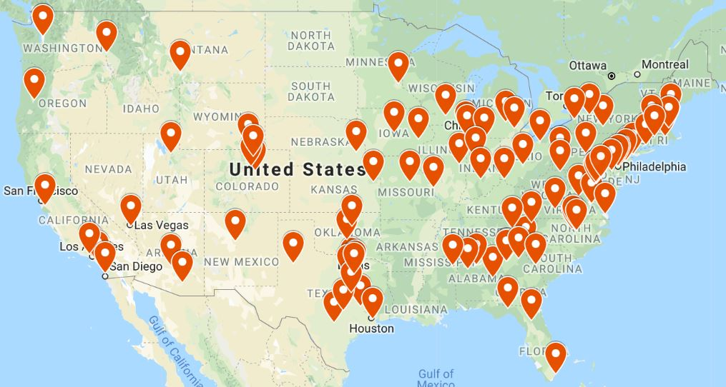
ORCID US Community Map
107+ institutional members
~300,000 ORCID iDs (public data, as of Oct. 1, 2018)

Slide 17
ORCID US Community Goals
Build a community of practice around ORCID in the US
Enable institutions to work together, share best practices, advice, etc. for ORCID adoption
Ease the pathway to ORCID adoption
Ensure that member institutions know how to get the most value from ORCID membership

Slide 18
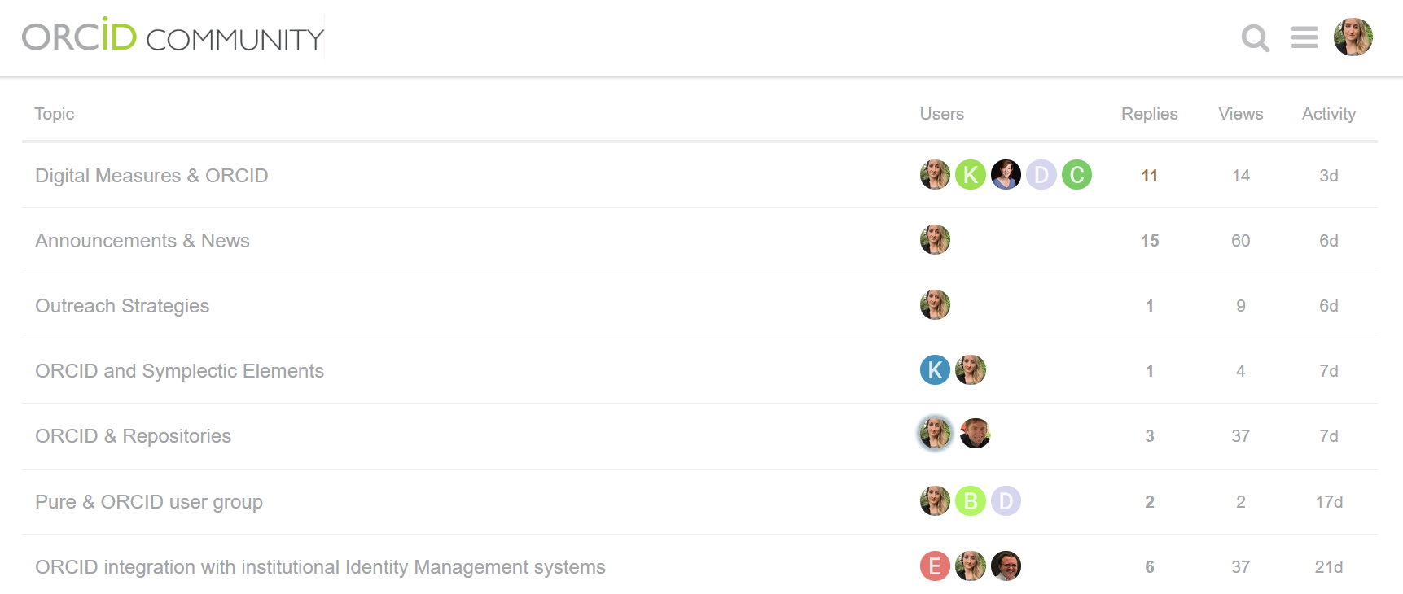
ORCID US Community Discussion Forum
Members-Only Discussion Forum: Utilize the collective wisdom of the community

Slide 19
ORCID US Community Website
ORCID US website: http://orcid-us.org

Slide 20
ORCID US Community Exemplars
https://www.lyrasis.org/Leadership/Pages/ORCID-US-Exemplars.aspx

Slide 21
ORCID US Community Resources
https://www.lyrasis.org/Leadership/Documents/ORCID-US-Planning-Guide.pdf

Slide 22
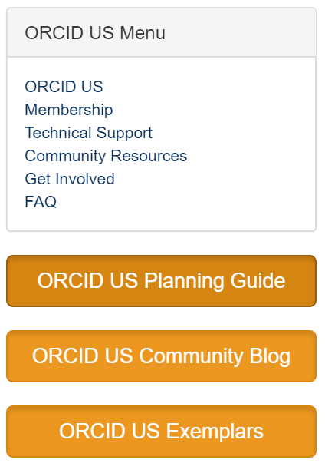
ORCID US Community Resources
Communication Channels:
Website https://orcid-us.org
Listserv (open to all) http://lyralists.lyrasis.org/mailman/listinfo/orcid-us
Twitter @USconsortium
Email: orcidus@lyrasis.org

Slide 23
Virginia ORCID Member Institutions
Virginia Commonwealth University
1761 ORCID iD holders (vcu.edu)
ORCID member as of June 2017
Virginia Tech
4041 ORCID iD holders (vt.edu)
ORCID member as of December 2014
University of Virginia
3172 ORCID iD holders (virginia.edu)
ORCID member as of May 2014
Notes:
Old Dominion is also a member but not featured in this webinar...

Slide 24
Virginia Commonwealth University
Notes:
Erin

Slide 25
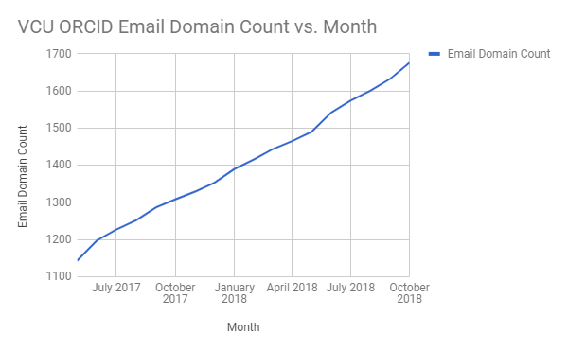
VCU ORCID History and Adoption
Membership June 2017
1,761 VCU ORCIDs with VCU email domain
Notes:
Email domain .vcu.edu or vcuhealth.org as email HOT Tip

Slide 26
VCU ORCID Integration Map
ORCID U.S. Showcase 9/12/2018
Permission ask (read vs write)
Attracted to Cornell approach eduPersonOrcid
Initial interest and dialog with central IT
Baist Atlas of Richmond, VA (1889)

Slide 27
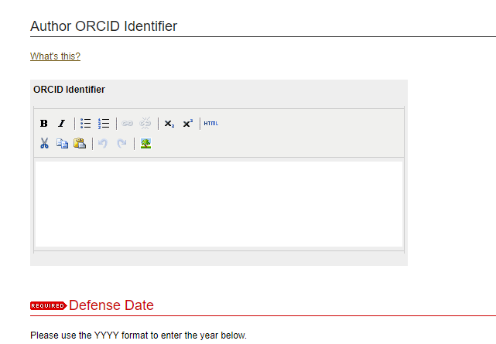
VCU ORCID and ETDs
ETD submission ORCID field October 2016
FY17: 18% FY18: 23%
799 total ETD students entering ORCID
Monitoring/Advocating for better integrations
Notes:
FY18 26% PhD Dissertations

Slide 28
VCU overview (Nina)
Key stakeholders, mostly in research tracking:
Graduate school
Office of Research and Innovation
Wright Center for Translational Research (our CTSA center)
Program coordinators of graduate programs in the departments
PIs assessing training and educational grants
“If they use ORCIDs you can track their futures”

Slide 29
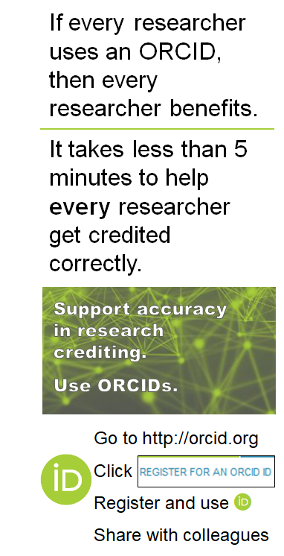
Beyond sign-up programs
We also need researchers to care enough to remember their (one) ORCID and continue to use it. We needed messaging of interest to all researchers. Our end-user message:
If you might ever need an ORCID, you should get one as early as possible
If you won’t ever need an ORCID, get one anyway to support diverse colleagues and accurate systems

Slide 30
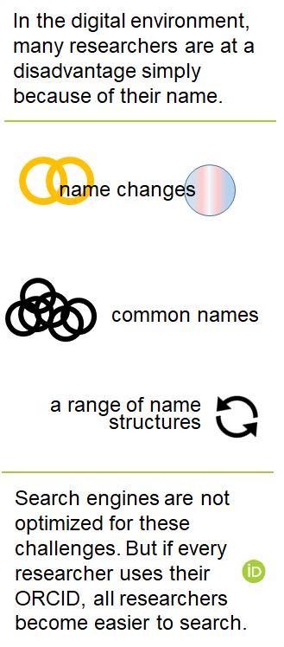
“Names are hard for computers!”
Married names, not just for women
Broadening name order examples
Black Elk, Toshiro Mifune
Still “Bob Smith” for common name
Trans flag! More on that in a moment...
Emphasis is that that computer search will be improved whether or not you personally need disambiguation.

Slide 31
Gender-inclusive workgroup (Erin)
Internal workgroup studied how the library can support trans/nonbinary people
Systems, services, spaces, staff
Importance of names/names are hard
One recommendation: advertise ORCID as a gender-inclusive identifier for research
Sent to researchers who request to use a different first name in library account
Included in brochure and web

Slide 32
Gender-inclusive workgroup (Erin)
https://ts.vcu.edu/askit/policies-and-publications/gender-name-notification/

Slide 33
Virginia Tech
Notes:
Philip

Slide 34
Virginia Tech ORCID History and Adoption
Member since 2014
4,041 ORCID iDs with VT email domain
1 integration: Symplectic Elements
1,049 ORCID iDs connected
Hope to integrate with:
Repository (VTechWorks - DSpace)
Data Repository (VTechData - Fedora)
ETD submission system

Slide 35
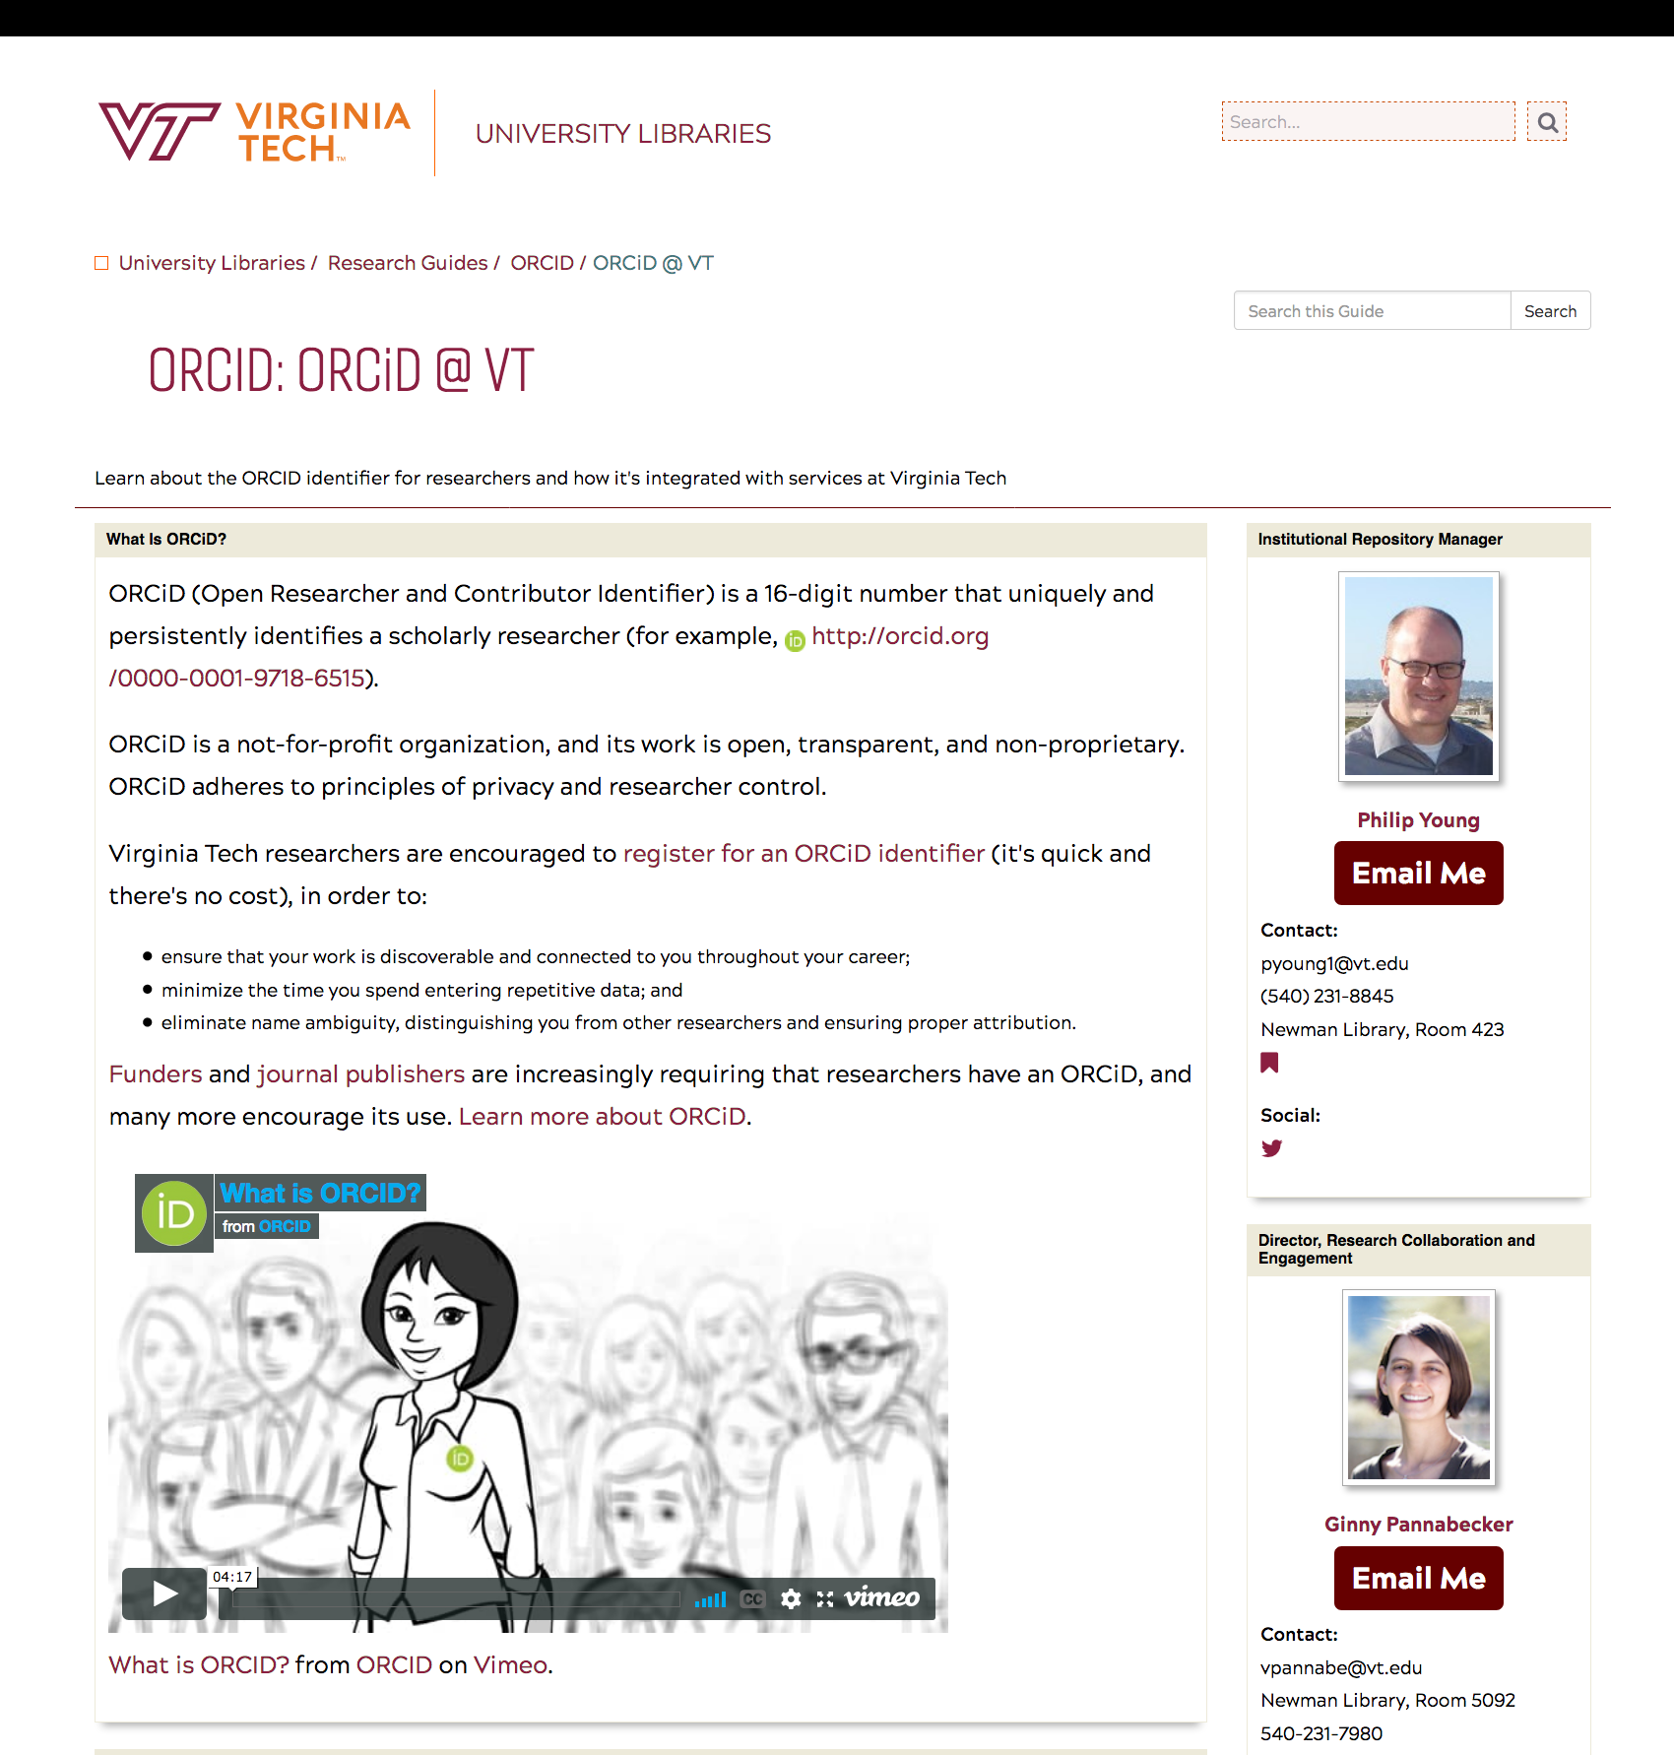
Virginia Tech ORCID History and Adoption
guides.lib.vt.edu/orcid
Nov. 2016
20 views/month

Slide 36
Virginia Tech ORCID and Elements

Slide 37
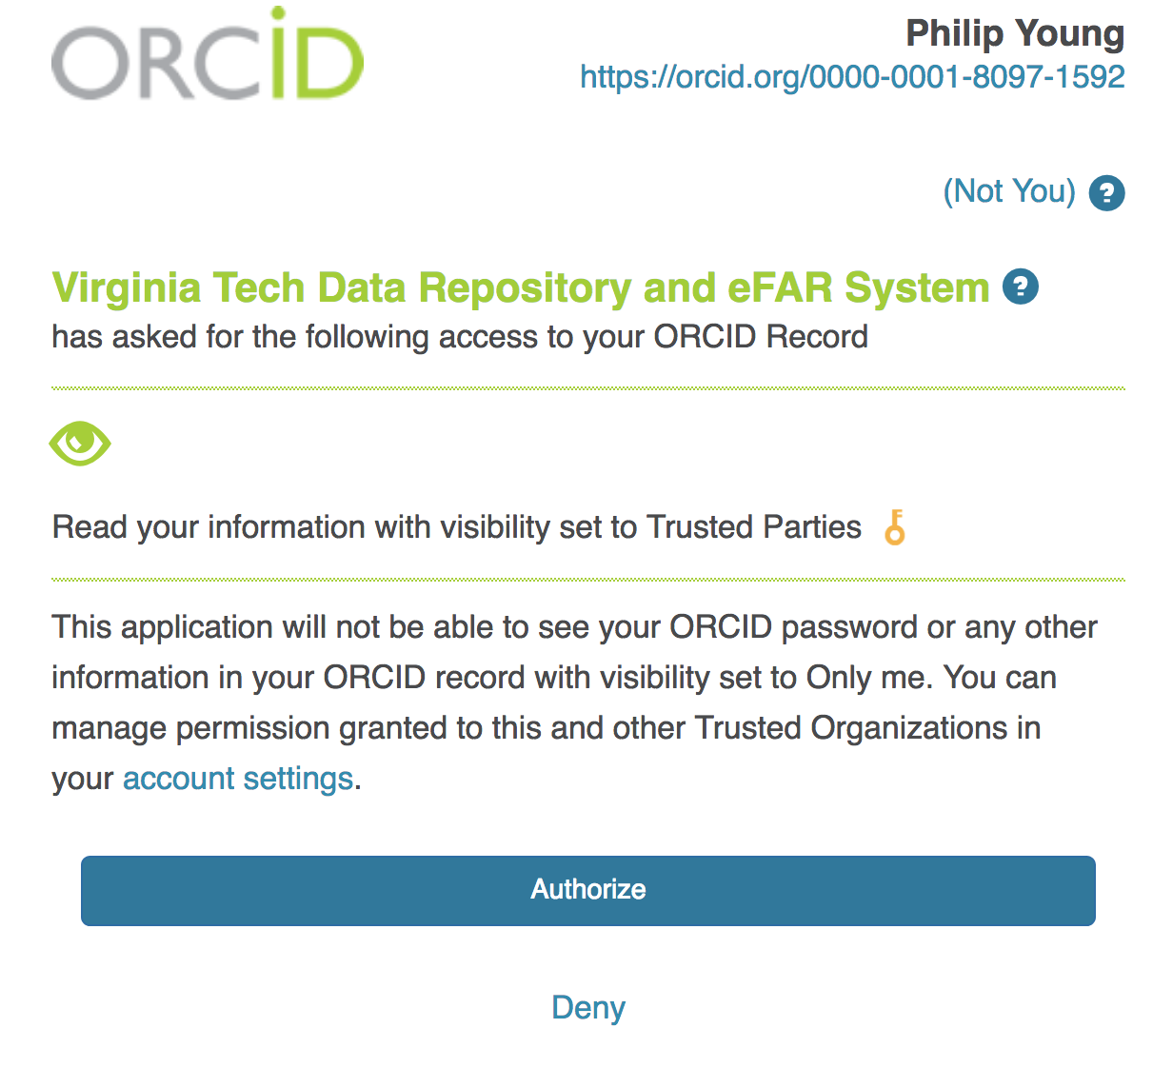
Virginia Tech ORCID and Elements
Menu > Publications > Automatic claiming

Slide 38
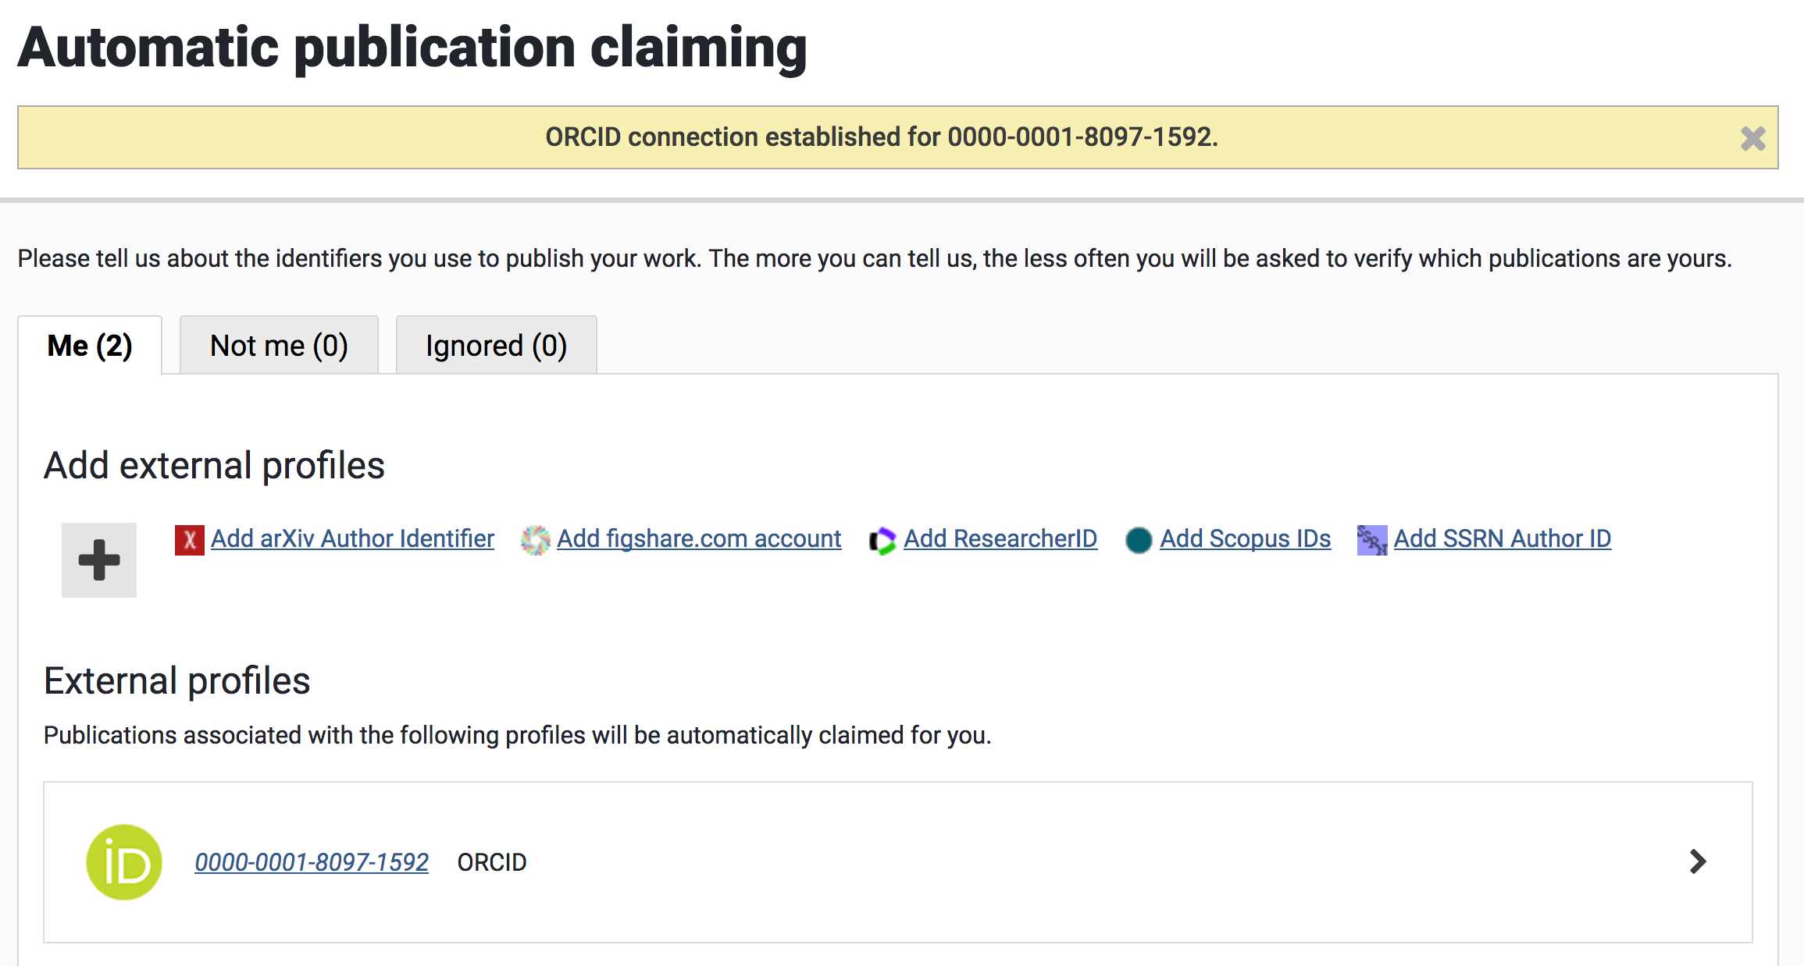
Virginia Tech ORCID and Elements

Slide 39
Virginia Tech ORCID and Elements
Repository deposits (1600+ since late 2016)
ORCID included only if author connected (500+)
Same for co-authors (VT only)
Currently not linked or in item display

Slide 40
University of Virginia
Notes:
Sherry

Slide 41
University of Virginia ORCID History and Adoption
Member since May 2014
3,711 ORCIDs with @virginia.edu email domain
2 integrations: Libra Repository Services
LibraOpen - Samvera
LibraETD - Samvera
Hope to integrate with:
Data Repository (LibraData - Dataverse)
Discovery Layer (Virgo - Blacklight)
Faculty Annual Reporting (local UVA system)

Slide 42
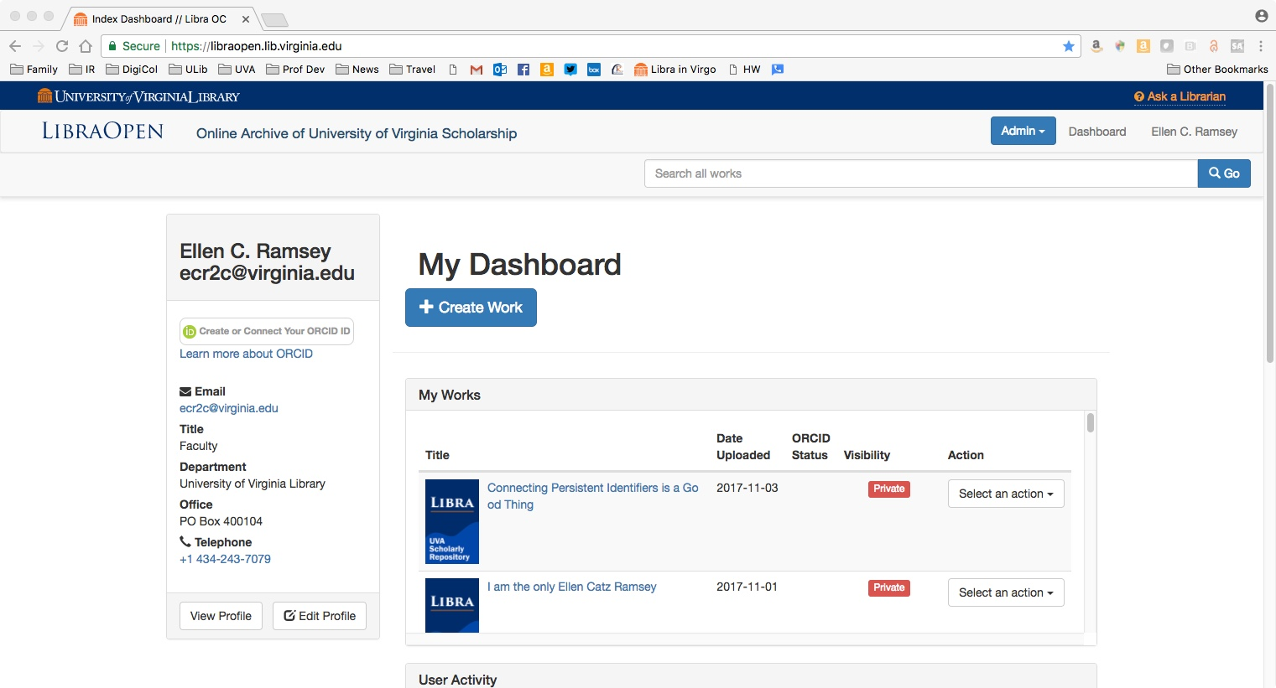

Slide 43
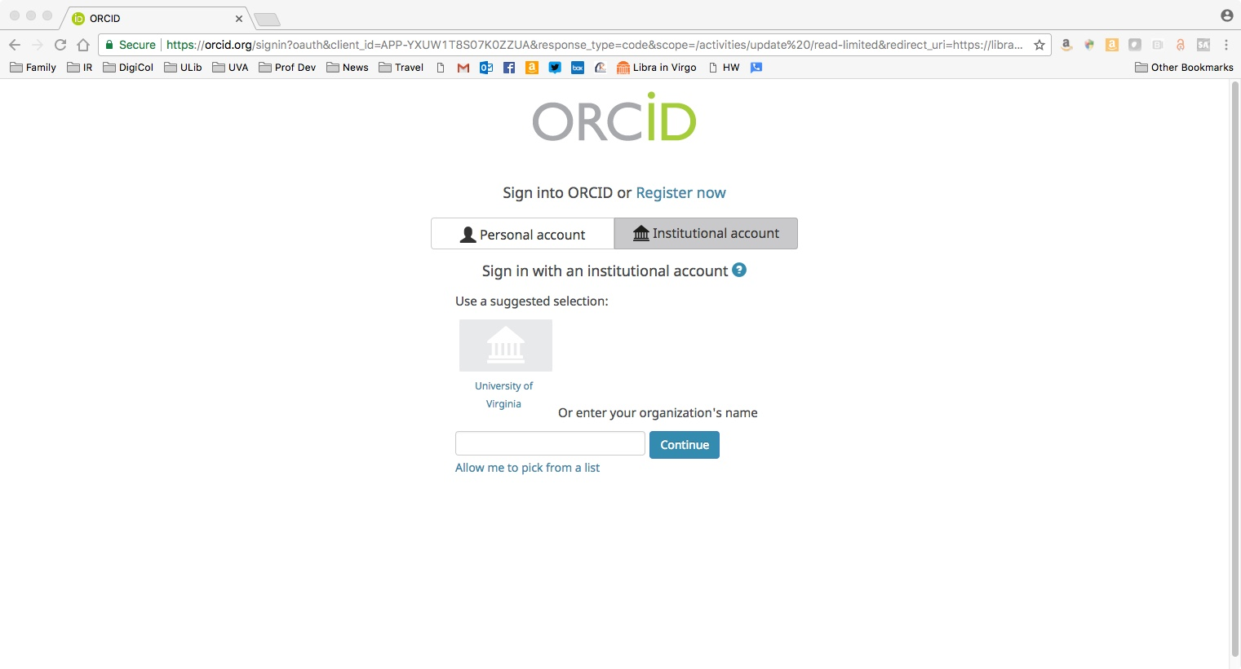

Slide 44
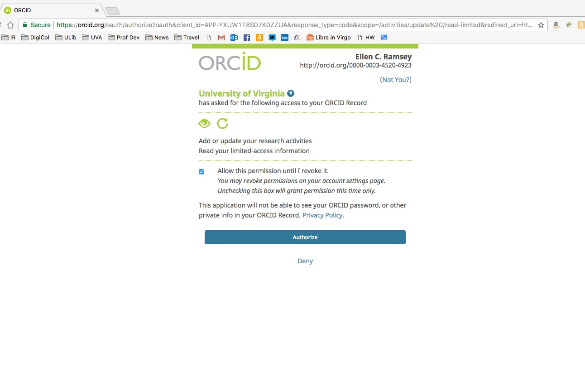

Slide 45
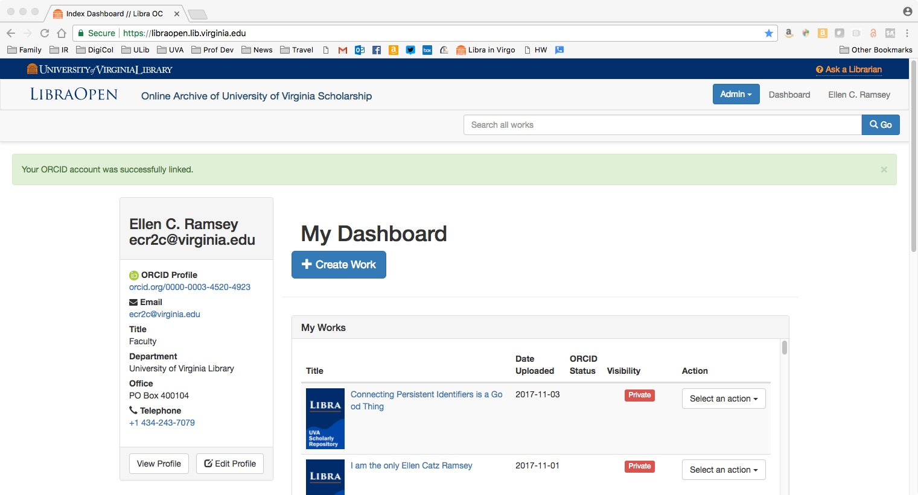

Slide 46
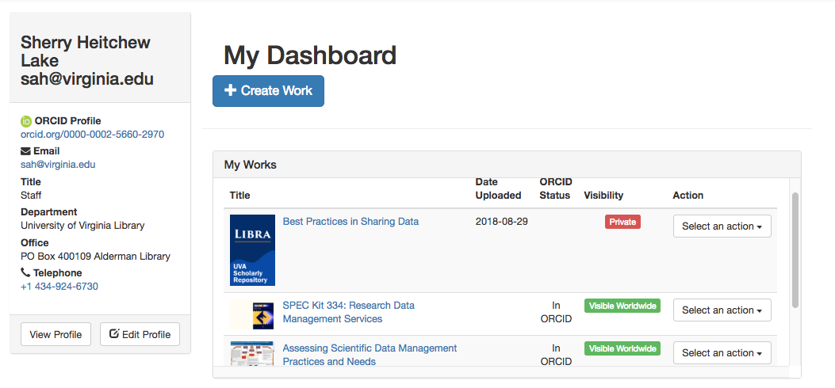

Slide 47
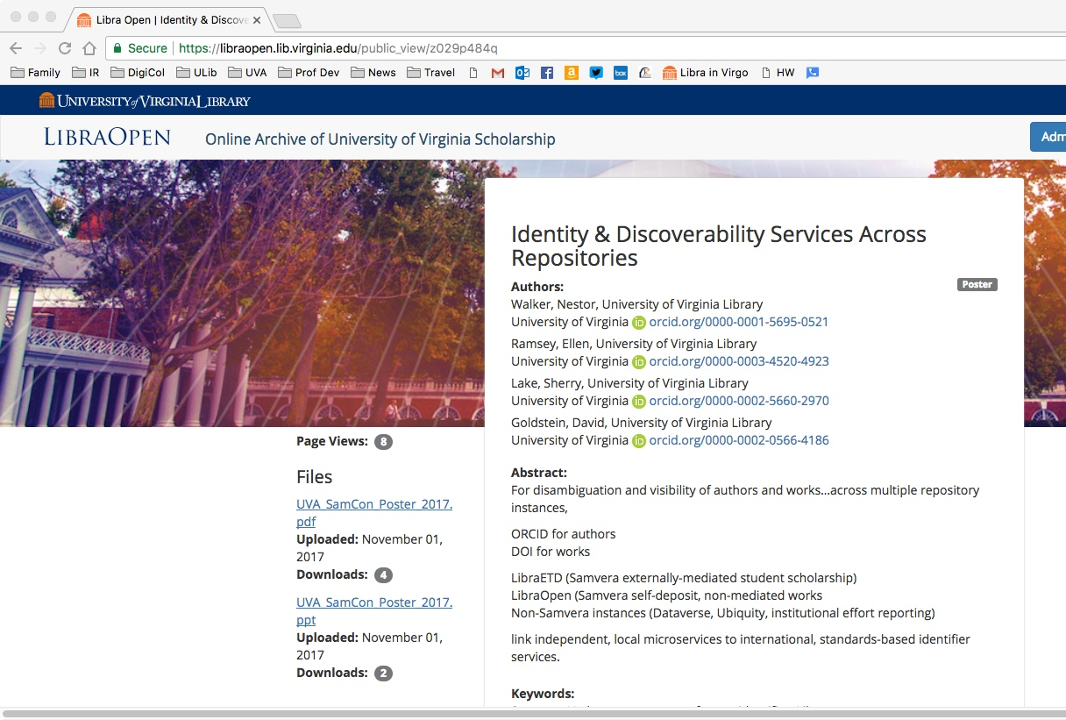

Slide 48
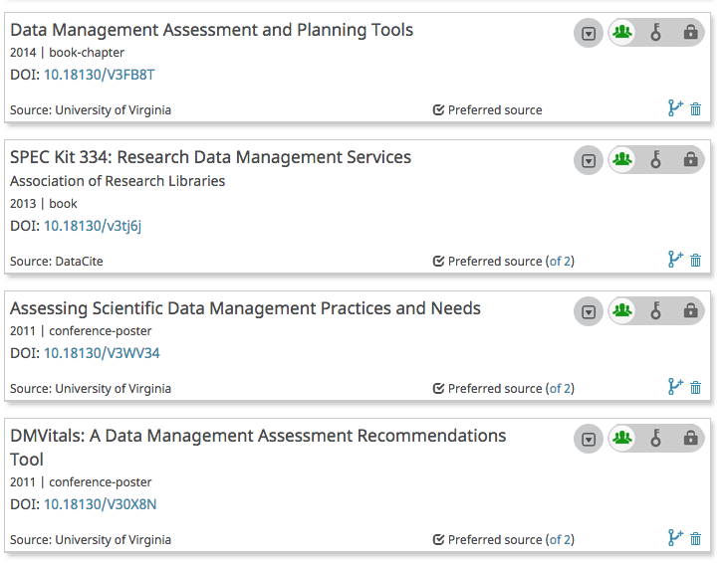

Slide 49
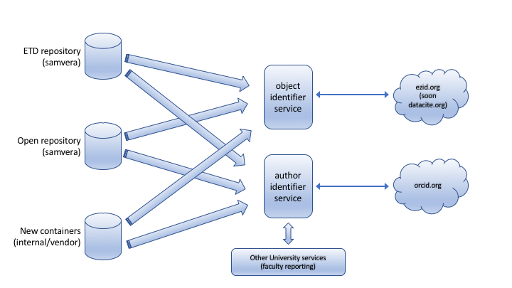
Identity & Discoverability Services Across Repositories
link independent, local microservices
For disambiguation and visibility
of authors and works…
ORCID for authors
DOI for works
across multiple repository instances
LibraETD (Samvera externally-mediated student scholarship)
LibraOpen (Samvera self-deposit, non-mediated works
Non-Samvera instances ????
to international, standards-based identifier services

Slide 50
Questions & Discussion

