Slide 1
ORCID US Community: Outreach Strategies for Promoting ORCID

Slide 2
Learning Outcomes

Slide 3
Agenda

Slide 4
What is ORCID?

Slide 5
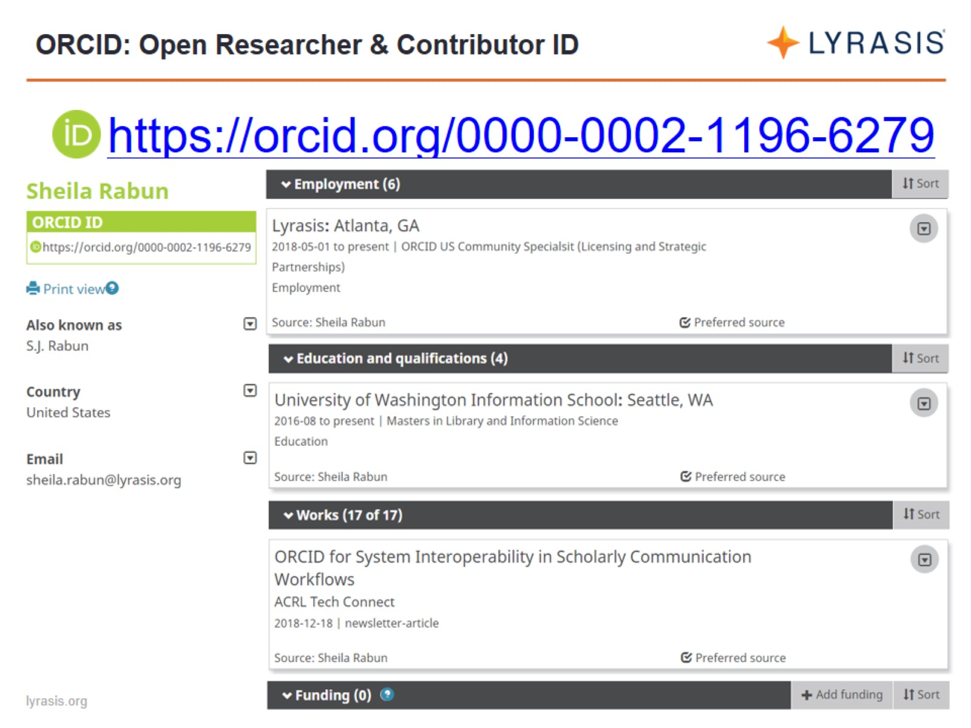
ORCID: Open Researcher & Contributor ID

Slide 6
ORCID Ecosystem: Interoperability

Slide 7
ORCID Across the Globe

Slide 8
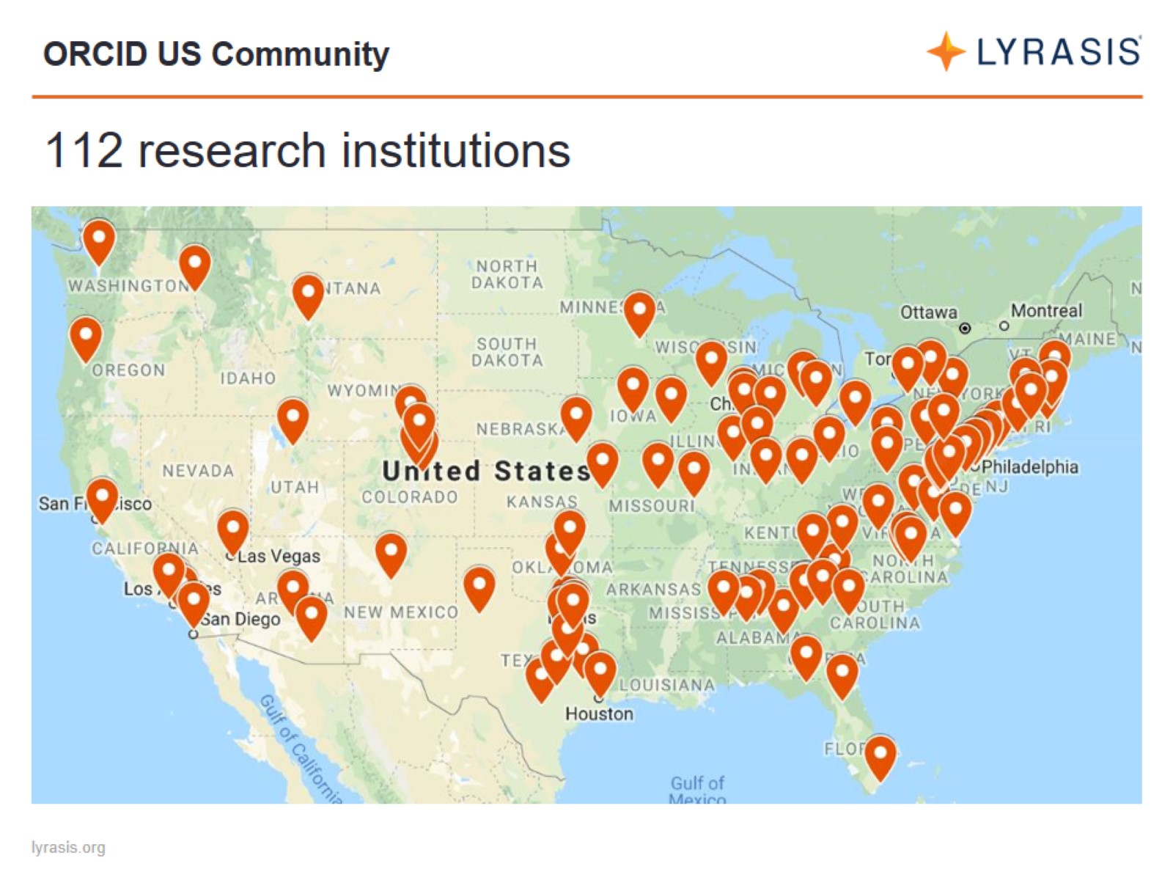
ORCID US Community

Slide 9
ORCID US Community

Slide 10
ORCID Benefits for Research Institutions

Slide 11
ORCID Ecosystem

Slide 12
ORCID for Individuals

Slide 13
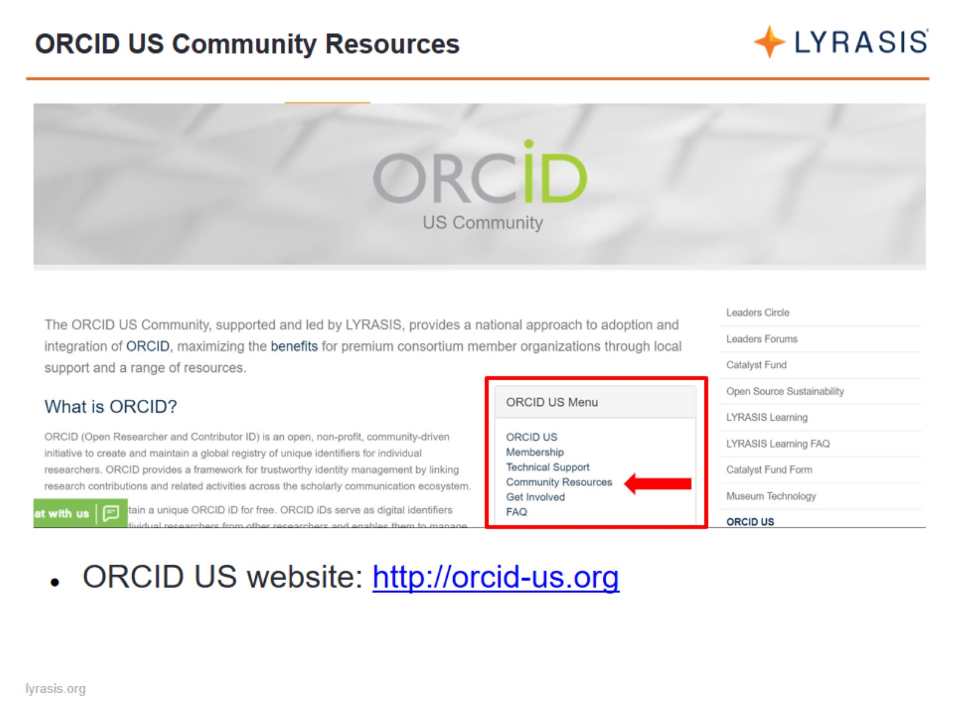
ORCID US Community Resources

Slide 14
ORCID US Community Resources

Slide 16
ORCID US Outreach Planning Guide

Slide 17
ORCID US Outreach Planning Guide

Slide 18
Key Stakeholder Support

Slide 19
Stakeholder conversations

Slide 23
Key Stakeholder Support

Slide 24
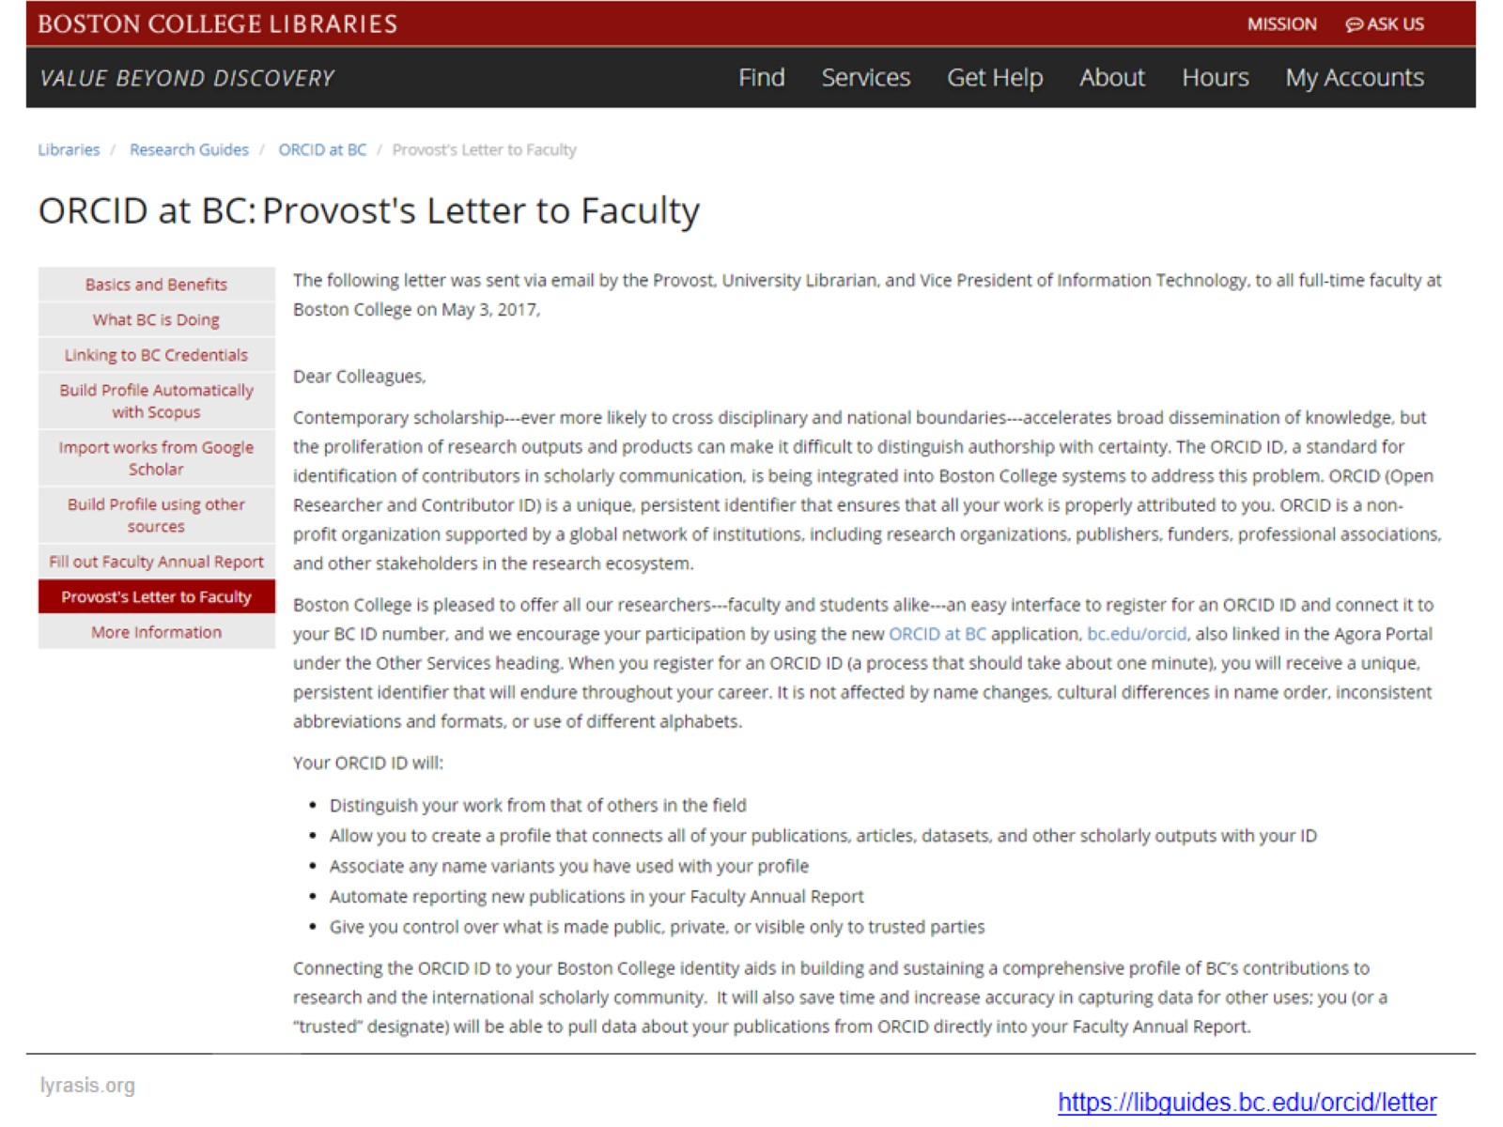

Slide 25
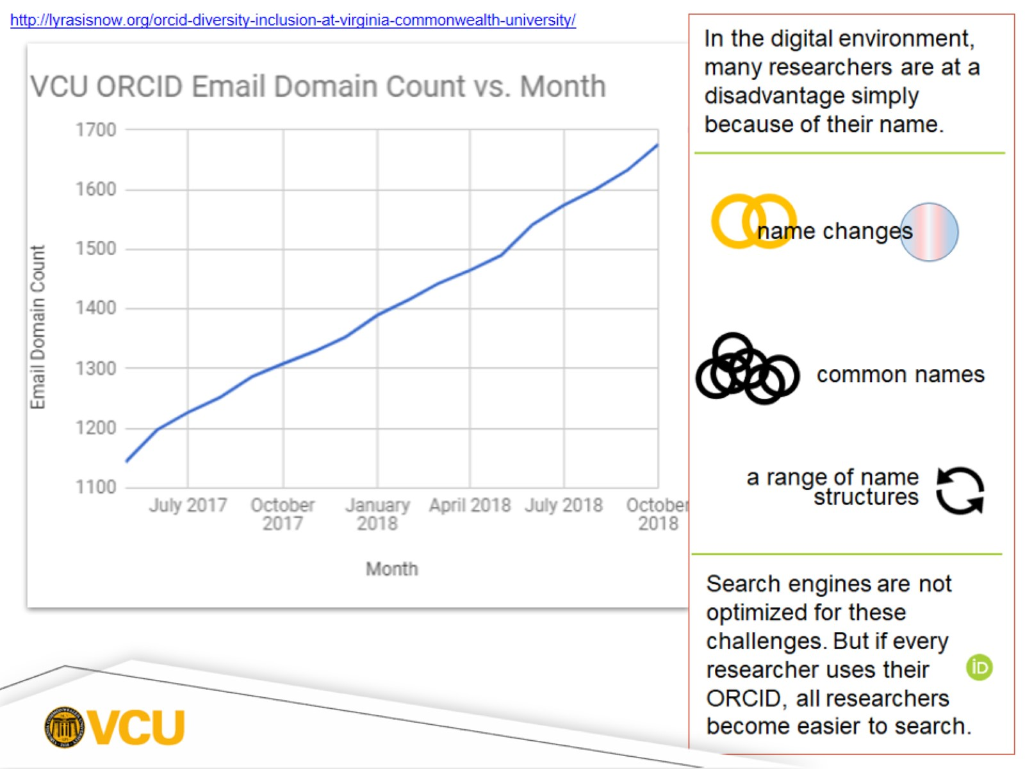

Slide 26
Outreach Leaders

Slide 27
ORCID 101

Slide 28
ORCID for Researchers flier template

Slide 29
ORCID Sandbox

Slide 30
Messaging & Custom Promo Materials

Slide 33
Benefits of ORCID for Researchers

Slide 36
Emphasize journals, funders, and societies

Slide 37
Outreach and Education Strategies

Slide 38
Consult ORCID’s Outreach Resources

Slide 39
Build Anticipation: What is ORCID?

Slide 40
Draw Attention to ORCID

Slide 41
Draw Attention to ORCID

Slide 42
Start with a Pilot Group

Slide 43
University of Iowa

Slide 44
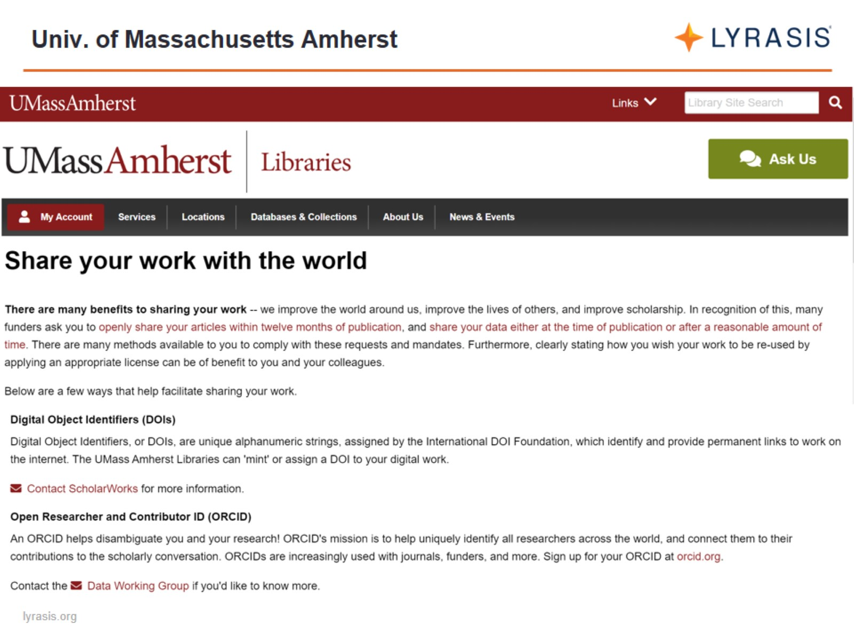
Univ. of Massachusetts Amherst

Slide 45
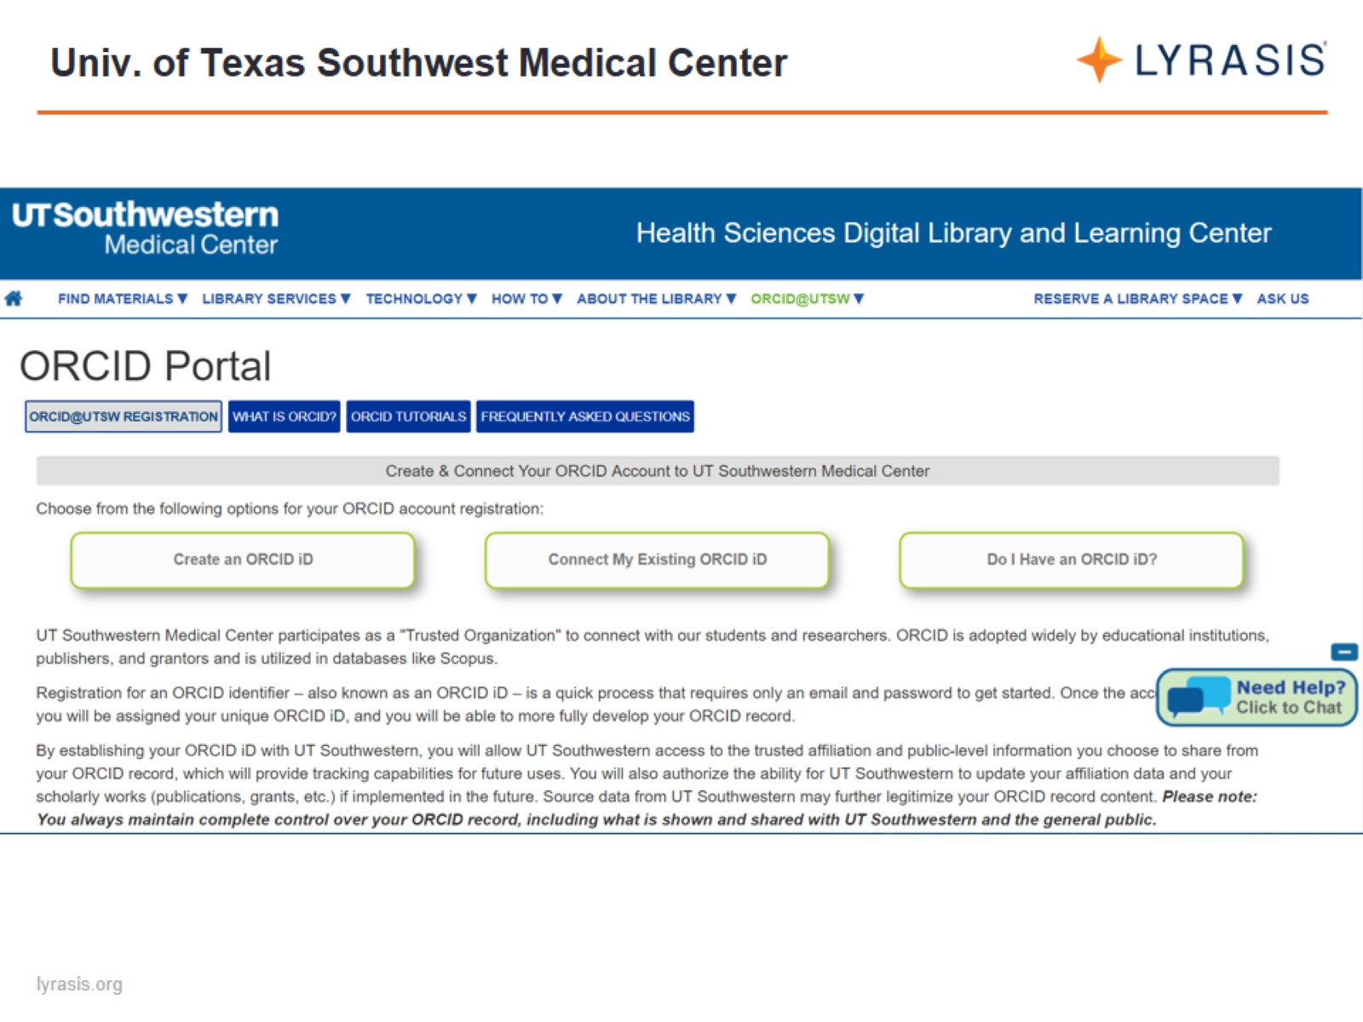
Univ. of Texas Southwest Medical Center

Slide 46
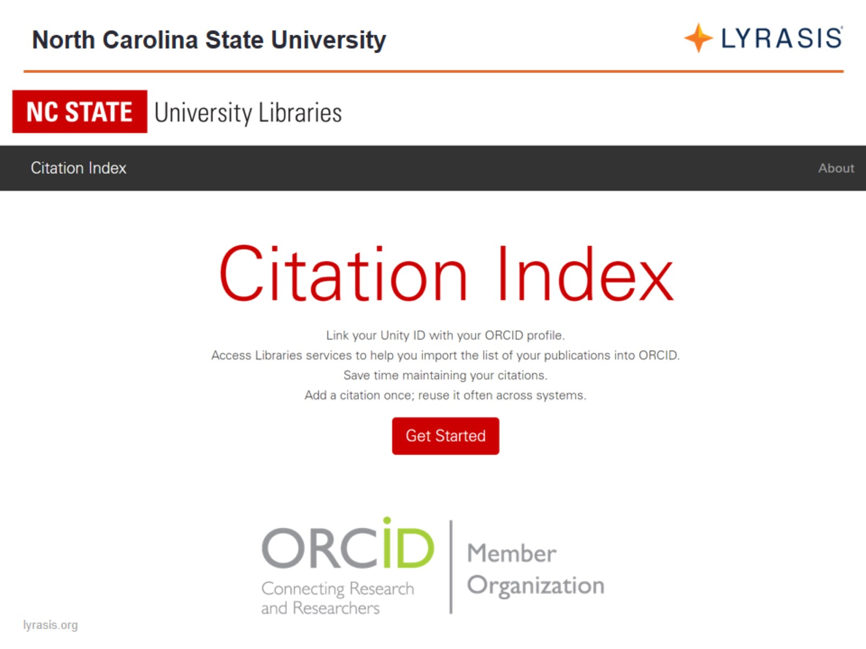
North Carolina State University

Slide 47
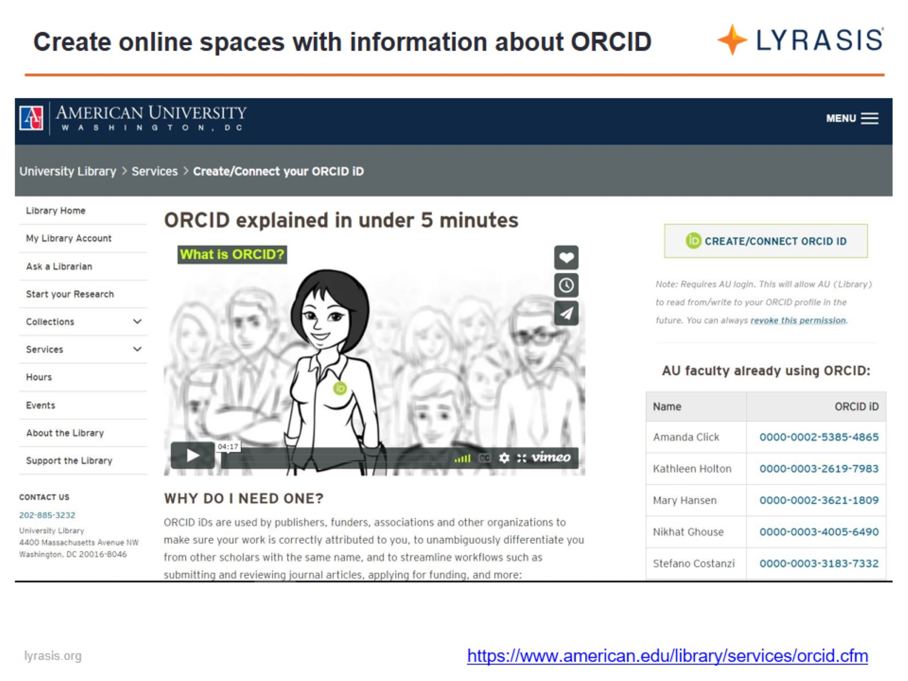
Create online spaces with information about ORCID

Slide 48
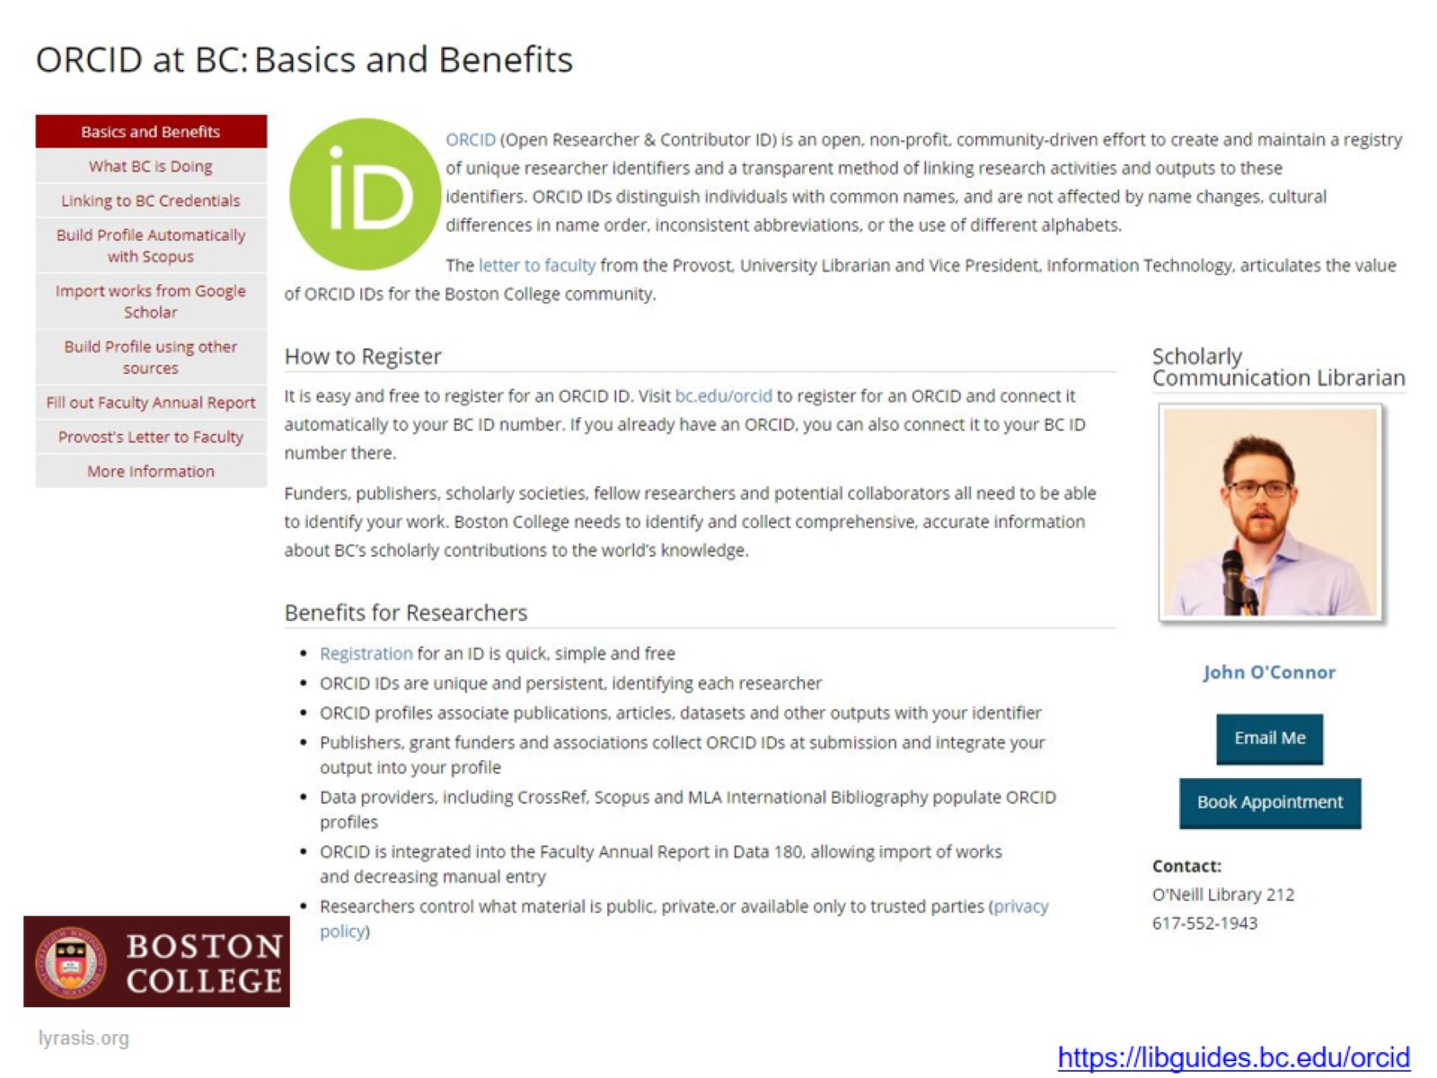

Slide 51
Include ORCID in larger training topics and events

Slide 52
Research Impact Challenge

Slide 53
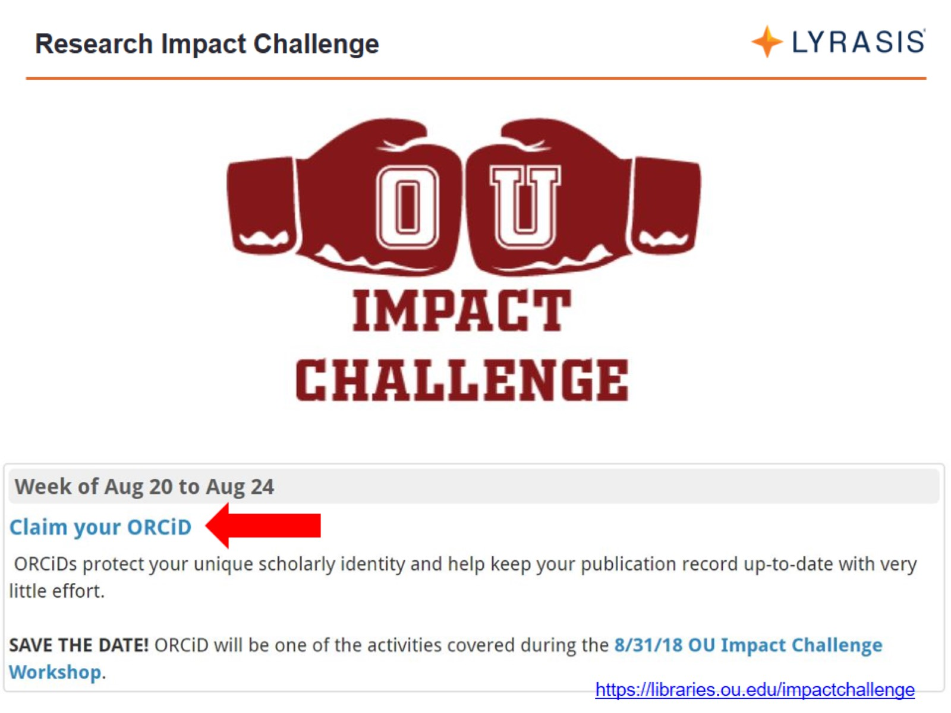
Research Impact Challenge

Slide 54
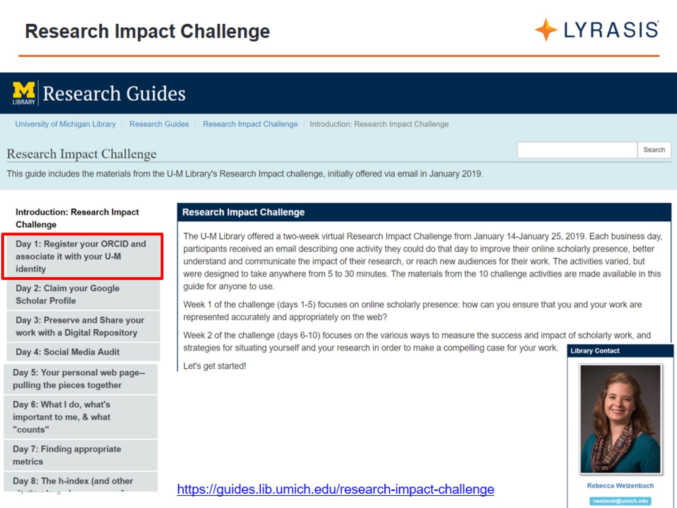
Research Impact Challenge

Slide 55
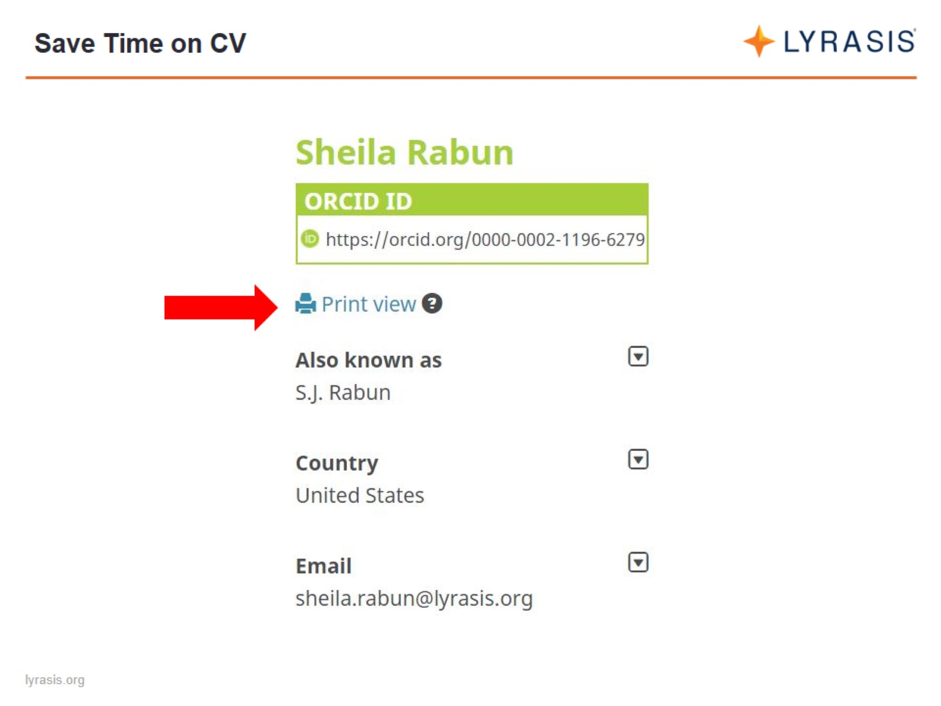
Save Time on CV

Slide 56
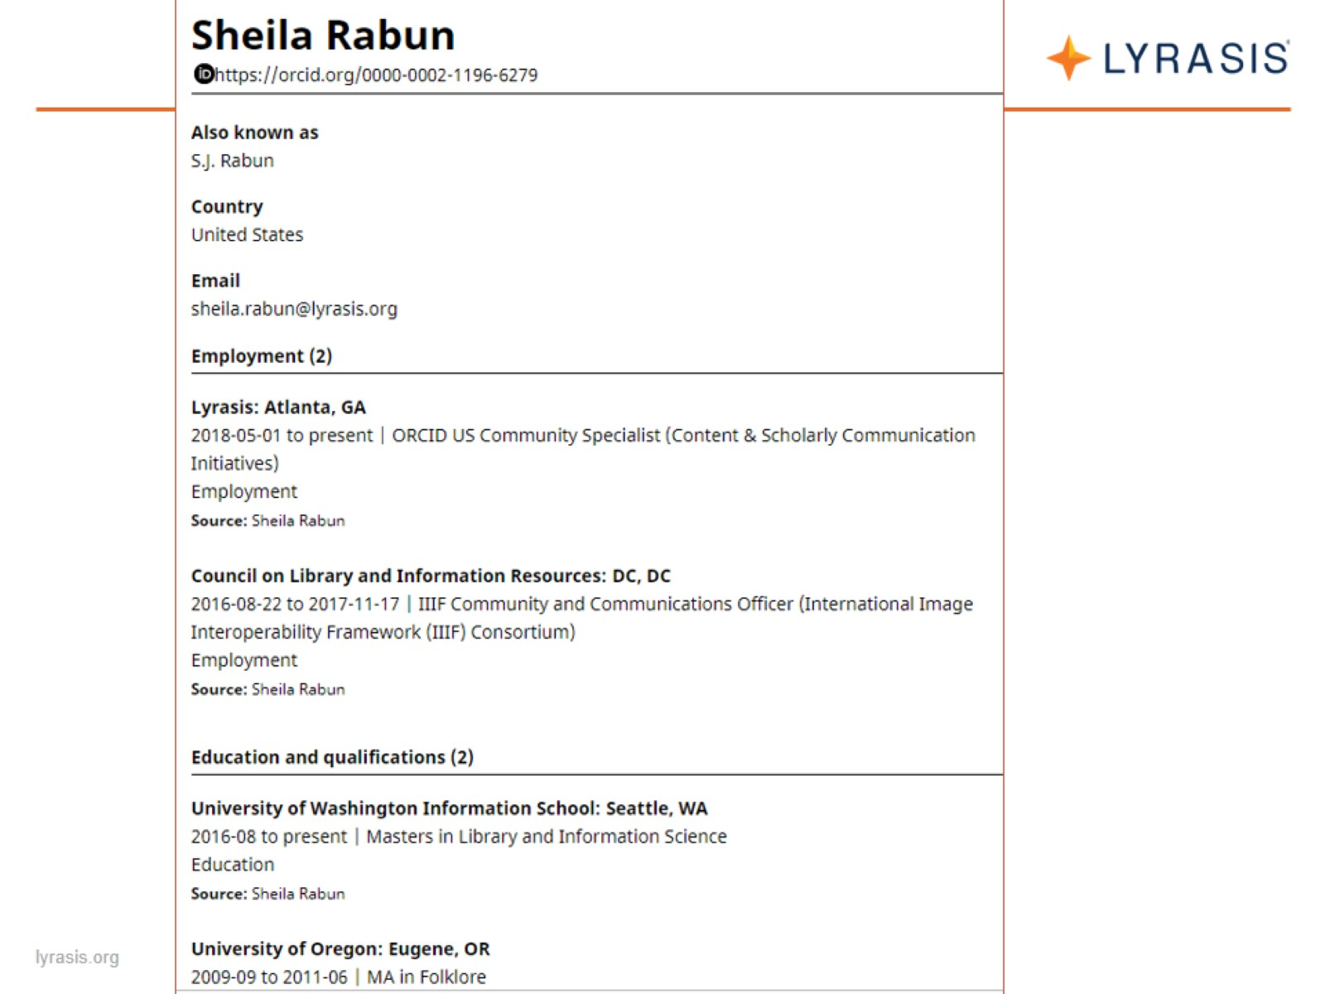

Slide 57
Open Access Week

Slide 58
Open Access Week

Slide 59
Tabling

Slide 60
Incentivise

Slide 61
3D-Printed ORCID Cookie Cutter

Slide 62
ORCID Swag

Slide 64
Share Your Experience

Slide 65
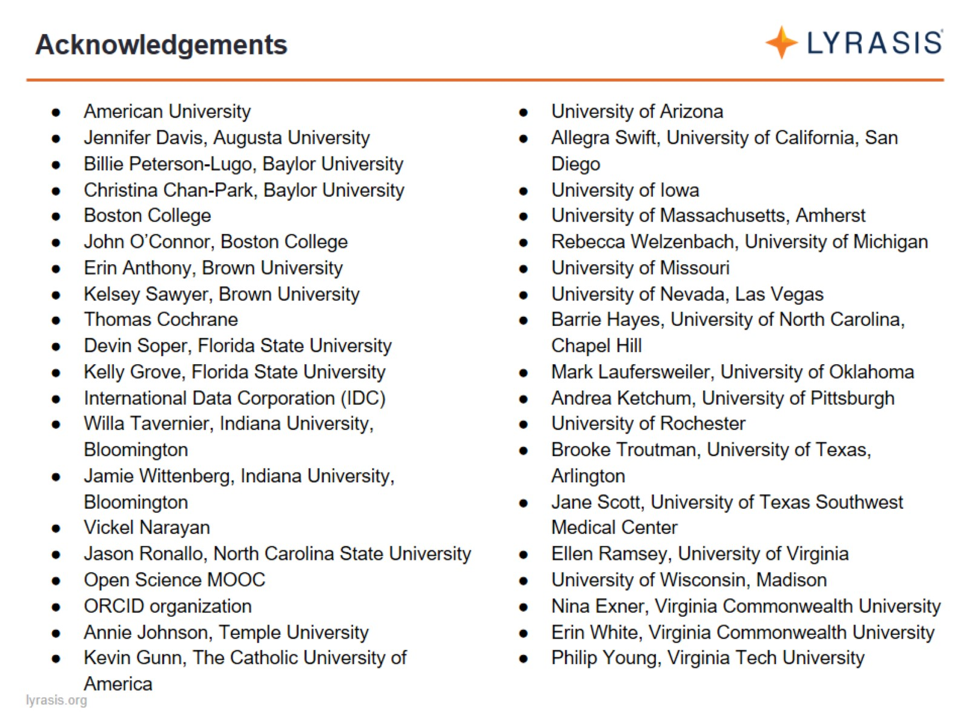
Acknowledgements

Slide 66
Thoughts? Questions?

