Slide 1
ORCID US Community Showcase #3
May 2, 2019
Presented by the ORCID US Community, supported by LYRASIS, in partnership with ORCID, University of Texas Southwestern Medical Center, and North Carolina State University
Notes:
Sheila

Slide 2
Agenda
ORCID US Community Overview
Global ORCID Overview
Highlights from US research institutions:
University of Texas Southwestern Medical Center
North Carolina State University
ORCID US Community Resources
Questions & Discussion
Notes:
Sheila

Slide 3
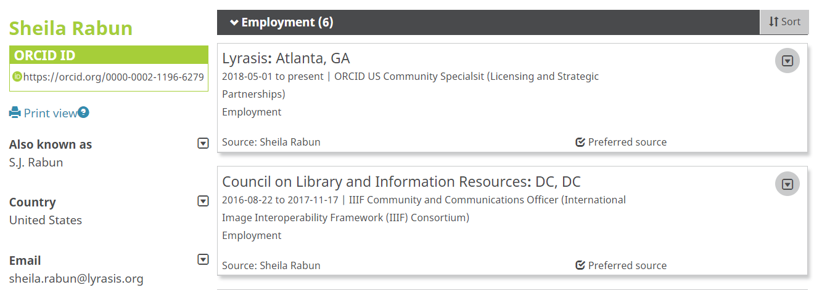
ORCID: Open Researcher & Contributor ID
https://orcid.org/0000-0002-1196-6279
Notes:
Sheila

Slide 4
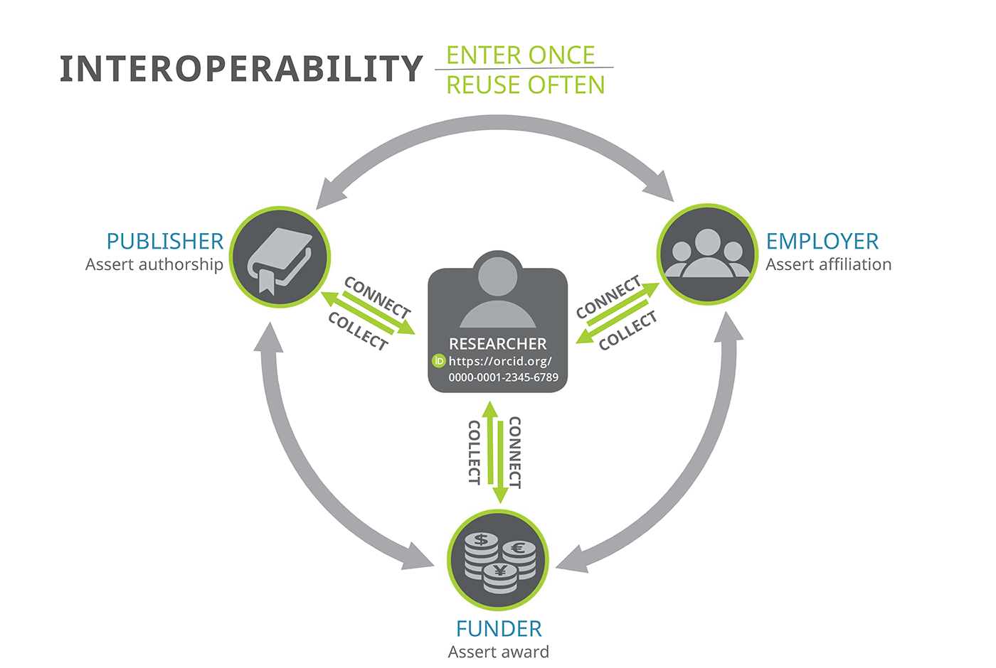
ORCID Ecosystem: Interoperability
ORCID API (Application Programming Interface)
Notes:
Sheila

Slide 5
ORCID API: Application Programming Interface
University
A
Publisher
B
University
C
Funder
E
ORCID API (Application Programming Interface)
Puzzle graphic: https://pixabay.com/en/jigsaw-puzzle-green-last-piece-313587/
Notes:
Sheila

Slide 6
ORCID Benefits for Research Institutions
Mitigate confusion caused by name ambiguity
Assess individual contributions & measure institutional impact
Assert trustworthy & accurate affiliations
Save time & reduce administrative burden
Notes:
Research institutions are interested in using ORCID because it can help to alleviate confusion caused by name ambiguity, and ORCID data can be used to help with assessment of individual contributions as well as aggregated demonstration of institutional impact. Institutions can also write data to their researchers’ ORCID records to contribute to the integrity of the metadata that circulates through the research and scholarly communication ecosystem, and ultimately ORCID is designed to save time and reduce administrative burden for both researchers and administrators.

Slide 7
ORCID Adoption
Effective ORCID adoption requires 3 equally important components:
Stakeholder Support
Technical Integration
Outreach & Education
Notes:
Because ORCID is structured like an ecosystem, ALL stakeholders need to be involved in order for everyone to get the most benefit. For research institutions, there are 3 equally important components needed to help both the institution and individual researchers benefit from ORCID: gaining internal stakeholder support to prioritize ORCID adoption, integrating the ORCID API with local systems, and doing outreach to educate researchers about ORCID so they will get and use their ORCID iDs, since researchers are central to the ORCID system

Slide 8
ORCID US Community
Formed in January 2018
National partnership for premium ORCID membership
Any non-profit research institution can join as a member
LYRASIS as lead
Notes:
This group was formed last year when LYRASIS, the Big Ten Academic Alliance, the NorthEast Research Libraries, and the Greater Western Library Alliance came together to form a national partnership to foster a community of practice and provide dedicated support for ORCID at research institutions in the US, with LYRASIS as the administrative home. Any non-profit research institution in the US can join the ORCID US Community.

Slide 9
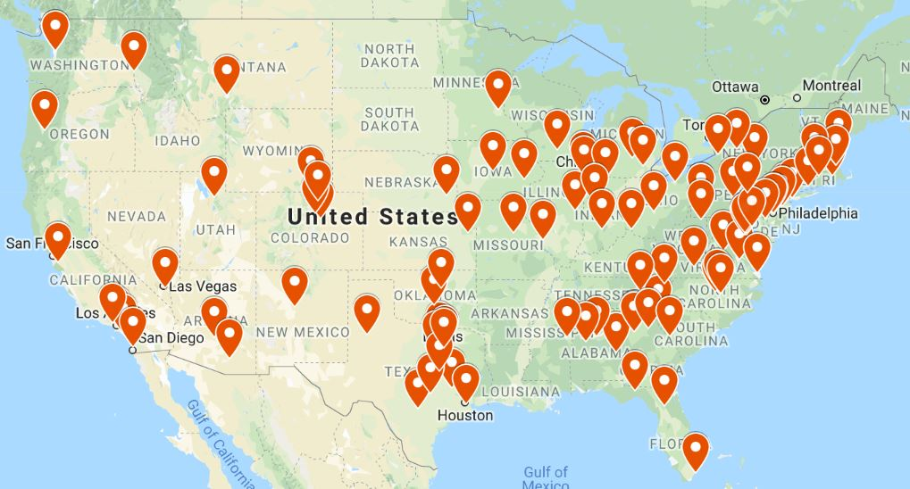
ORCID US Community
114 institutional members!
Notes:
Sheila

Slide 10
ORCID US Community
Building a community of practice around ORCID in the US
Substantially reduced fee for ORCID membership
Dedicated resources, technical & community support
Notes:
Sheila

Slide 11
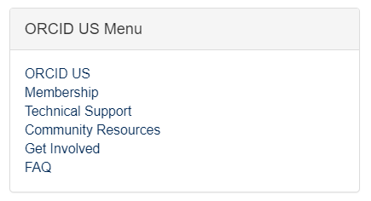
ORCID US Community Resources
Communication Channels:
Website https://orcid-us.org
Email
orcidus@lyrasis.org
Twitter
@USconsortium
Members:
Discussion Forum
Notes:
Sheila

Slide 12
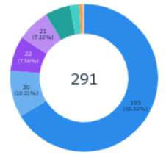
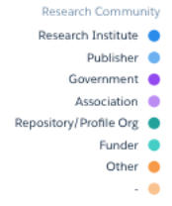
ORCID: Americas Region
THE AMERICAS REGION
291 Members
185 Integrations
31% of Total
28 C&C Badges Awarded
21% of Total
4 Consortia
193 Research Institutions
ORCID US Community Consortia is the largest
Notes:
Bernette

Slide 13
ORCID: Americas Region
THE AMERICAS REGION
CANADA
1 Consortia
39 Members
7 Integrations
US
2 Consortia
222 Members
169 Integrations
LATIN AMERICA
1 Consortia (Brazil)
30 Members (13 Brazil)
9 Integrations (4 Brazil)
Notes:
Bernette

Slide 14
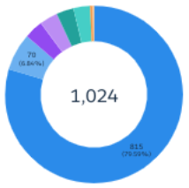
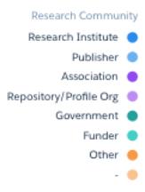
ORCID: Global Picture
ORCID BY THE NUMBERS
6+m ORCID iDs
21 Consortia
600+ Integrations
1020+ Members
Notes:
Bernette

Slide 15
ORCID @ University of Texas Southwestern Medical Center
Notes:
Kevin

Slide 31
ORCID @
North Carolina State University
Notes:
Matt

Slide 33
https://ronallo.com/presentations/orcid-us/

Slide 34
ORCID US Community Resources
Communication Channels:
Website https://orcid-us.org
Email
orcidus@lyrasis.org
Twitter
@USconsortium
Members:
Discussion Forum
Notes:
Sheila

Slide 35
Questions?
Web orcid-us.org
Email orcidus@lyrasis.org
Notes:
Sheila moderates

