Slide 1
ORCID workflows from a researcher’s perspective
Richard de Grijs
ORCID Board of Directors &
Macquarie University, Sydney, Australia

Slide 2
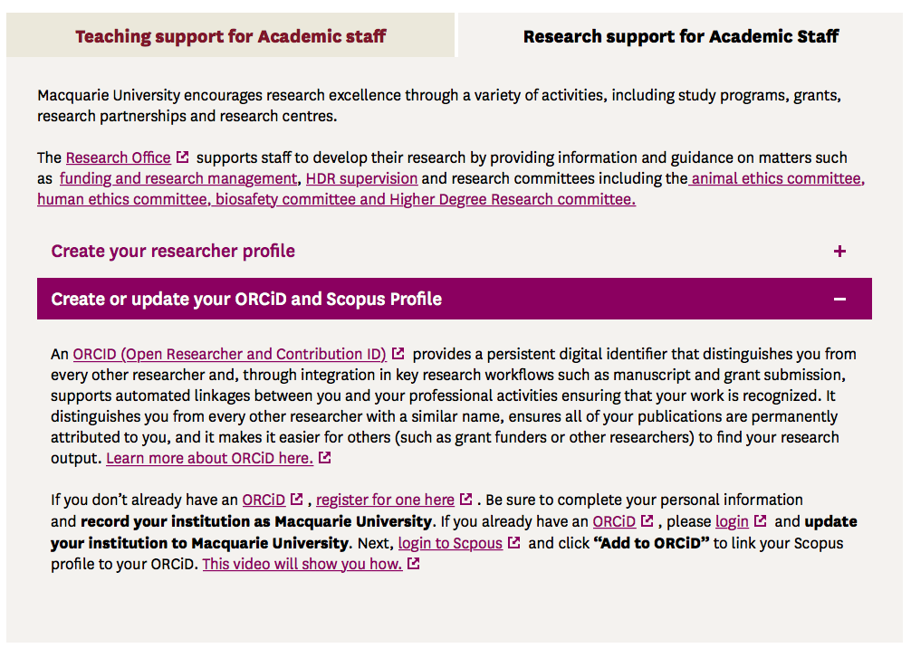
Welcome to Macquarie University!
Now link your ORCID to us…
… and don’t forget to also link us to your Scopus ID!

Slide 3
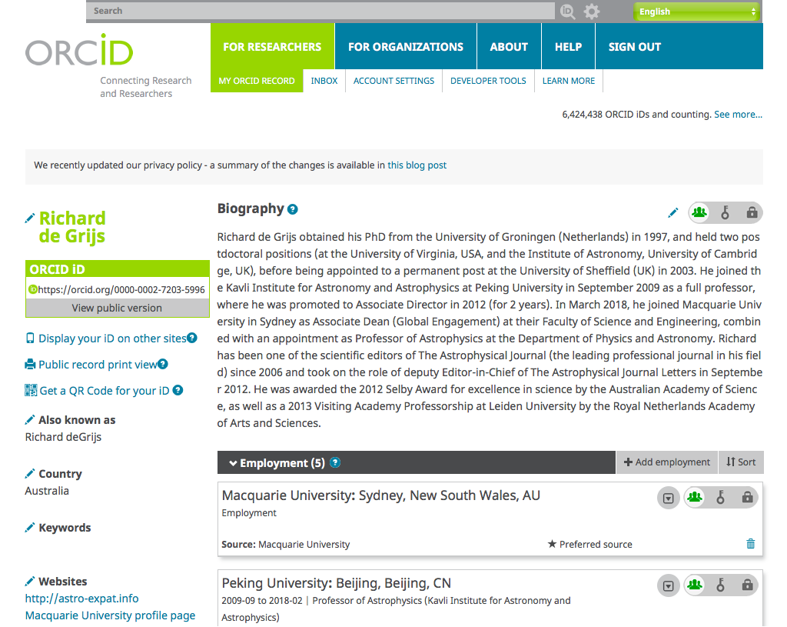

Slide 4
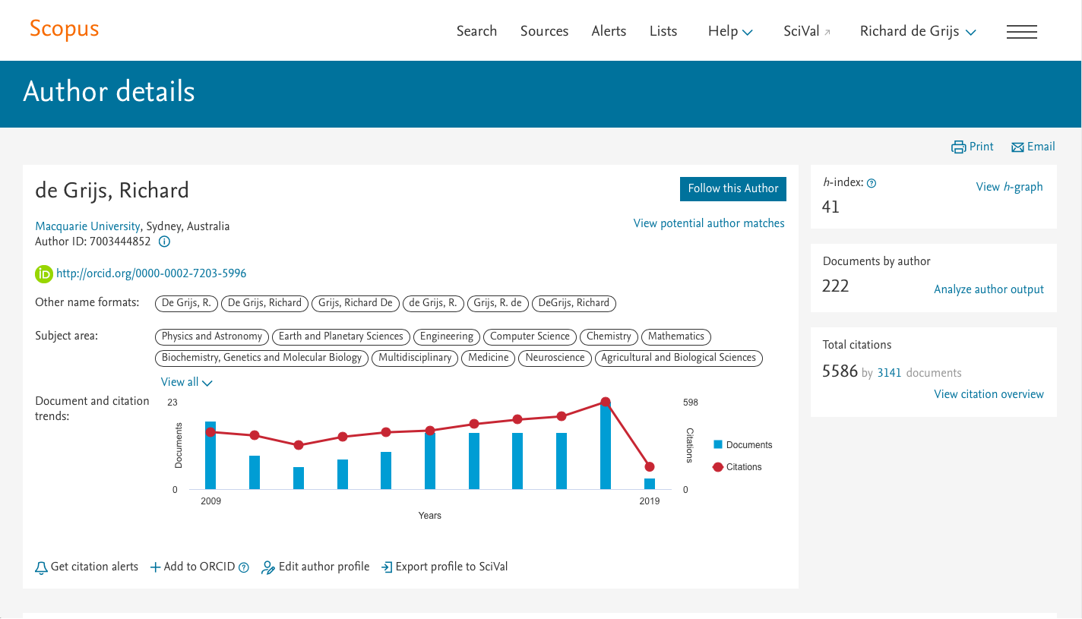

Slide 5
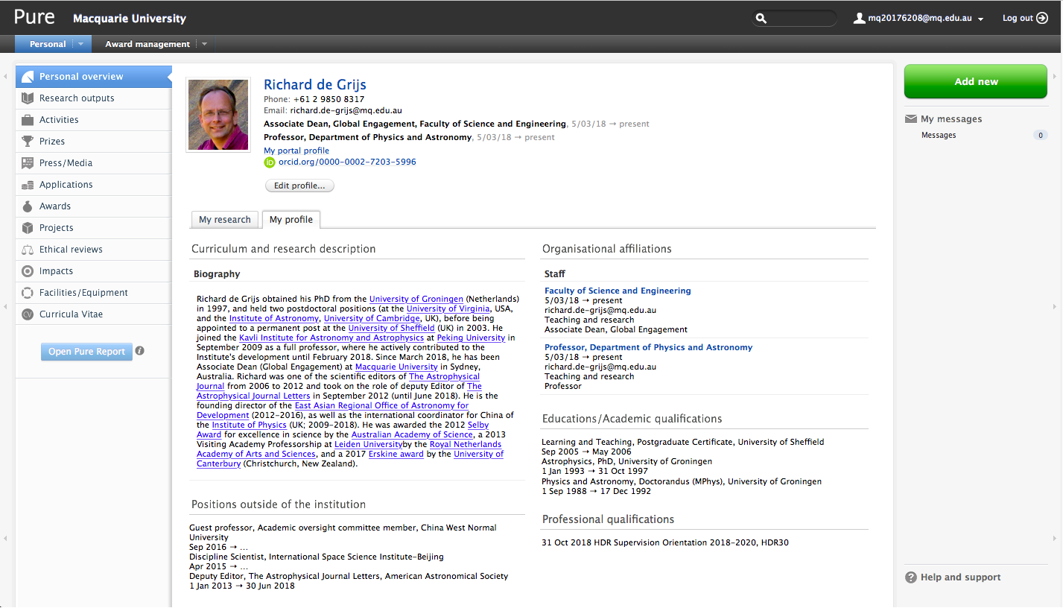

Slide 6
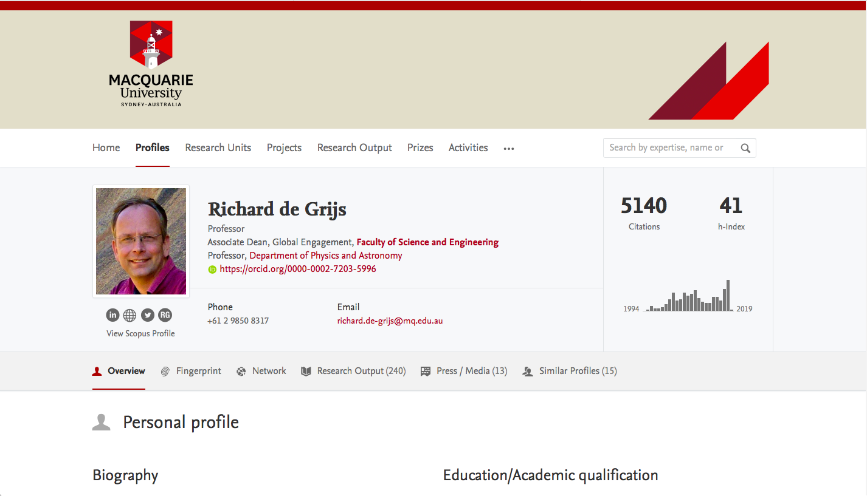

Slide 7
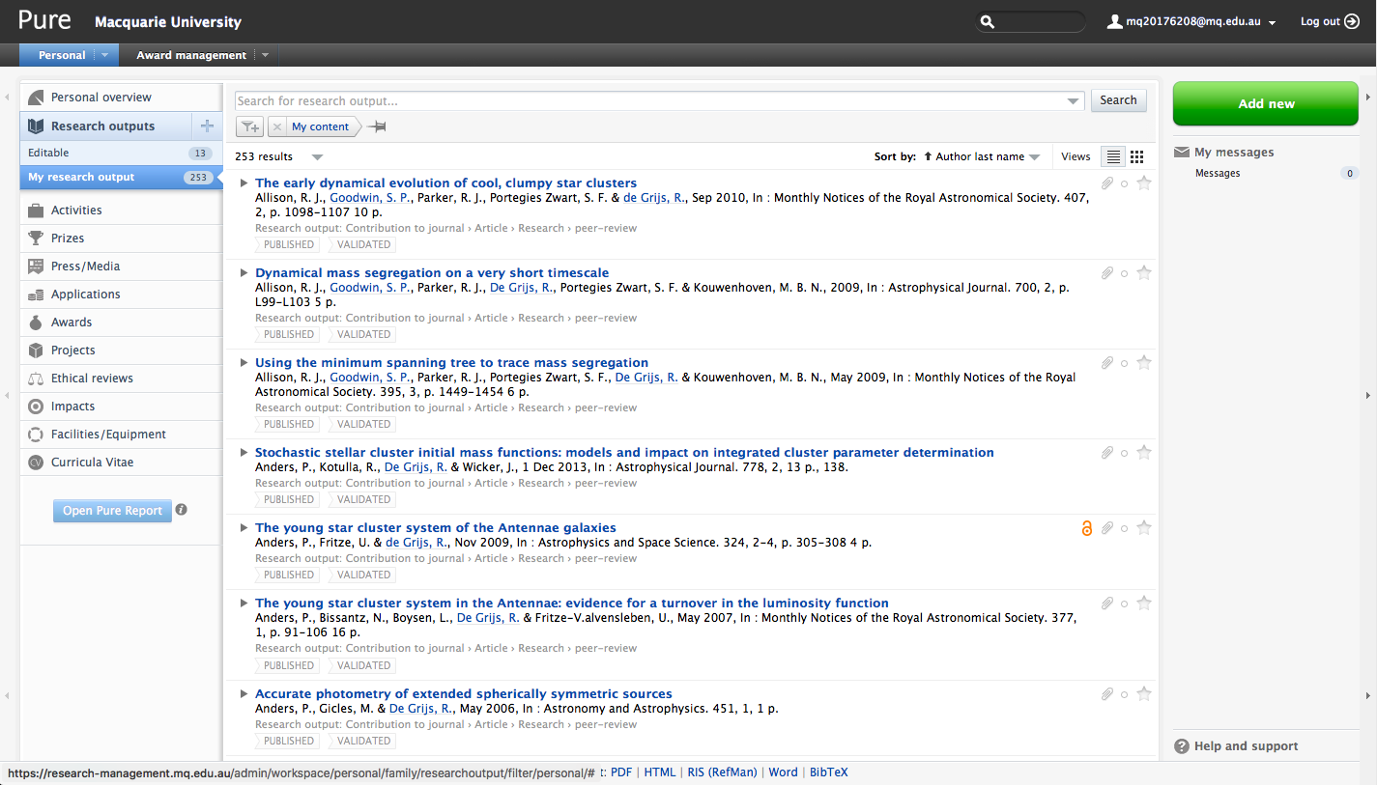

Slide 9
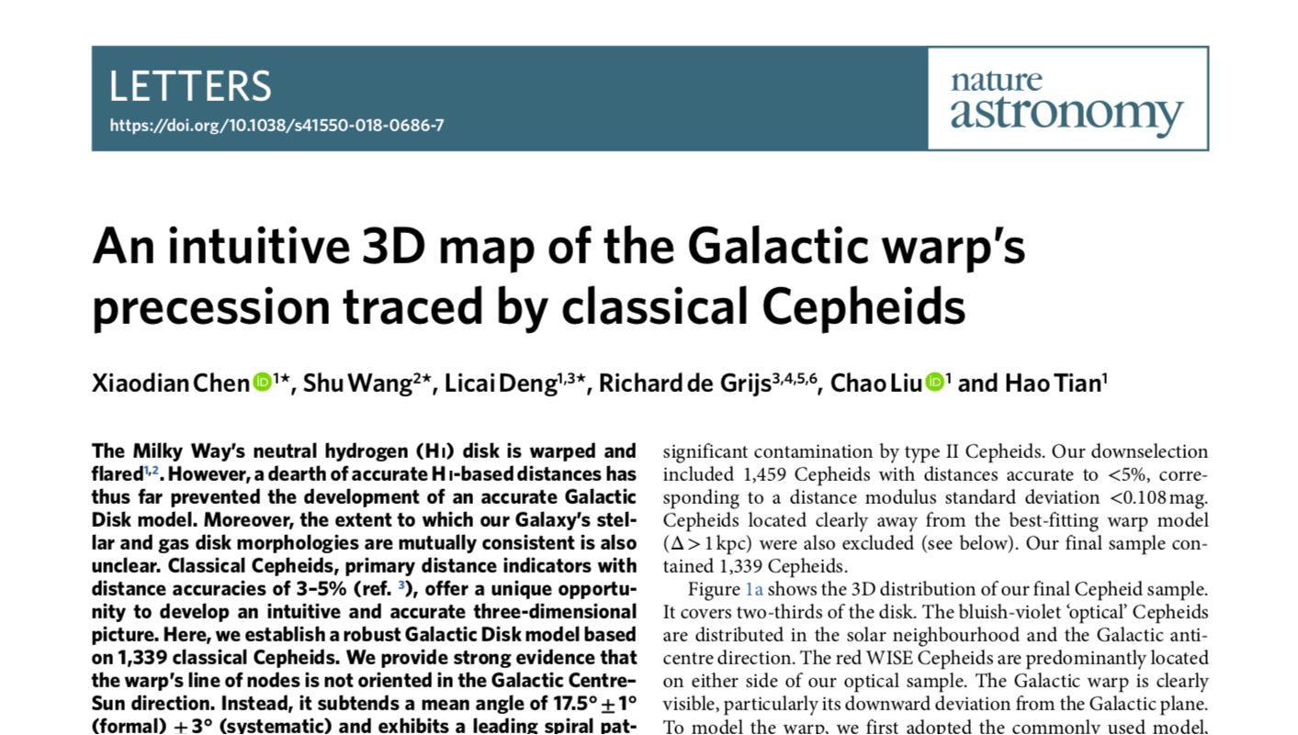

Slide 10
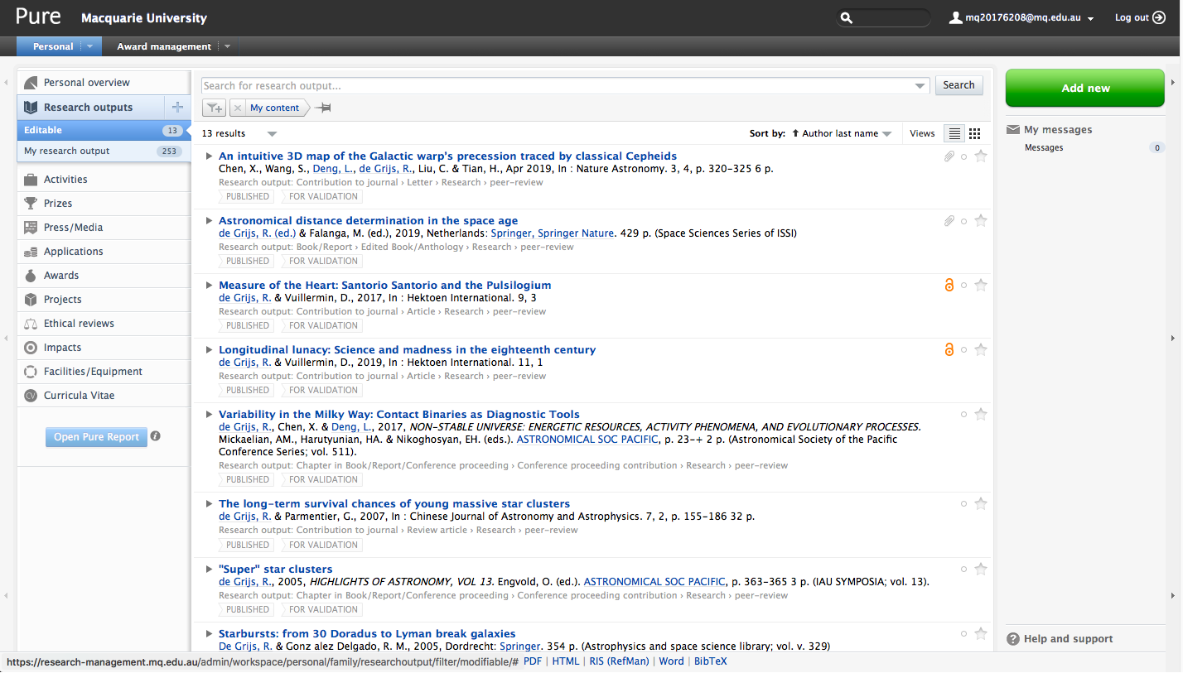

Slide 11
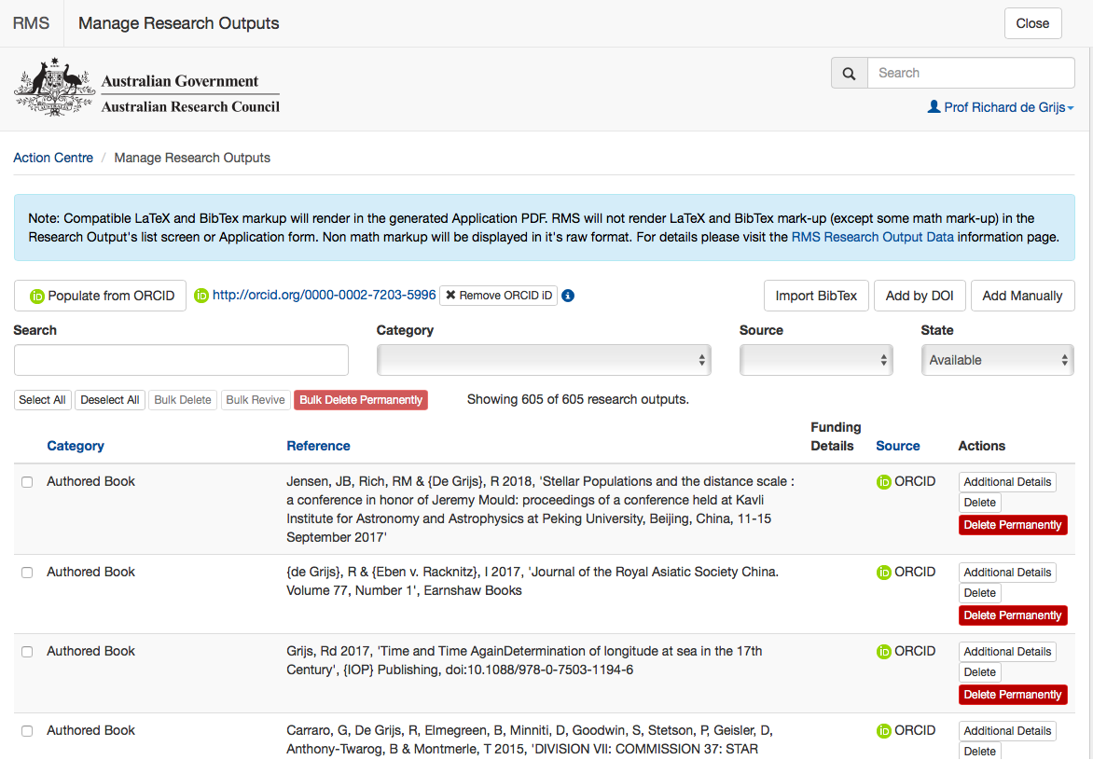

Slide 12
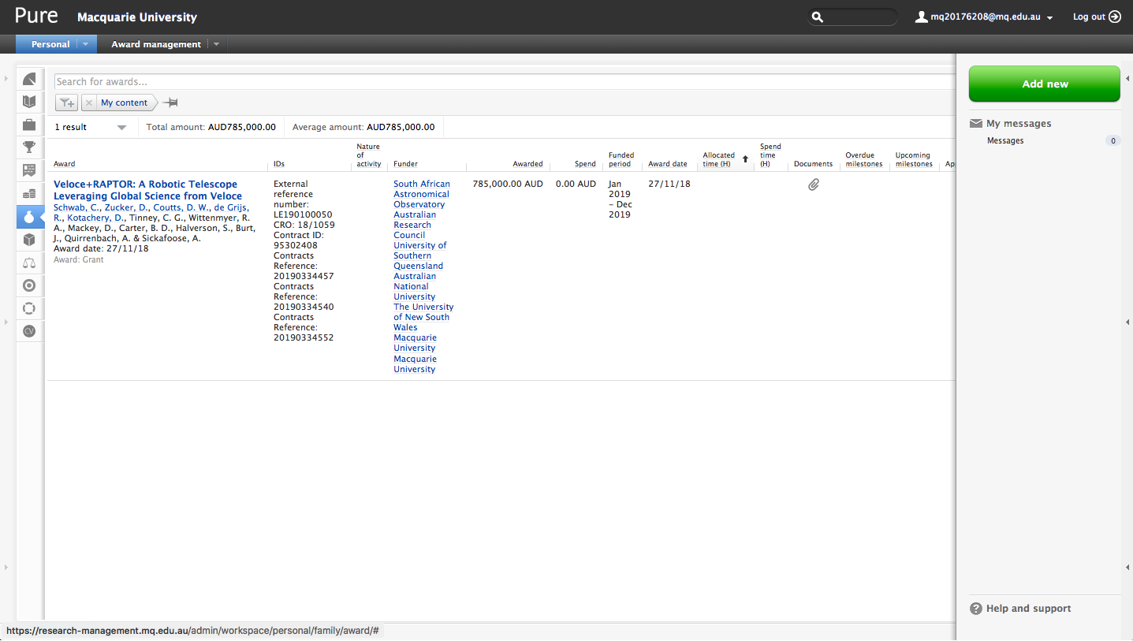

Slide 13
So … ?
ORCID has reached the stage where it’s getting useful to me in my professional life!

