Slide 1

ORCID US Community: ORCID API Basics & Benefits
Sheila Rabun, ORCID US Community Specialist
https://orcid.org/0000-0002-1196-6279
February 13, 2020

Slide 2
Agenda
What is the ORCID API?
Public API vs. Member API
Benefits of Member ORCID API for research institutions
How the ORCID member API works
Technical ORCID API integration planning
ORCID US Community services
Notes:
Today we are going to cover:
What is the ORCID API?
Public API vs. Member API
Benefits of Member ORCID API for research institutions
How the ORCID member API works
Technical ORCID API integration planning
ORCID US Community services
If you have any questions as we go along please type them into the chat, and we will address questions at the end of the session.

Slide 3

What is the ORCID API?
Notes:
So what is the ORCID API?

Slide 4

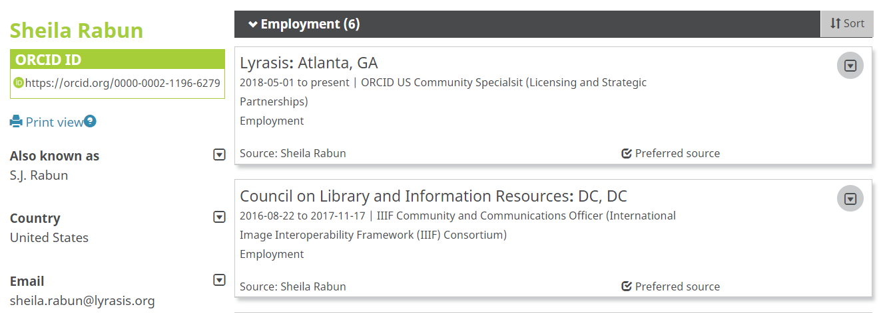
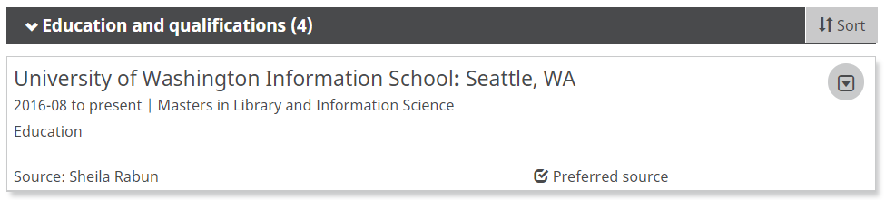
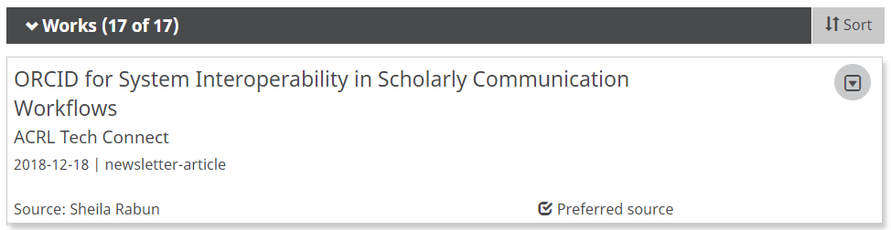
ORCID: Open Researcher & Contributor ID
https://orcid.org/0000-0002-1196-6279
Notes:
To start us off so we are all on the same page, as a quick review: ORCID stands for Open Contributor and Researcher Identifier. The basis of ORCID is the ORCID iD, a free unique persistent identifier for individuals that looks something like this. An ORCID iD is also a URI that links to the corresponding ORCID record (click). Some of the common data that can be found in an ORCID record includes things like employment and education information, and works - things like publications and presentations, similar to what you would find on a CV. In fact, you can think of ORCID as a new replacement for static word doc CVs - ORCID provides an interoperable, universal CV system with the goal of making a researcher's life as easy as possible. Rather than updating a word document resume, researchers can use their ORCID record as a persistent, reliable way to keep track of their achievements, contributions, and affiliations throughout their careers despite any changes in name, institutional affiliation, area of study, or location.

Slide 5
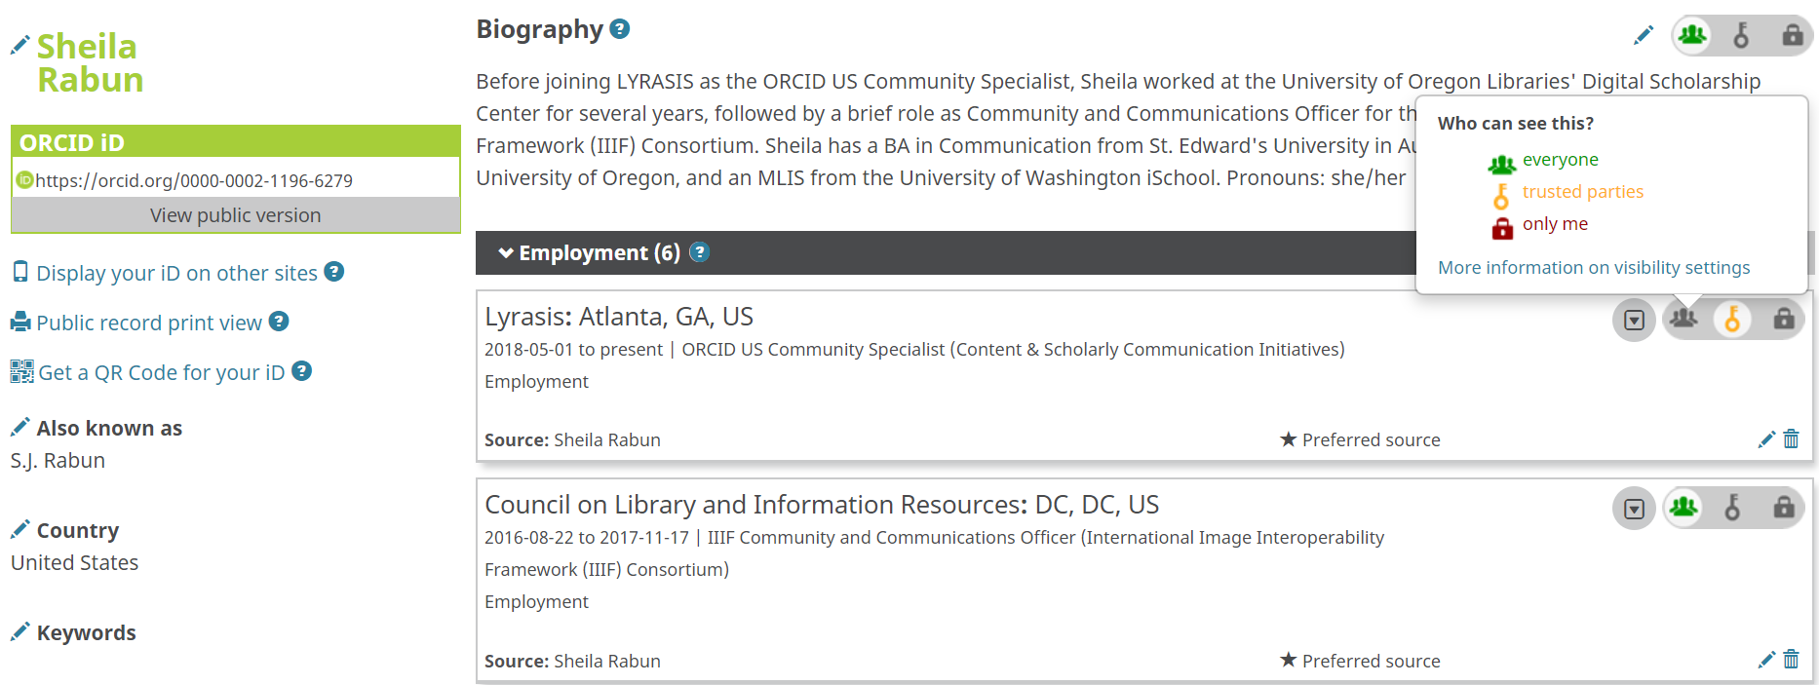
ORCID for Individuals
Notes:
As an individual, I have full control over my ORCID record and the visibility of the data within my record. Each different data point in ORCID has visibility settings that I can adjust, ranging from...

Slide 6
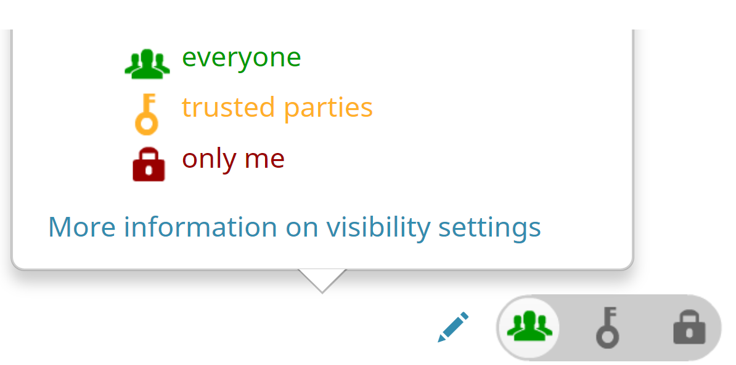
ORCID for Individuals
Notes:
public visibility where anyone can see,

Slide 7
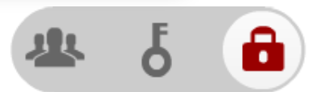
ORCID for Individuals
Notes:
private visibility so that no one can see this data but me, and finally

Slide 8

ORCID for Individuals
Notes:
trusted parties only, where only individuals and organizations that I designate as trusted parties can see this data.

Slide 9
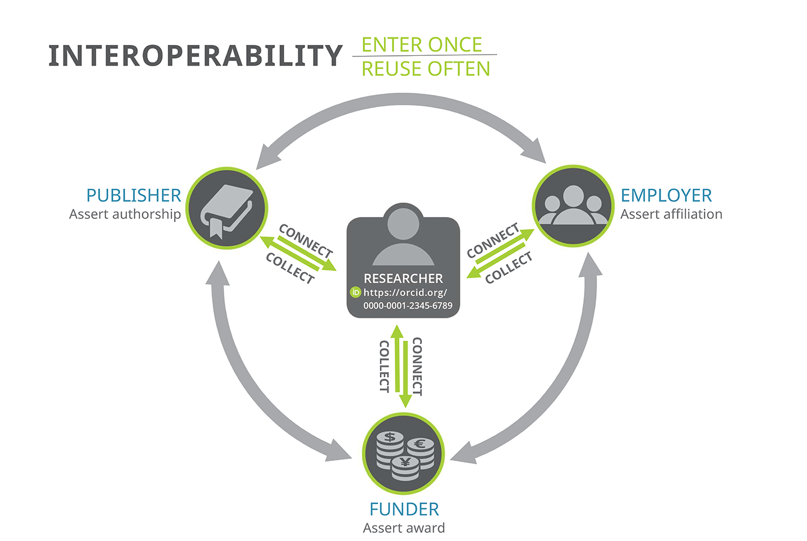
ORCID for Organizations
ORCID API (Application Programming Interface)
Notes:
While individuals interact with their ORCID record by logging in at orcid.org, organizations can also interact with individuals’ ORCID records as trusted parties using the ORCID API, or application programming interface (click). Participating organizations like publishers, funders, and research institutions, can use the ORCID API to interact with their affiliated researchers’ ORCID records in a few different ways, which we will explore in a minute. The graphic that you see here depicts a researcher in the center with their ORCID iD, and the different organizations that the researcher is affiliated with - a publisher, an employer, and a funder - all of which are connecting directly to the researchers’ ORCID record, and thus each other.

Slide 10
ORCID for Organizations
Research Institution
Reading data from ORCID record
Publisher
Writing data to ORCID record
Funder
Researcher ORCID record
ORCID API (Application Programming Interface)
Notes:
In some cases the organization may be (click) reading data from the researchers’ ORCID record rather than have the researcher fill out forms to collect their data. In other cases the organization may be (click) actually writing data to the researchers’ ORCID record to make a clear assertion about the relationship between the researcher and the organization. The ORCID API makes this possible.

Slide 11

API = Application Programming Interface
API → Interoperability between silos
Funding System
Research Reporting System
Publishing System
Institutional Repository
Image: https://pixabay.com/photos/silos-grain-storage-industry-1602209/
Notes:
So what exactly is the ORCID API? API stands for “application programming interface.” many online platforms, such as Twitter and DPLA, have an API, which essentially describes the rules that need to be followed in order to interact with that platform on the backend. APIs in general allow different software systems to communicate with each other, machine to machine, so that data can be transferred between two completely separate systems that would otherwise be siloed. So the graphic on this slide is showing a row of silos, which can be compared to different systems that you might be using at a research institution (click) you might have an institutional repository (click) and a publishing system likely in the library, and then in other parts of campus you may have (click) a research reporting system (click) and a grants management system - all separate systems that can be thought of like silos where the data within each system is only accessible from within that system. The crosswalk going over the top of all of the silos (click) can be thought of like an API (click) to allow a degree of interoperability between the data contained in each individual system.

Slide 12

ORCID API: Application Programming Interface
Institutional Repository
Publishing System
Research Reporting System
Funding System
ORCID API (Application Programming Interface)
Puzzle graphic: https://pixabay.com/en/jigsaw-puzzle-green-last-piece-313587/
Notes:
The ORCID API basically provides instructions for how a system needs to be configured in order to interact with your researchers’ ORCID records. You can think of the ORCID API like a puzzle piece that connects different organizational systems with ORCID: Once these systems are configured according to the ORCID API instructions, they can communicate with ORCID records and thus with each other. This is not limited to systems at your institution -

Slide 13
ORCID for Organizations
Notes:
any system can be configured to work with the ORCID API, therefore enabling interoperability of data across the wider research and scholarly communication ecosystem, as we saw in this graphic.

Slide 14





Common Systems for ORCID API Integration
Institutional ID and Profile Systems
Current Research Information Systems (CRIS)
Grant Management
Human Resources
Institutional Repositories
Publishing Platforms
Peer Review
Data Management Platform
Common systems in the US: https://www.lyrasis.org/Leadership/Pages/orcid-technical-support.aspx
ORCID workflows: https://members.orcid.org/api/workflow
Notes:
At a research institution, the most common types of systems for ORCID API integration are central ID management and HR systems, research reporting and profiling systems, grants management, publishing, and repositories (see a list of common systems in the US and ORCID workflows for various types of systems). Any system can be configured to integrate with the ORCID API, although vendor systems require the vendor to configure the integration, whereas open source or home-built custom systems require a developer to configure the integration.

Slide 15
ORCID Public API
vs.
ORCID Member API
Notes:
The specific functionality that can be achieved in systems that are integrated with the ORCID API varies depending on which ORCID API is used: ORCID provides a public API and a Member API, which we will cover next.

Slide 16
ORCID API: Public vs. Member
ORCID Public API
ORCID Member API
Gather authenticated ORCID iDs
Search for public data in ORCID
Read public data from ORCID records
Basic:
Gather authenticated ORCID iDs
Search for public data in ORCID
Read public data from ORCID records
Read limited-visibility data from ORCID records
Write data to ORCID records
Premium:
enable automatic updates
Notes:
ORCID has a Public API that is free for anyone to use, and a Member API that can be used by ORCID member institutions that pay a fee to support the Member API functionality.
(click) The Public API allows for collecting authenticated ORCID iDs and reading public data/searching the ORCID registry for public data.
(click) There are two types of member API: basic and premium. Both basic and premium allow for collecting authenticated ORCID iDs, reading public data as well as data set to “trusted parties only” and writing to ORCID records. The premium member API, which is what ORCID US Community member institutions have access to, also allows for enabling auto-updates so that if a change is made to an individual’s ORCID record, your institutional system gets notified and can be updated accordingly.

Slide 17
ORCID API Credentials
1 ORCID API Credential =
Client ID
+
Client Secret
Example:
Client ID: APP-8Z5NTGA5MBZ1Z84Q
Client Secret: 7cf1d95f-10cb-44c8-9741-a08d6ea102de
Notes:
To use either the public or member API, you will need to get API credentials, which include a client ID and client secret given to you by ORCID. The client ID will be used within your system integration, while the client secret should be kept a secret for security purposes and not shared publicly with anyone.

Slide 18
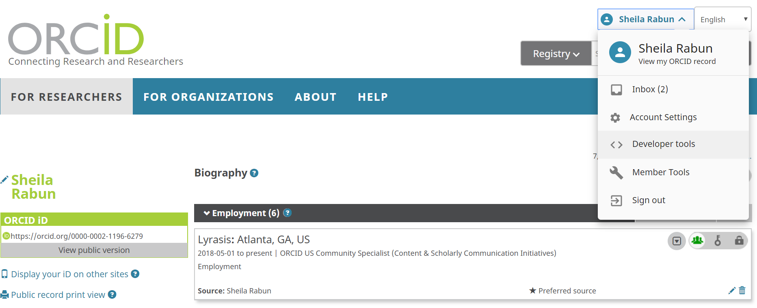
ORCID Public API
Sign in to your ORCID record
Go to the “Developer Tools” tab
More details: https://support.orcid.org/hc/en-us/articles/360006897174
Notes:
Public API credentials are issued to an individual through the individual’s ORCID record. To get access to public API credentials, log in to your ORCID record and go to the developers tab in the dropdown of your ORCID record as shown here. It’s important to note that public API credentials are granted to an individual through their ORCID iD and can not be transferred from one individual to another, whereas member API credentials are granted to the member institution. So, for institutional systems, the member API is recommended as it’s more sustainable, so you don’t have to worry about the person who requested the credentials leaving the institution.

Slide 19

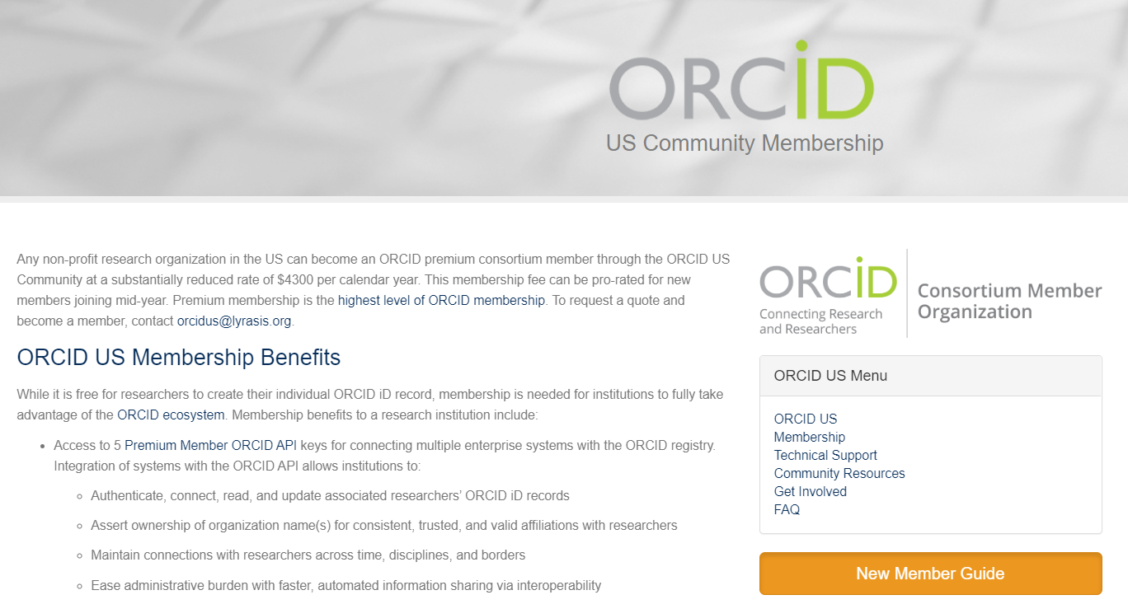
ORCID Member API
https://www.lyrasis.org/Leadership/Pages/orcid-membership.aspx
Notes:
To get access to member API credentials, your organization must first be an ORCID member. The ORCID US Community provides premium ORCID membership for non-profit research institutions in the US as an ORCID consortium administered by LYRASIS.

Slide 20
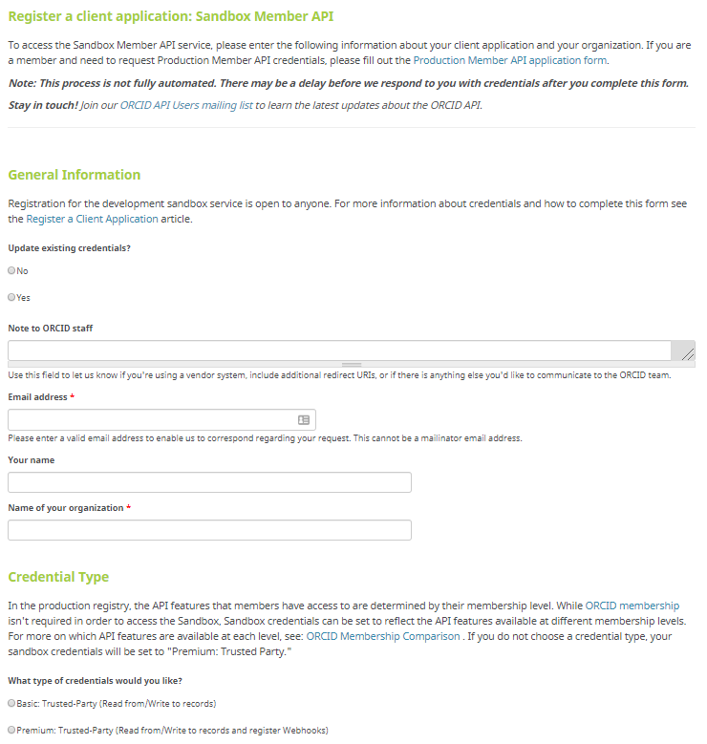
ORCID Member API: Sandbox
Request Sandbox API Credentials (development):
https://orcid.org/content/register-client-application-sandbox
Notes:
When you are ready to start working on an API system integration, there are forms online to request API credentials from ORCID depending on the type of integration you are pursuing. If you are working with open source systems like VIVO or OJS, or custom home-grown systems, you will first fill out ORCID’s form for sandbox credentials so you can work in a development environment first. ORCID provides a sandbox development environment that replicates the production environment so you can test your integration before working with any real data. You can create as many fake ORCID iDs as needed at sandbox.orcid.org for experimentation.

Slide 21
ORCID Member API: Sandbox
Review documentation:
  Getting Started: http://members.orcid.org/api/getting-started
  “Create & Connect” ORCID OAuth workflow: https://members.orcid.org/api/integrate/create-records
  ORCID scopes/permissions (aka what do you want to do with ORCID data): https://members.orcid.org/api/oauth/orcid-scopes
  Best practices: https://orcid.org/content/best-practices-research-organizations
Notes:
This slide shows links to documentation that you will want to look at if you are pursuing a custom ORCID API integration.

Slide 22
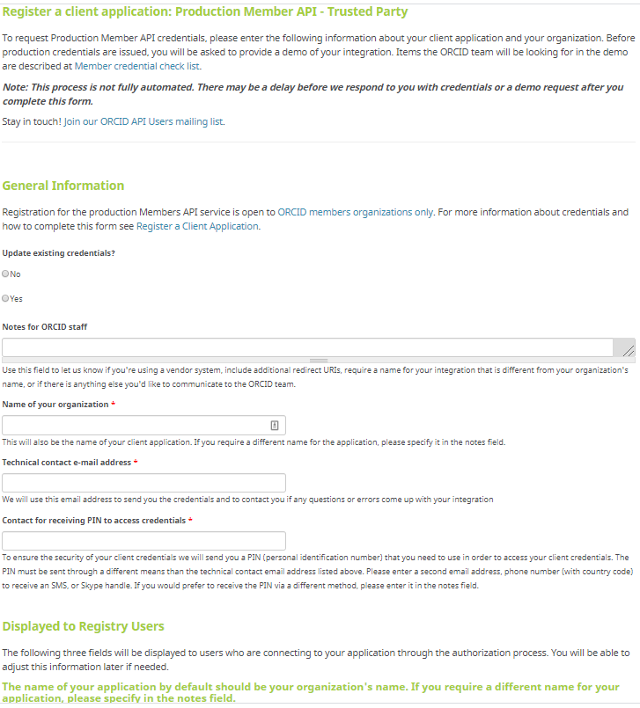
ORCID Member API: Production
Request Production API Credentials : https://orcid.org/content/register-client-application-production-trusted-party
Notes:
When you are ready to go live with your custom integration, you can fill out ORCID’s form to request production credentials, shown here. If you are working with a vendor system, many common vendor systems already have ORCID functionality built in, where you would need to use one of your API credentials to turn on the integration

Slide 23





ORCID API Integration - Vendor Systems
And more...
More info: http://members.orcid.org/api/orcid-enabled-systems
Notes:
This slide shows a handful of common vendor systems that have this ORCID functionality already built in - for these systems you can skip the sandbox credentials and apply directly for production credentials for your vendor system

Slide 24
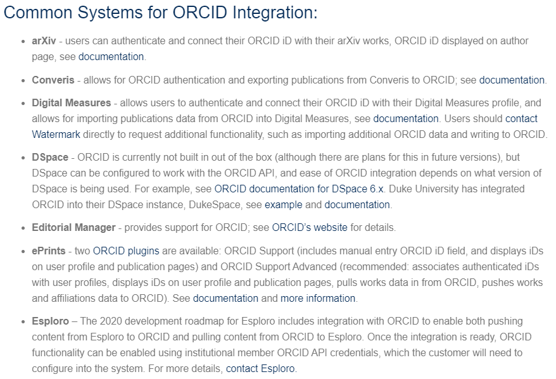
Technical Integration Planning
https://www.lyrasis.org/Leadership/Pages/orcid-technical-support.aspx
Notes:
If you are curious or unsure about the status of systems that you are using, the ORCID US Community website has a list of common systems with notes about what is needed to enable ORCID integration. If a system that you are using is not listed please let me know.

Slide 25
Benefits of Member ORCID API for Research Institutions
Notes:
So now that you know alittle bit more about the ORCID Public and Member APIs, Let’s turn our attention specifically to the details of the Member API and address the question of WHY an institution would want to integrate its systems with the ORCID Member API.

Slide 26
ORCID Member API Benefits for Research Institutions
Gather authenticated ORCID iDs
Mitigate confusion caused by name ambiguity
Read data from ORCID
Assess & track individual contributions & measure institutional impact
Write data to ORCID
Assert trustworthy & accurate affiliations, contribute to metadata integrity
All of the above + auto-updates
Save time & reduce administrative burden (for both researchers and administrators)
Notes:
There are four main benefits for institutions that use the ORCID Member API:
(click) First, by using the API to have your researchers connect their ORCID iDs with your systems, you can gather authenticated ORCID iDs in order to mitigate any confusion caused by name ambiguity amongst your researchers. For example, if you have multiple people with the same name or initials, or if you have researchers that have changed names over the course of their career, you can distinguish between people using their ORCID iD number rather than just their name.
(click) Second, by using the API to read data from your researchers’ ORCID records, you can not only save time by collecting information from ORCID as opposed to having your researchers fill out forms over and over again, but you can then use individual ORCID data to help with assessment of activities and things like promotion and tenure review, as well as looking at aggregate ORCID data to assess activity and impact at the departmental or institutional level.
(click) Third, by using the API to write data to your researchers’ ORCID records, you can not only save time for your researchers so they don’t have to enter all of their own data manually, but you can maintain control over how your organization’s name appears on their ORCID records and make sure that the data written is accurate and trustworthy, essentially contributing to the integrity of the metadata that is then being used by other stakeholders in the ORCID ecosystem, including other units within your own institution.
(click) Finally, all of this is designed to ultimately save time and reduce administrative burden for both your researchers and research administrators and staff. By utilizing the auto-update functionality of the premium member API, you can save even more time for everyone involved.

Slide 27
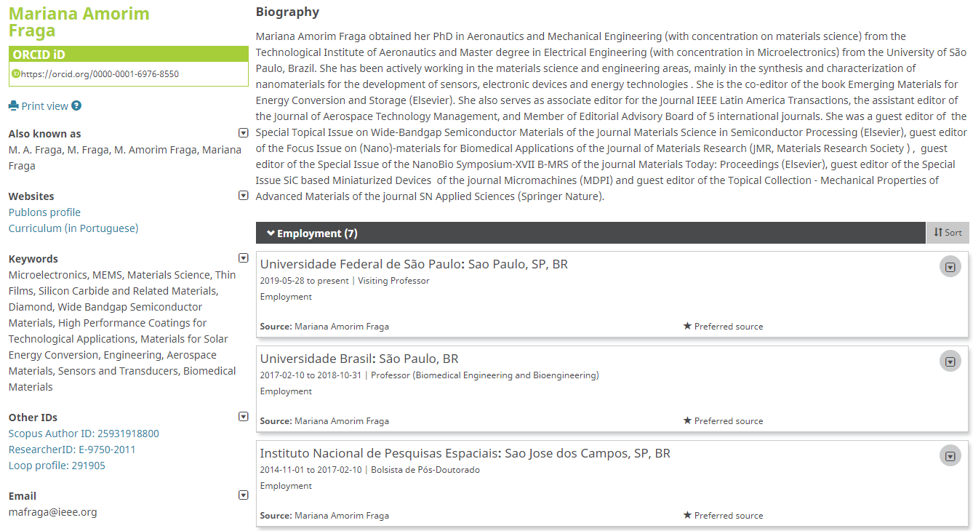
Biographical Information
Notes:
When you look at all of the different types of information that could be read, written, and updated via ORCID, you can start to see how transferring data using the ORCID API could be useful in a variety of contexts. Depending on your existing systems, priorities, and needs, ORCID records can include:Biographical information, such as a biography, other names used, websites, keywords, other identifiers, and email contact info,

Slide 28
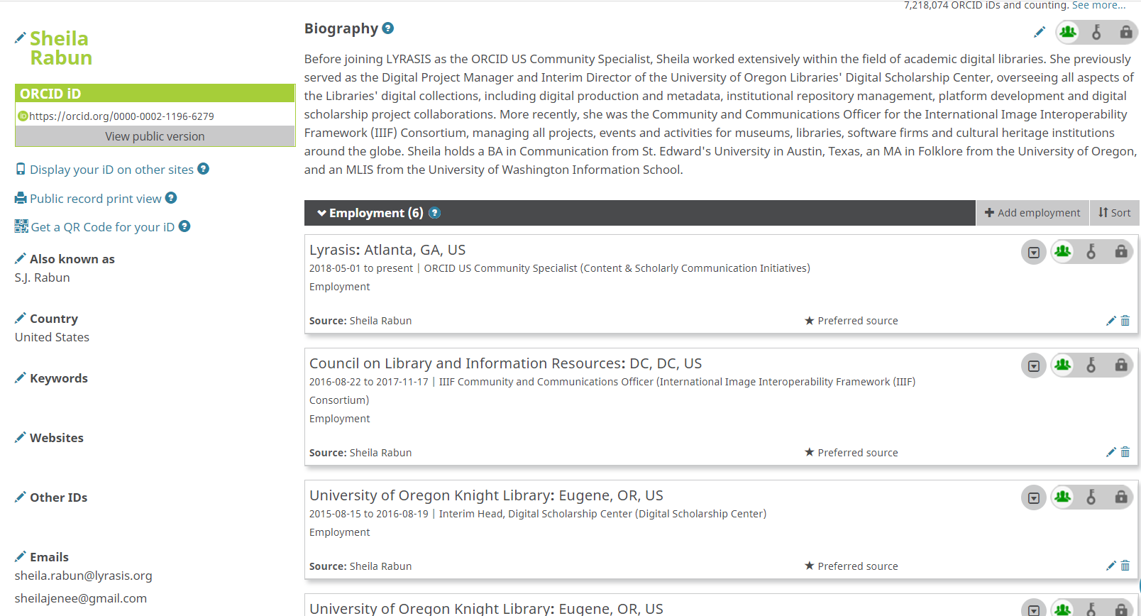
Employment Information
Notes:
Past and current employment

Slide 29
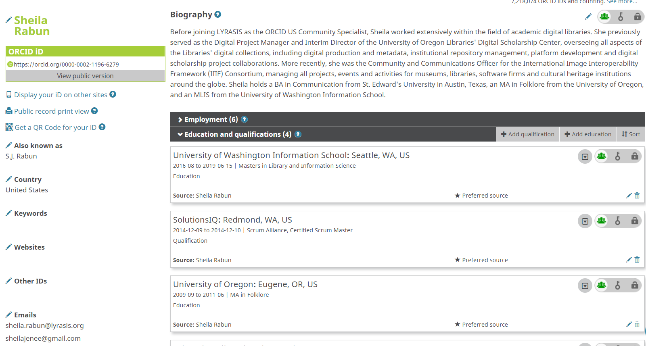
Education & Qualifications
Notes:
Education & qualifications

Slide 30
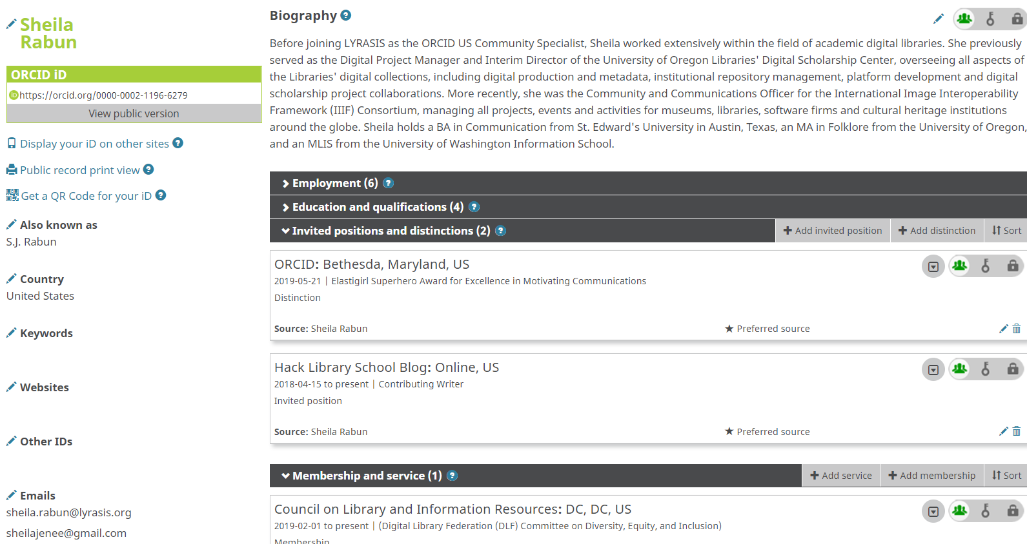
Invited Positions & Distinctions
Notes:
Invited Positions & distinctions

Slide 31
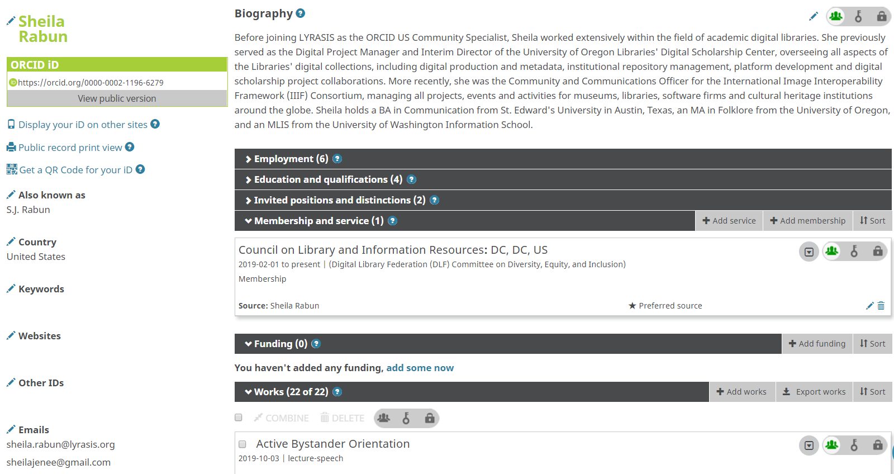
Memberships & Service
Notes:
memberships, & service

Slide 32
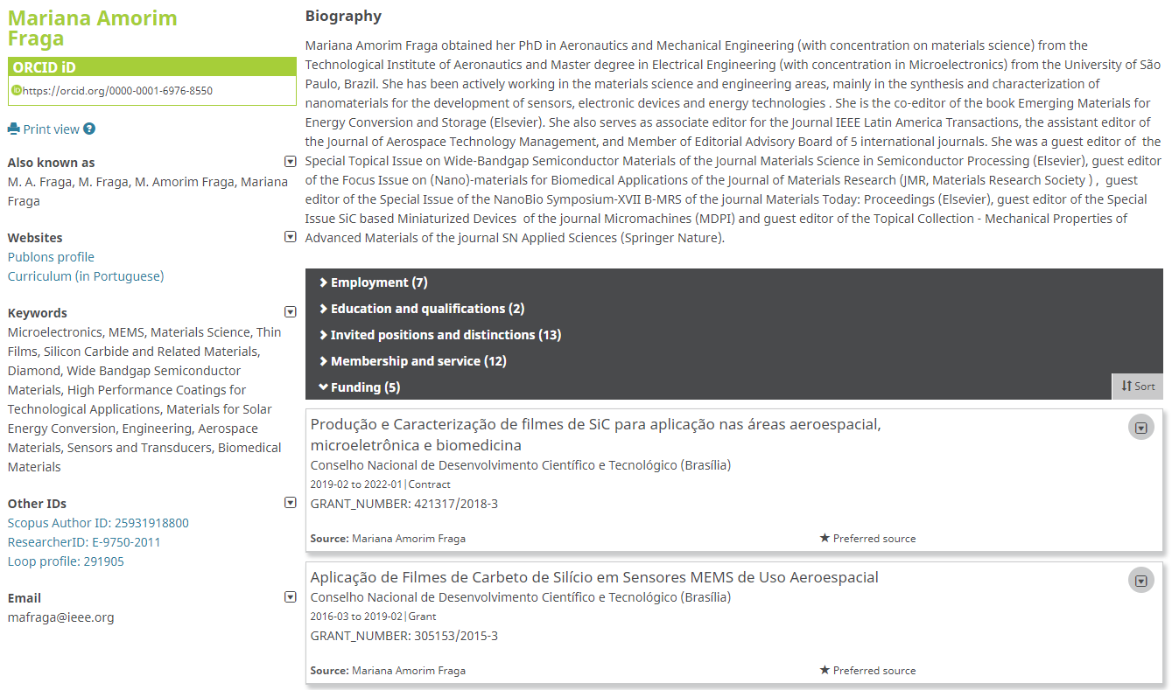
Funding
Notes:
Funding awards received

Slide 33
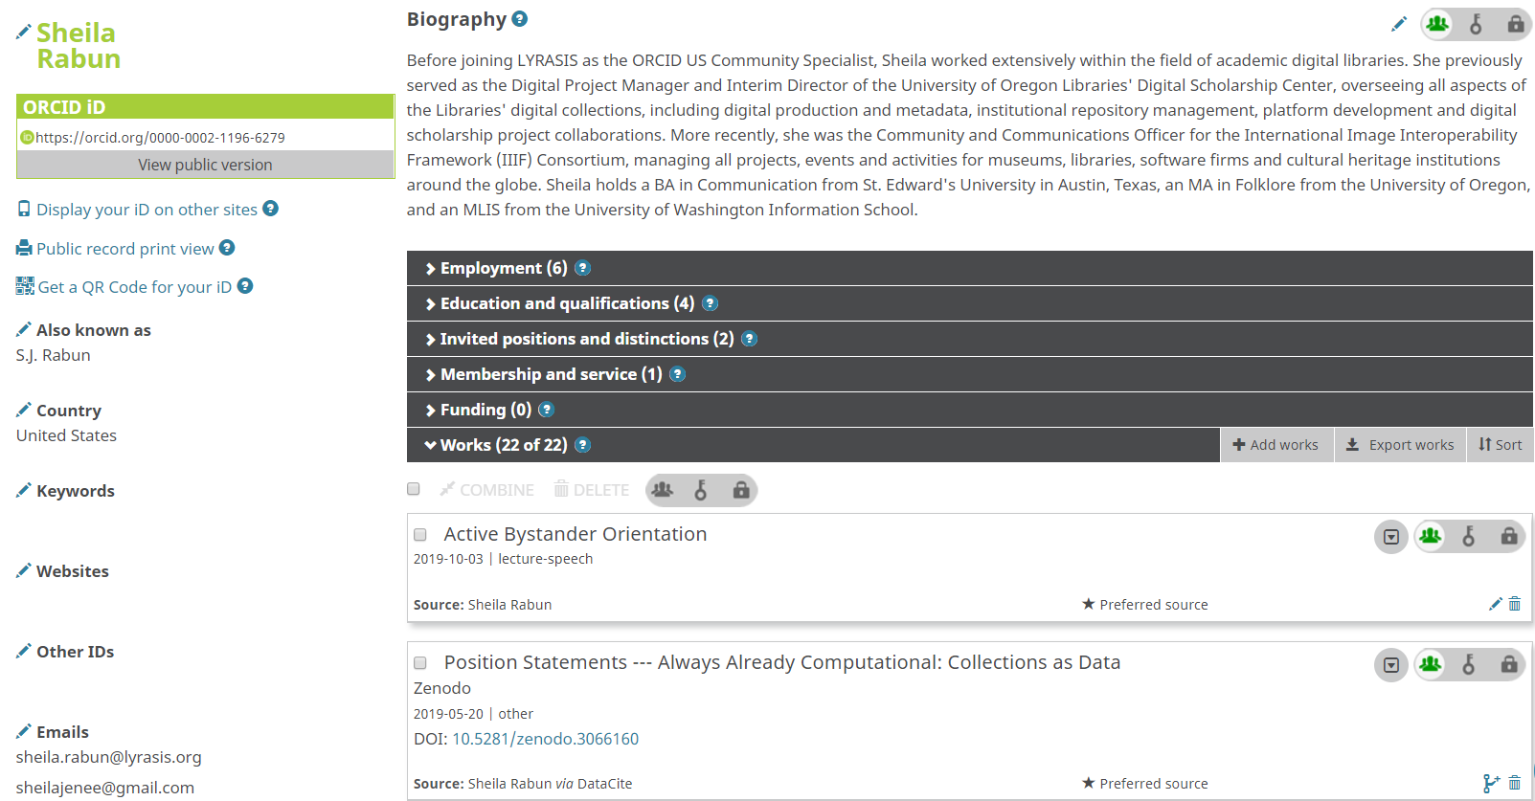
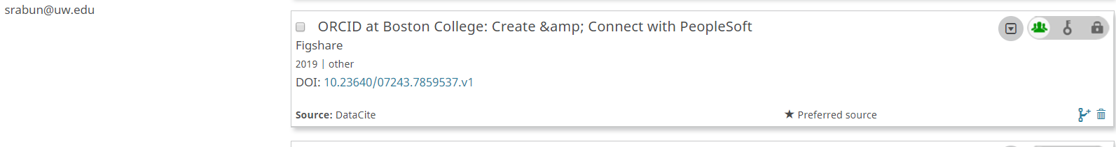
Works
Notes:
Works and contributions

Slide 34
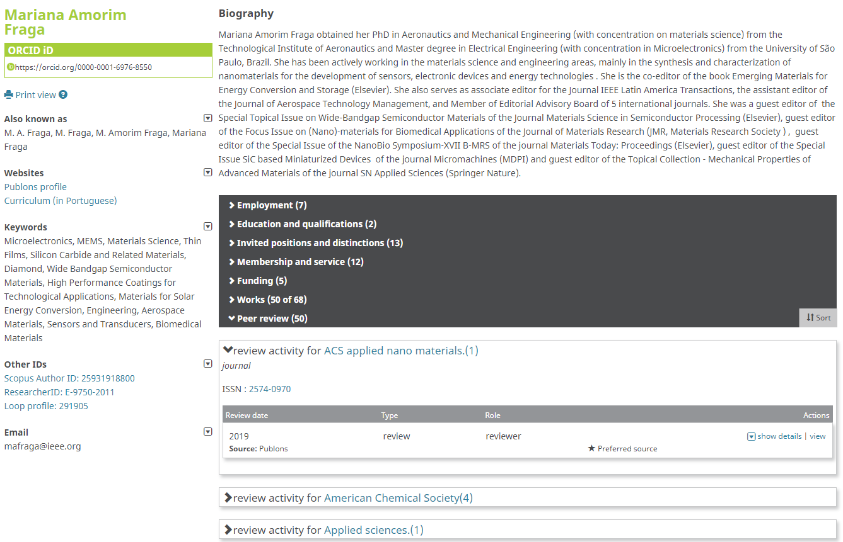
Peer Review Activity
Notes:
peer review activity

Slide 35
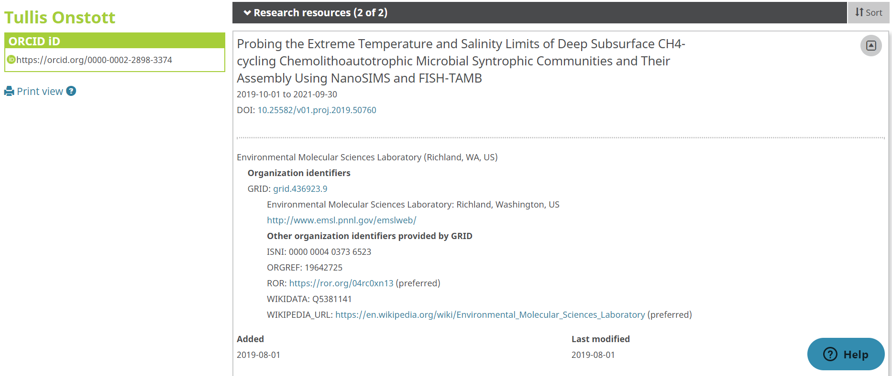
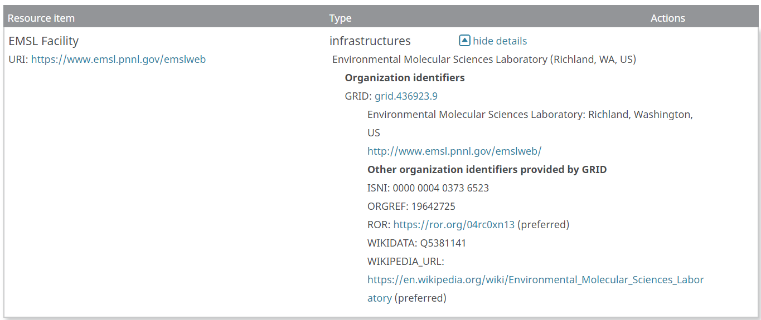
Research Resources
Notes:
Research resources used ( such as labs, facilities, equipment, collections, etc.). All of these different types of data can be read from or written to ORCID records using the ORCID member API, so that you can know exactly who did what, assess activities, assert activities and affiliations, and save time for everyone involved by allowing data to be transferred automatically as opposed to asking researchers to manually fill out forms over and over again or submit static CVs every time they have to report their activities.

Slide 36
How the Member ORCID API Works
Notes:
So at this point you know that the ORCID API allows institutions to connect with researchers’ authenticated ORCID iDs and read and write to any of the data that could be contained within an ORCID record. But how does all of this actually work?

Slide 37

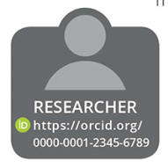

Authenticated ORCID iDs
Institutional System(s)
https://orcid.org/0000-0002-1196-6279
DO: Configure a system to gather authenticated ORCID data, using the ORCID API (application programming interface)
ORCID iD:
(Manual Entry)
DON’T: Ask researchers to manually enter their ORCID iD into a system - this is not authenticated
Notes:
The purpose of the ORCID API is to allow various institutional systems (click) to use ORCID iDs and data from ORCID records in an accurate and trustworthy manner (click). We really want to avoid having people type in their ORCID iD, copy and paste their ORCID iD, or otherwise manually enter their ORCID iD into a system (click). With a 16-digit number, there is room for typos and mistakes, even if just one number is entered incorrectly. Additionally, (click) having a researcher type in their ORCID iD into a system does not enable the authenticated, trusted, interoperable connection between the researchers’ ORCID data and your institutional systems that the API provides. (click) So, rather than doing this, the best practice (click) for gathering accurate, authenticated ORCID iDs and enabling interoperability is to configure your systems to use the ORCID API.

Slide 38
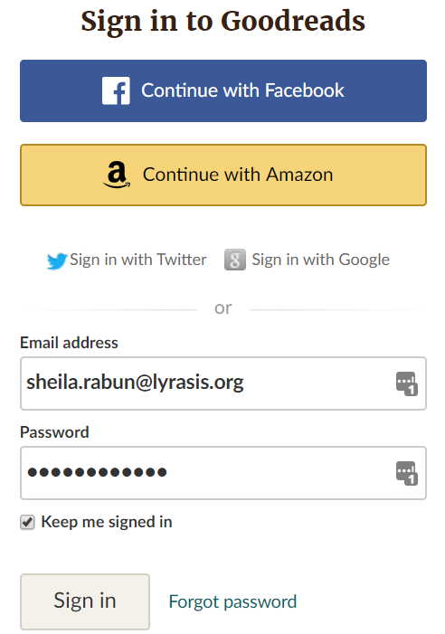
Step 1: OAuth
Researcher must grant permission in order for your institution to interact with their ORCID iD.
Permission is granted by having the user go through an authentication process (OAuth) from within your system.
Notes:
So, in order to configure your systems to take advantage of the benefits of the ORCID API, the process starts by getting permission from your affiliated researchers to connect with their authenticated ORCID iD number, and interact with their ORCID record as a trusted party. The main thing to remember here is that in accordance with ORCID’s principal that the researcher has full control over their ORCID data, in order to interact with researchers’ ORCID records as a trusted party, you will need to ask your researchers for permission to interact with their ORCID records. Permission is granted by having the user go through an authentication process called OAuth, from within your system integration. (click) OAuth is a process by which a user can grant permission for an application to access data from a third party system. If you think you are not familiar with OAuth, you probably have actually seen it in action before, For example, (click) if you have ever used your gmail or facebook login credentials to sign in to a different website like ebay or Goodreads, you have used OAuth.

Slide 39
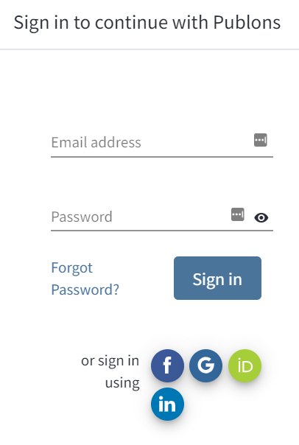
Step 1: OAuth
Notes:
A good example of a platform that allows logging in using facebook, google, and ORCID is Publons...

Slide 40
ORCID OAuth Process
Get permission from researchers by using the ORCID API OAuth process, where the user must:
Visit user-facing portal to “create & connect” their ORCID iD
2) Log in with institutional credentials to verify
institutional identity
3) Log in to ORCID to verify ORCID iD
4) Authorize permissions (scopes) for your system
to interact with the user’s ORCID record
Notes:
With ORCID, the OAuth process consists of 4 steps for typical research institution system integrations:
first, the user will need to go to a web portal that you have set up at your institution where they can access the ORCID OAuth process - we typically call this the ORCID “create & connect” or ORCID portal.
Typically, the user then logs in with their institutional credentials to verify their identity and affiliation with your institution,
then is asked to either register for their ORCID iD if they don’t already have one, or log in to their ORCID record if they do already have one.
Finally, the user will be asked to authorize permission for your institution to interact with their ORCID record. Once the user has gone through this process and granted permission, you can interact with their ORCID record as a trusted party. I will demonstrate this process in just a minute.

Slide 41
ORCID OAuth Process
Ask users for one or more of the following permissions (aka scopes):
Get authenticated ORCID iD number
2) Read any limited-access data from ORCID record
3) Write data to ORCID record
4) Enable automatic updates
Notes:
For each integration, you can choose which permissions you want to ask the researcher for, or you can allow them to select which permissions they want to grant. At the very basic level, you can just ask to get their ORCiD iD and nothing else. However, this would not be taking full advantage of the benefits of the ORCID member API. You can also ask to read limited-access data from the ORCID record, you can ask to write data to their ORCID record, and you can include the option for allowing automatic updates if you are using the premium member API.

Slide 42
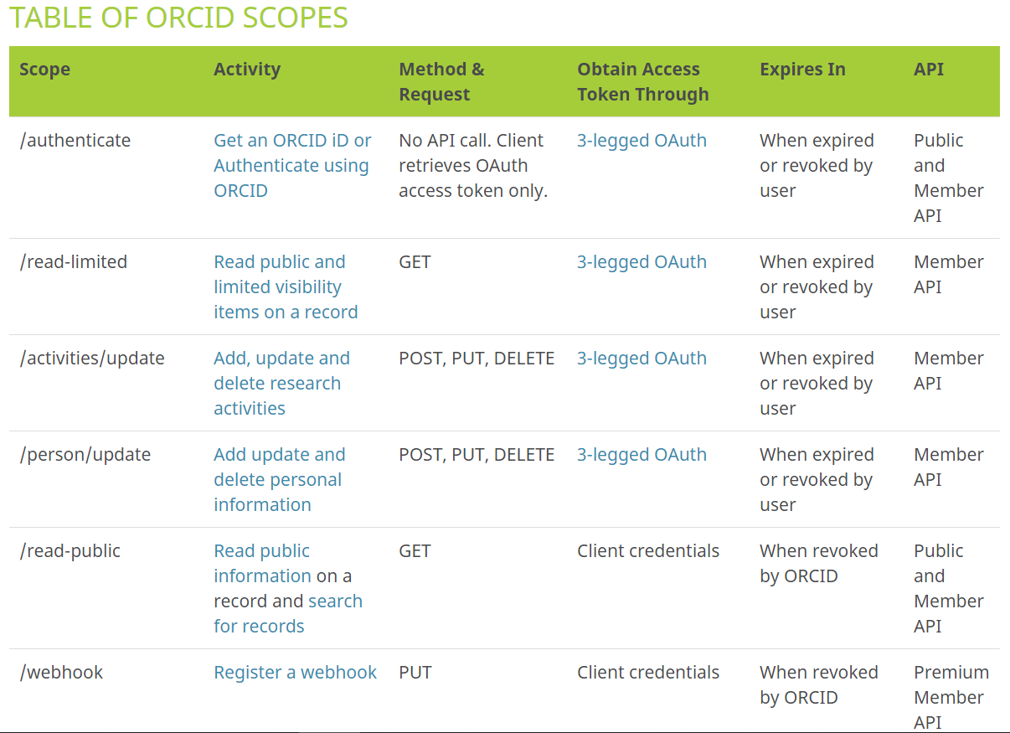
ORCID Scopes (Permissions)
https://members.orcid.org/api/oauth/orcid-scopes
Notes:
This image shows the variety of different permissions or scopes that members can use in their integrations: the first is authenticate - this can be used with the Public or Member API to simply gather the authenticated ORCID iD.

Slide 43
ORCID Scopes (Permissions)
https://members.orcid.org/api/oauth/orcid-scopes
Notes:
The read-limited scope allows for reading any limited-access information on the ORCID record - so any data set to the “trusted parties” visibility setting that we saw earlier

Slide 44
ORCID Scopes (Permissions)
https://members.orcid.org/api/oauth/orcid-scopes
Notes:
The activities/update scope allows for writing affiliations and activities such as employment, education, works, funding, and other data points found in the main column of the ORCID record

Slide 45
ORCID Scopes (Permissions)
https://members.orcid.org/api/oauth/orcid-scopes
Notes:
The person/update scope allows for writing biographical information to the ORCID record, which includes the biography, other names used, country, websites, keywords, other identifiers, and email addresses.

Slide 46
ORCID Scopes (Permissions)
https://members.orcid.org/api/oauth/orcid-scopes
Notes:
If you don’t want to ask for permission to read limited-access data, you can instead explicitly ask for permission to read public data on an ORCID record. However, the ability to read public data from an ORCID record is included with the /authenticate scope, so you don’t necessarily have to specify this permission unless you want to.

Slide 47
ORCID Scopes (Permissions)
https://members.orcid.org/api/oauth/orcid-scopes
Notes:
And finally, the /webhooks scope will enable auto-updates between your system and the researcher’s ORCID record any time changes occur.

Slide 48
ORCID Member API Benefits for Research Institutions
Mitigate confusion caused by name ambiguity
Scope: /authenticate
Assess & track individual contributions & measure institutional impact
Scope: /read-limited
Assert trustworthy & accurate affiliations
Scope(s): /activities/update
/person/update
Save time & reduce administrative burden (for both researchers and administrators)
Scope: /webhooks
Notes:
Each of these scopes corresponds to a specific benefit of using the ORCID member API: for example, (click) authenticate will allow for gathering the authenticated ORCID iD that will help with name disambiguation, (click) the read-limited scope will help to pull data into your systems to be used for assessment purposes, (click) the activities/update and person/update scopes will allow for your systems to write data to your researchers’ ORCID records, and all of the scopes as well as the /webhooks scope will allow for saving time and reducing administrative burden.

Slide 49
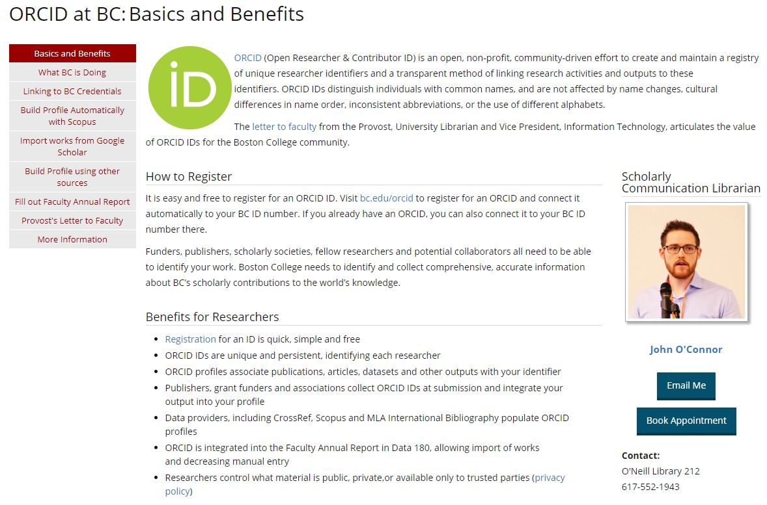
Example: Boston College LibGuide
https://libguides.bc.edu/orcid
Notes:
To demonstrate how all of this works, I will walk us through a typical ORCID OAuth interaction to show both what the user will see as well as how the code of a system needs to be configured, using examples from Boston College. The first step is to provide some sort of user-facing portal designed to educate people about ORCID (what it is and why they should care) and to prompt them to connect their ORCID iD with the institutional system integration. What you’re seeing here is Boston College’s LibGuide on ORCID…notice that in their “how to register” section rather than linking to the ORCID website, they provide a local Boston College link. if we click on the link to register...

Slide 50
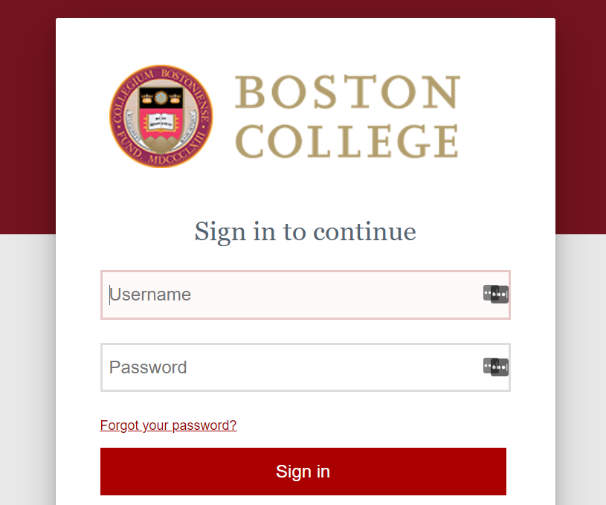
Example: Boston College “Create or Connect”
Notes:
We are first asked to sign in to Shibboleth with our institutional credentials so the institutional system knows who we are. This step is not required, but it is typical with ORCID integrations to have users sign in to the organizational system or profile first so that they can then connect their ORCID iD with their institutional account or profile.

Slide 51
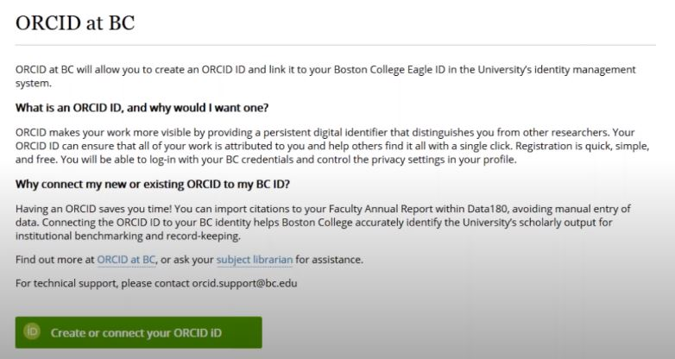
Example: Boston College “Create or Connect”
Click prompt → Launch into ORCID OAuth process
Authorization URL:
https://orcid.org/oauth/authorize?client_id=APP-NPXKK6HFN6TJ4YYI&response_type=code&scope=/read-limited/activities/update&redirect_uri=https://bc.edu/orcid
https://bc.edu/orcid
Notes:
Once we are logged in to Shibboleth, we are taken to a new page that again explains what ORCID is and why we are being asked to connect our ORCID iD with the institution. You’ll notice the button prompting the user to “create or connect” their ORCID iD. (click) behind that button is an authorization URL, comprised of the client ID which is part of your API credentials from ORCID,

Slide 52
Example: Boston College “Create or Connect”
Click prompt → Launch into ORCID OAuth process
Authorization URL:
https://orcid.org/oauth/authorize?client_id=APP-NPXKK6HFN6TJ4YYI&response_type=code&scope=/read-limited/activities/update&redirect_uri=https://bc.edu/orcid
https://bc.edu/orcid
Notes:
scopes which are the permissions that you will be asking your researchers to authorize,

Slide 53
Example: Boston College “Create or Connect”
Click prompt → Launch into ORCID OAuth process
Authorization URL:
https://orcid.org/oauth/authorize?client_id=APP-NPXKK6HFN6TJ4YYI&response_type=code&scope=/read-limited/activities/update&redirect_uri=https://bc.edu/orcid
https://bc.edu/orcid
Notes:
and redirect URI, which is where you want the user to be re-directed once they complete the OAuth process.

Slide 54
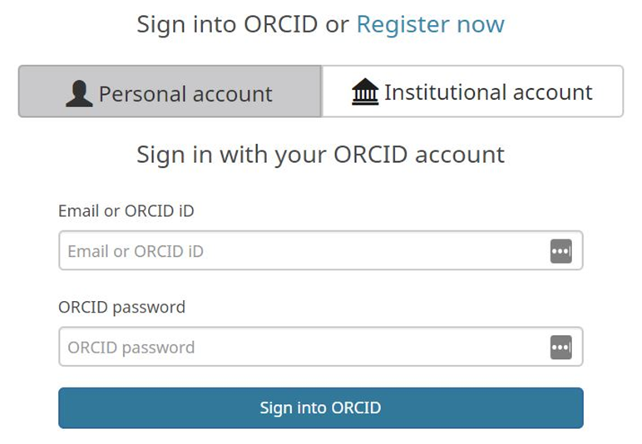
Log In Screen
Notes:
Back to our workflow, once we click the authorization URL through the “create or connect” button, we are launched into the ORCID OAUth process. It starts by having the user sign in to the ORCID record to verify their ORCID iD number.

Slide 55
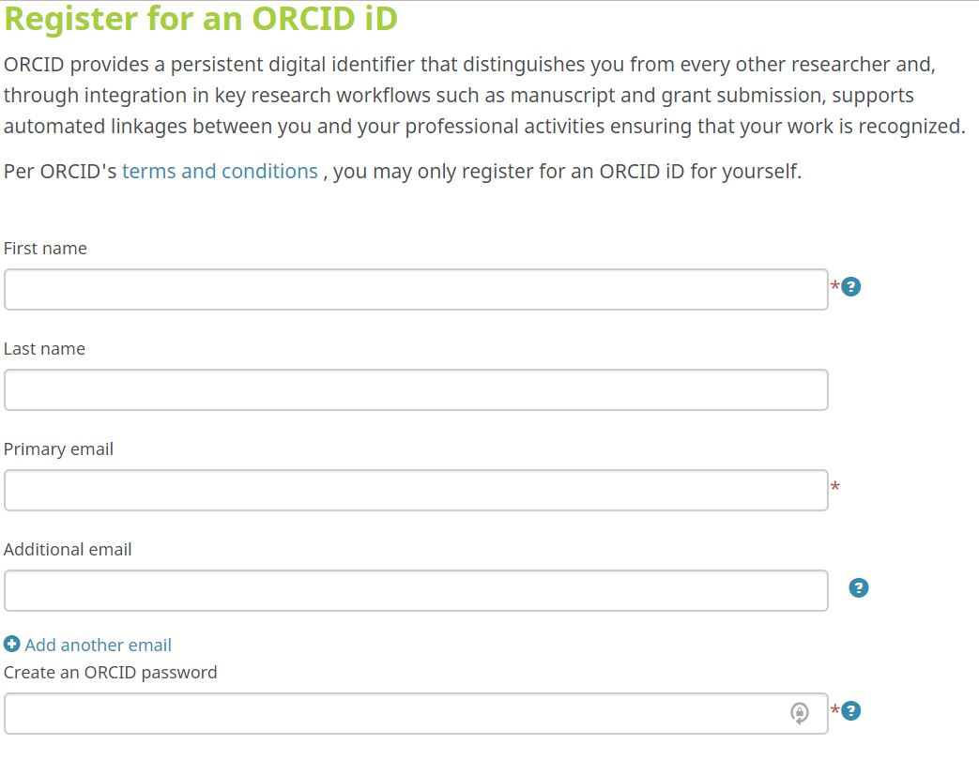
Registration Screen
Notes:
If a user does not already have an ORCID iD, they can register for one right then and there. Either way, the user is logging in to their ORCID account so the system can retrieve their accurate ORCID iD number.

Slide 56
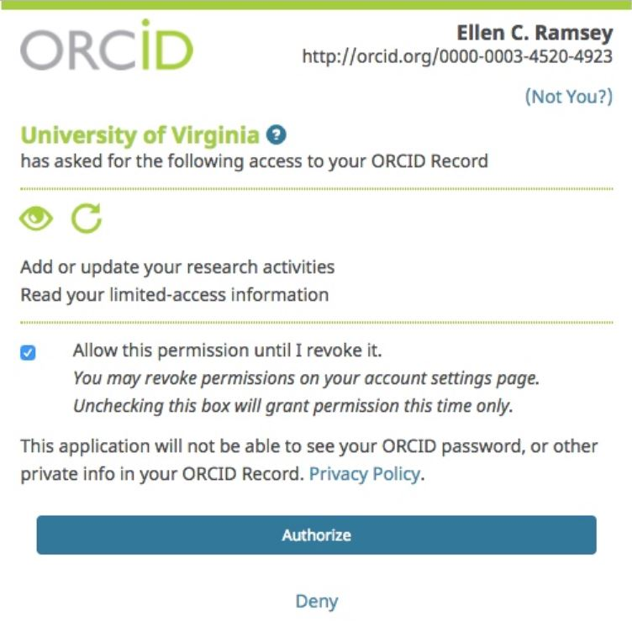
Authorization Screen
Individual’s Name
http://orcid.org/0000-0000-0000-0000
XYZ Institution Name
Authorization URL:
https://sandbox.orcid.org/oauth/authorize?client_id=APP-NPXKK6HFN6TJ4YYI&response_type=code&scope=/read-limited/activities/update&redirect_uri=https://developers.google.com/oauthplayground
Notes:
At this point, the ORCID AUthorization screen will appear, with the users name, their ORCID iD, and a note that the institution is asking them for permission to connect with their ORCID record in any number of ways. In this example, we are being asked to allow the institution permission to read any limited-access data and to add and update research activities. (click) This is where the scopes from the authorization URL come into play. The scopes you included in your authorization URL, will determine the permissions that researchers will be asked to grant for this integration. In this example, the scopes are read-limited and activities/update.

Slide 57
Authorization Screen
Individual’s Name
http://orcid.org/0000-0000-0000-0000
XYZ Institution Name
Notes:
Once the researcher is ready to grant this permission, they will click authorize.

Slide 58
Storing Authenticated Data
Upon authentication, your system will receive the user’s name, ORCID iD, and access token that will allow you to connect with their ORCID record:
  access_token: 89f0181c-168b-4d7d-831c-1fdda2d7bbbb
  token_type: bearer
  refresh_token: 60e883f6-d84e-4ae6-87f5-ef0044e3e9a7
  expires_in: 631138518
  scope: /read-limited/activities/update
  orcid: 0000-0002-8354-0496
  name: Karen Arnold
This data will need to be stored in a secure database
Permissions last for 20 years unless otherwise revoked
Notes:
At which point your system will receive back a handful of data that will need to be stored in a secure database, including the person’s name

Slide 59
Storing Authenticated Data
Upon authentication, your system will receive the user’s name, ORCID iD, and access token that will allow you to connect with their ORCID record:
  access_token: 89f0181c-168b-4d7d-831c-1fdda2d7bbbb
  token_type: bearer
  refresh_token: 60e883f6-d84e-4ae6-87f5-ef0044e3e9a7
  expires_in: 631138518
  scope: /read-limited/activities/update
  orcid: 0000-0002-8354-0496
  name: Karen Arnold
This data will need to be stored in a secure database
Permissions last for 20 years unless otherwise revoked
Notes:
their ORCID iD,

Slide 60
Storing Authenticated Data
Upon authentication, your system will receive the user’s name, ORCID iD, and access token that will allow you to connect with their ORCID record:
  access_token: 89f0181c-168b-4d7d-831c-1fdda2d7bbbb
  token_type: bearer
  refresh_token: 60e883f6-d84e-4ae6-87f5-ef0044e3e9a7
  expires_in: 631138518
  scope: /read-limited/activities/update
  orcid: 0000-0002-8354-0496
  name: Karen Arnold
This data will need to be stored in a secure database
Permissions last for 20 years unless otherwise revoked
Notes:
The scopes granted,

Slide 61
Storing Authenticated Data
Upon authentication, your system will receive the user’s name, ORCID iD, and access token that will allow you to connect with their ORCID record:
  access_token: 89f0181c-168b-4d7d-831c-1fdda2d7bbbb
  token_type: bearer
  refresh_token: 60e883f6-d84e-4ae6-87f5-ef0044e3e9a7
  expires_in: 631138518
  scope: /read-limited/activities/update
  orcid: 0000-0002-8354-0496
  name: Karen Arnold
This data will need to be stored in a secure database
Permissions last for 20 years unless otherwise revoked
Notes:
and the access token that will allow you to interact with this specific person’s ORCID record data using the API.

Slide 62
Storing Authenticated Data
Upon authentication, your system will receive the user’s name, ORCID iD, and access token that will allow you to connect with their ORCID record:
  access_token: 89f0181c-168b-4d7d-831c-1fdda2d7bbbb
  token_type: bearer
  refresh_token: 60e883f6-d84e-4ae6-87f5-ef0044e3e9a7
  expires_in: 631138518
  scope: /read-limited/activities/update
  orcid: 0000-0002-8354-0496
  name: Karen Arnold
This data will need to be stored in a secure database
Permissions last for 20 years unless otherwise revoked
Notes:
Once a user goes through the OAUth process and authorizes the connection, those permissions stay in place by default for 20 years, which is helpful for keeping up with researchers even after they leave the institution.

Slide 63
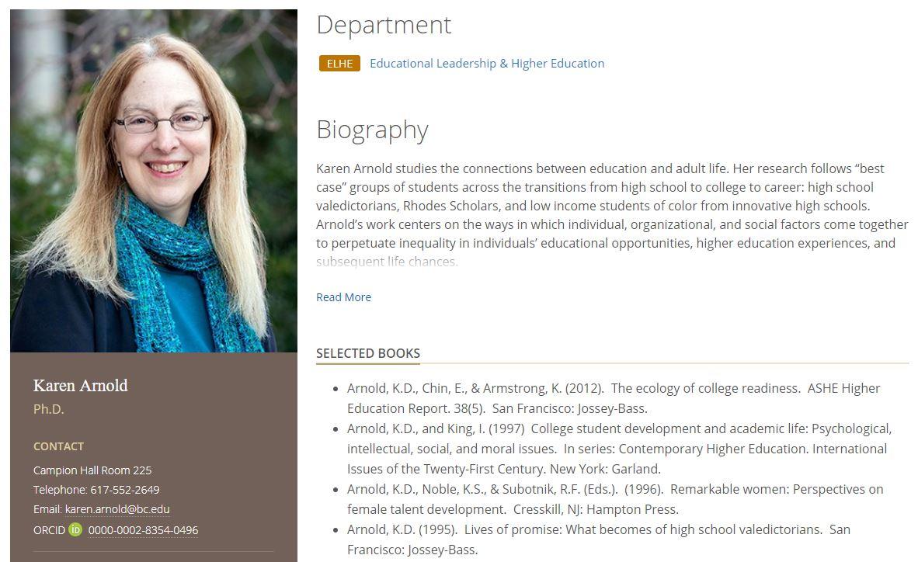
Display Example: Boston College
Notes:
Once you have collected authenticated ORCID iDs, you can display them in relevant systems such as faculty profiles in this example from Boston College. You can also import any public data from ORCID into your system, such as a faculty profile or reporting system

Slide 64
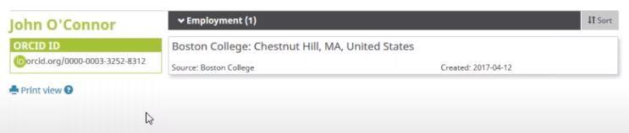
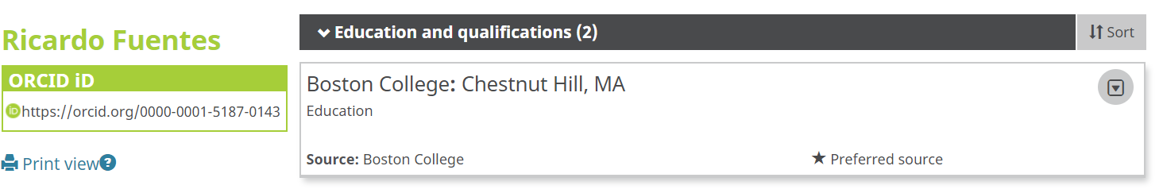
Write Example: Boston College
Writing data to ORCID records:
https://members.orcid.org/api/basic-tutorial-add-and-update-data-orcid-record-30
Notes:
If you asked for the activities/update or the person/update scopes, You can also write data to ORCID records as you can see in this example from Boston College where they are writing education and employment affiliations to ORCID records

Slide 65
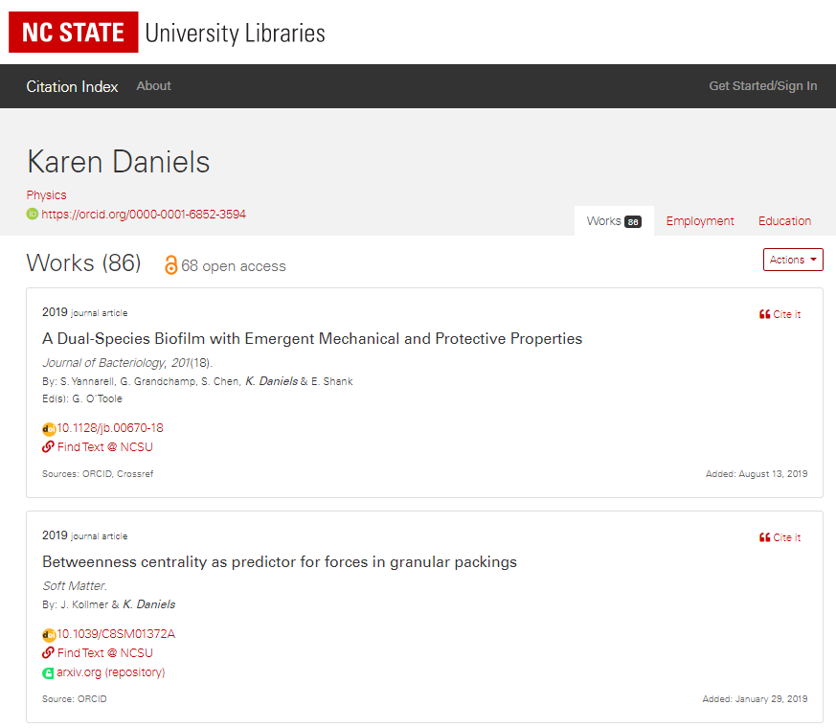
Reading Data from ORCID
Image source: NC State University Libraries’ Citation Index:https://ci.lib.ncsu.edu/profiles/kdaniel
Notes:
WHen it comes to reading data from ORCID, you can pull in public data into your systems in whatever way is helpful to you. ORCID is designed to be configurable to meet a variety of different needs. Those using the Member API have the ability to read limited access data in addition to public data, making data access more complete. And if you asked for the read-limited scope, you can also pull in any information from their ORCID record that is set to trusted parties only. Keep in mind that researchers may have set their data to “trusted parties only” for a reason, so you probably don’t want to display that data in a public-facing site but rather use it for reporting and assessment purposes only. The example that you are seeing here is from the North Carolina State University Libraries’ Citation Index, where they are pulling works data from ORCID into their Citation Index application - this is just one example of how your systems can read data from ORCID using the ORCID API.

Slide 66
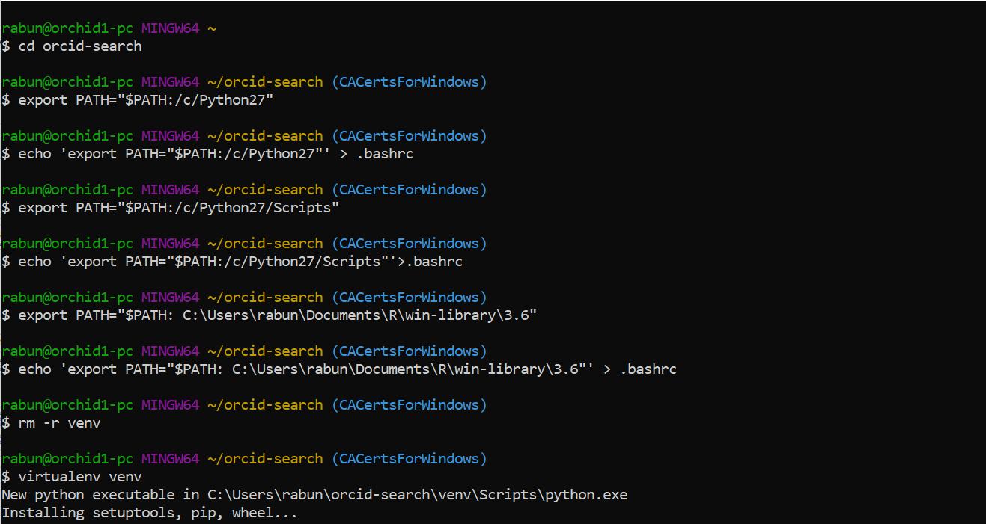
ORCID API - Backend
REST (Representational State Transfer) API = uses HTTP calls (URLs) to request, send, and receive data
Send HTTPS calls using:
  programming language within your system(s)
  desktop tools such as command line
  web-based tools such as Google OAuth Playground
Notes:
With the examples that I just showed, we were looking at the user-facing end product of ORCID data in interaction with the ORCID API, because for the purposes of explaining the basics and benefits of the API we don’t necessarily need to look at slides of code. If you are interested in seeing sample code, please let me know. ORCID is a REST API, which stands for Representational State Transfer and basically means that it relies on HTTPS calls or URLs to search, send, request, and retrieve data. For practice and testing, you can interact with the ORCID API using a range of tools capable of making and receiving HTTPS requests. In real-world situations, API interactions are completed by your system using a programming language such as PHP, Java, or Ruby on Rails. Most desktop HTTPS tools are run in the command line which is the image that you see here; for those who prefer a graphical interface, web-based tools are also available - One popular tool is Google's OAuth 2.0 Playground, a free, web-based tool developed and maintained by Google

Slide 67
ORCID API call: Read
curl -i -H "Accept: application/vnd.orcid+xml" -H 'Authorization: Bearer dd91868d-d29a-475e-9acb-bd3fdf2f43f4' 'https://api.sandbox.orcid.org/v3.0/0000-0002-9227-8514/works'
Access token = dd91868d-d29a-475e-9acb-bd3fdf2f43f4
ORCID iD = 0000-0002-9227-8514
Part of the record you want to read = /works
Sample API calls: https://github.com/ORCID/ORCID-Source/tree/master/orcid-model/src/main/resources/record_3.0
Sample XML for reading data from ORCID: https://github.com/ORCID/ORCID-Source/tree/master/orcid-model/src/main/resources/record_3.0/samples/read_samples
Notes:
An example API call using curl in the command line to read works from an ORCID record would look something like this: you would have some header information, as well as the person’s access token, their ORCID iD, and the part of the ORCID record you want to retrieve, in this case works. Once the call is sent, data would be retrieved from the ORCID record in either XML or JSON format as specified by your system

Slide 68
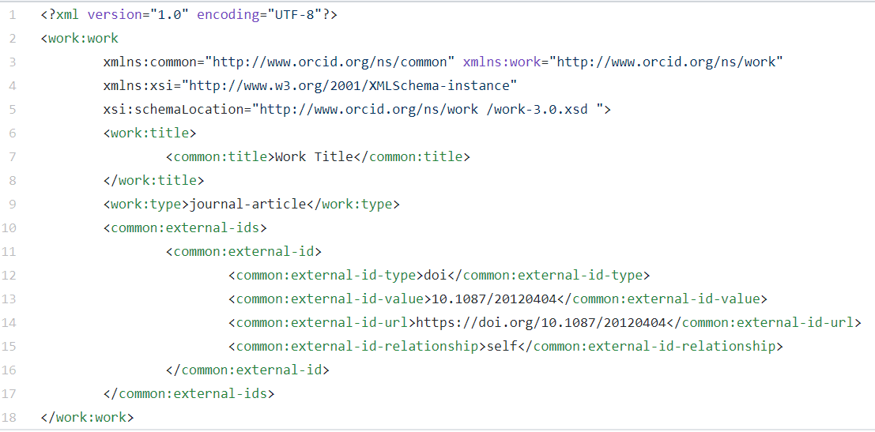
ORCID API call: Write
curl -i -H 'Content-type: application/vnd.orcid+xml' -H 'Authorization: Bearer dd91868d-d29a-475e-9acb-bd3fdf2f43f4' -d '@[FILE-PATH]/work.xml' -X POST 'https://api.sandbox.orcid.org/v3.0/0000-0002-9227-8514/work'
Sample XML for writing data to ORCID: https://github.com/ORCID/ORCID-Source/tree/master/orcid-model/src/main/resources/record_3.0/samples/write_samples
Notes:
An example API call using curl in the command line to write data, in this example a work, to an ORCID record would look something like this - you would need to include the access token, the person’s ORCID iD, and the file path to the XML or JSON file containing the data to send from your system to the ORCID record. Here is a sample XML file for writing a work to an ORCID record.

Slide 69
ORCID API Tutorials
ORCID API Tutorials: https://members.orcid.org/api/tutorial
Note differences between API v.2 and v.3
How to read data from each ORCID record (v.3): https://members.orcid.org/api/basic-tutorial-reading-data-orcid-record-30
How to add & update data on an ORCID record (v.3): https://members.orcid.org/api/basic-tutorial-add-and-update-data-orcid-record-30
Explore the ORCID API with Google OAuth Playground: https://members.orcid.org/api/explore-orcid-api-google-oauth-playground
Getting Started with your ORCID API integration: https://members.orcid.org/api/getting-started
Notes:
When you are ready to go in-depth with all of this functionality, ORCID has a number of tutorials for how to use API calls to read and write ORCID data. I would also recommend getting a feel for how the API works by using ORCID’s tutorial with Google OAuth Playground - you do not have to be a developer to do the tutorial. The tutorial explains how to configure and use the OAuth Playground with the ORCID Sandbox Member API. ORCID’s “Getting started” guide is also a great place to start for documentation on getting started with sandbox credentials and getting your own integration set up.

Slide 70
Planning for your ORCID Member API Integration
Notes:
Now that you know some of the basics, you can start thinking about planning for or taking any existing integrations further at your institution

Slide 71
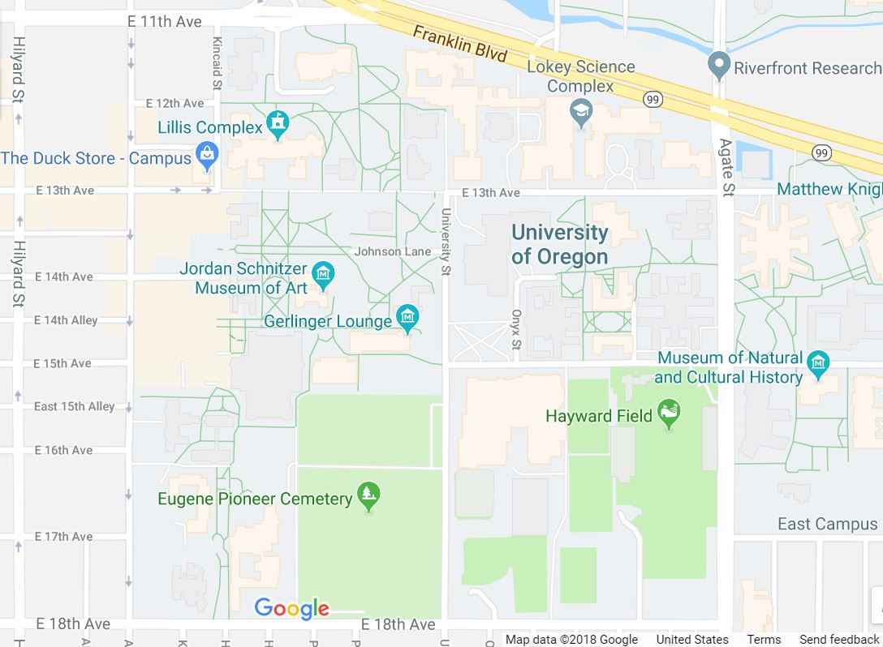








Technical Integration Planning
Central IT
Research Office
Human Resources
Academic Units
Graduate School
Provost
Library/Libraries
Grants Office
What systems are being used across campus? Who are the stakeholders?
Notes:
When it comes to planning ORCID integrations at your institution, keep in mind that ORCID can benefit data flow in systems across the institution, not just in one specific department or unit. At an academic research institution, common stakeholders that could benefit from ORCID include the research office, provost office, libraries, central IT, grants office, HR, and specific academic units. As you start to think about adopting ORCID at your institution, take inventory of the types of systems that are in use and think about what internal stakeholders might need to be involved.

Slide 72
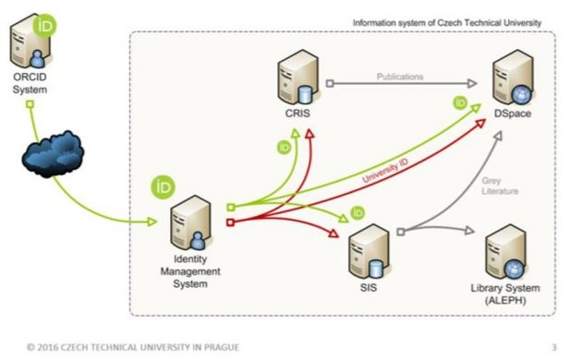
Technical Integration Planning
Inventory campus systems
Which systems might integrate with ORCID?
How will information flow between systems?
Image from Czech Technical University in Prague, 2016: https://dspace.cvut.cz/bitstream/handle/10467/67742/or2016_slides_ctu_comments.pdf?sequence=1&isAllowed=y
Notes:
As you are taking stock of what systems are being used, think about how data is or could flow between systems? For example, this graphic is illustrating the use of 1 API credential for an integration with a central ID management system, where ORCID data collected can then flow to other systems, streamlining efforts to make system infrastructure more efficient.

Slide 73
Planning with Stakeholders
What do you want to do with ORCID?
  Read information from ORCID records?
  Write information to ORCID records?
  What kind of information are you interested in?
Example: Florida State University ORCID Implementation Committee
  Office of Faculty Development & Advancement
  Office of Research
  University Libraries
  Office of Institutional Research
  National Magnet Lab
  Graduate School
  College of Medicine
https://docs.google.com/document/d/1-PYyYAxY55MmdliiATxHZ3GylEG__k1yPlg4MP0xpdc/edit?usp=sharing
Notes:
Once you identify what parties should be involved, work with these stakeholders to determine: What do you want to do with ORCID? What are your priorities? For example, do you want to read data, write data, or both? If so, what data are you most interested in? You may even want to form a cross-campus ORCID committee or similar group to discuss strategy for how and where to use ORCID in your systems, as well as rollout/timing, and outreach strategy once your integration is in place. (click) At Florida State University, they formed an ORCID implementation committee comprised of stakeholders from various units to determine the most strategic approach for ORCID adoption and this is working quite well for them. They have kindly shared this link to their ORCID committee charter document, so you can use this as an example for your own institution.

Slide 74

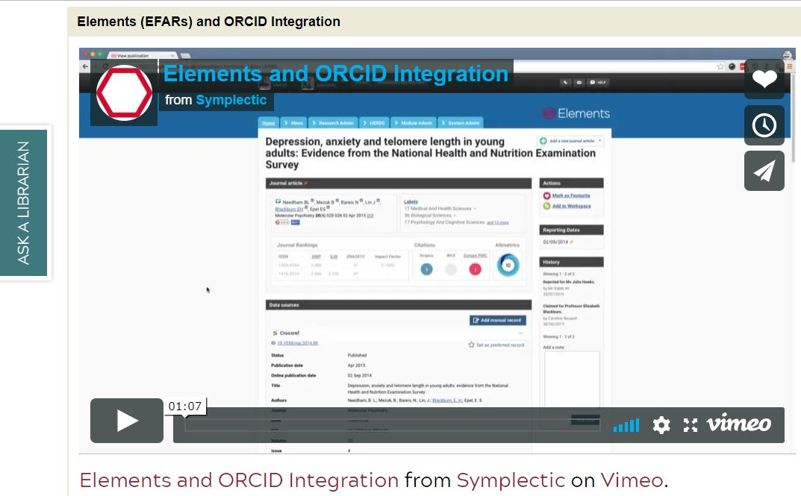
End User Documentation & Outreach
Image credit: Virginia Tech, https://guides.lib.vt.edu/orcid
Notes:
Regardless of whether you are using vendor systems or custom system ORCID integrations, you will want to make sure you have end user documentation available for explaining how and why users should connect their ORCID iD with your systems, as well as a plan for doing outreach to make sure your researchers know what ORCID is and why they should get their ORCID iD and connect with your institutional systems.

Slide 75
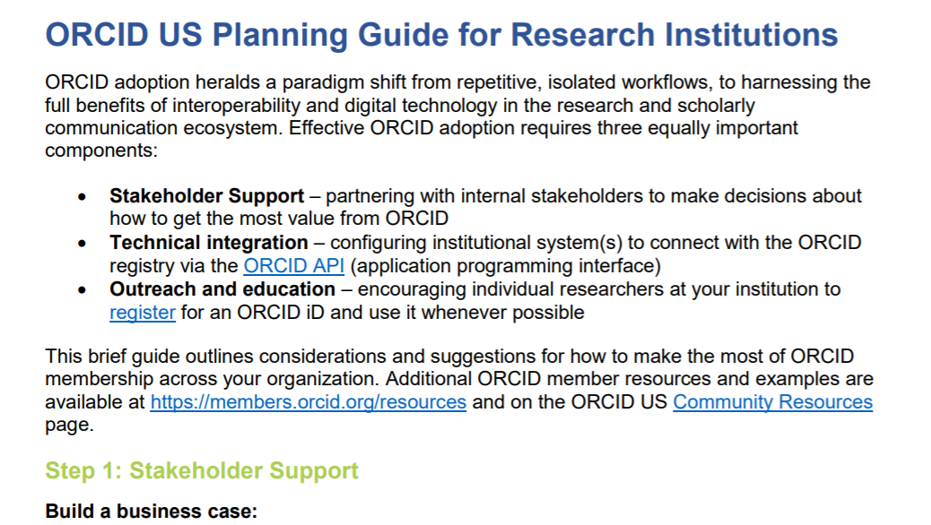
ORCID Planning Guide
https://www.lyrasis.org/Leadership/Pages/orcid-us-planning-guide.aspx
Notes:
The ORCID US Community Planning Guide provides a good starting point for opening conversations and considerations around ORCID adoption, so I recommend checking that out.

Slide 76
ORCID US Community Services
Notes:
As we are wrapping up I want to finish by covering what the ORCID US Community can do to help you get the most value from ORCID by using the ORCID API

Slide 77
ORCID US Community Services
Dedicated support:
Planning
Brainstorming
Consultation
System assessment & investigation
Technical questions
Contact sheila.rabun@lyrasis.org for consulting and help with assessing possibilities for your local context based on the systems you are using and what your goals are for using ORCID
Notes:
My role as the ORCID US Community SPecialist is to provide dedicated support for ORCID US member institutions and I also help prospective members. At any time I am available for consultations and I am here to help with all of your ORCID questions, including helping you assess your context to see where ORCID integration would make the most sense, so please contact me.

Slide 78
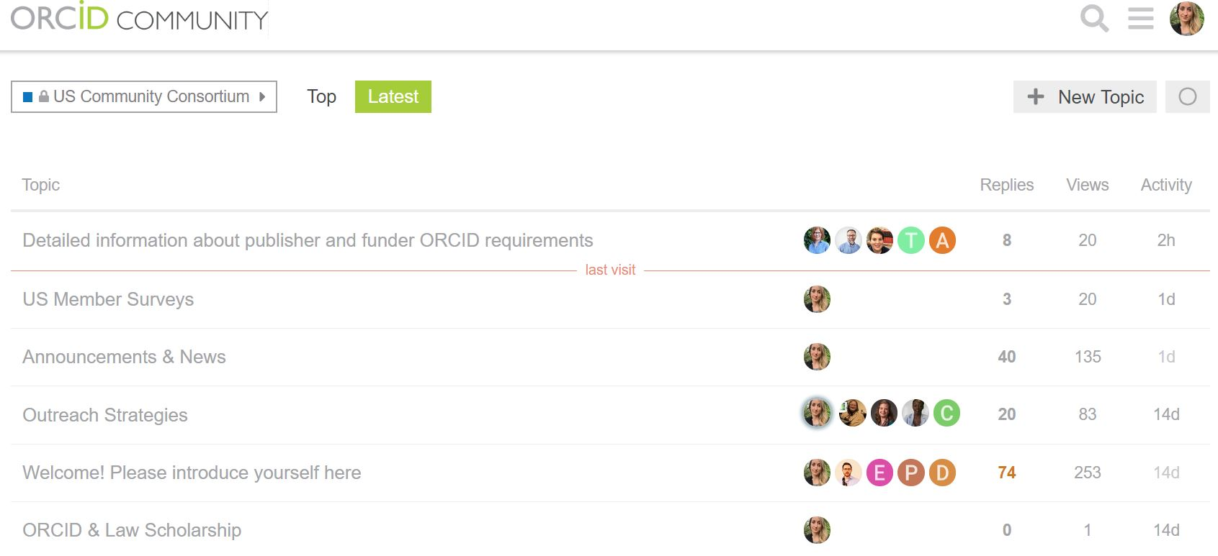
ORCID US Community Services
Community Support:
Examples & case studies from other institutions
Webinars, blogs, community calls, etc.
Planning guides
Notes:
We also have the advantage of community and sharing information. I encourage community members to share their experiences and case studies so we can all learn from each other. THe image you are seeing here is a screenshot of our ORCID US COmmunity member discussion forum for example. We also have periodic webinars, blogs, and community calls for the purpose of sharing information and examples. We also have a number of planning guides designed to help you walk through the various considerations for planning ORCID adoption initiatives. THe bottom line here is that you are not alone. THe institutions that are part of the ORCID US Community are at all different stages of the ORCID adoption process, so no matter whether you are just getting started or are well ahead of the curve at your institution, the community welcomes your advice, experience, and questions.

Slide 79

Thoughts? Questions?
Web orcid-us.org
Email orcidus@lyrasis.org
@USconsortium
Thank you!
Notes:
Welcome everyone, thanks for joining us today. My name is Sheila Rabun and I am the ORCID US Community Specialist at LYRASIS. I provide dedicated technical and community support for institutional members of the ORCID US Community. This session is designed for anyone who is interested in learning about the ORCID API, but specifically for those at ORCID member institutions working with the ORCID Member API.

