Slide 1
Top down, bottom up & everything in between ORCID’s multifaceted approach to technical & cultural change
Liz Krznarich, MLIS, Technical Lead, ORCID https://orcid.org/0000-0001-6622-4910
NIH Workshop on the Role of Generalist Repositories to
Enhance Data Discoverability and Reuse| 12 Feb 2020
Notes:
Hi! And many thanks to the NIH for inviting me to speak with you today. I’m Liz Krznarich, and I’m the technical lead at ORCID where I work on developing and implementing new features and generally keeping the ORCID Registry up and running. I’ve been at ORCID since nearly the beginning, and I’m here to share a bit about our experience inciting cultural and technical in research. Although we’re not directly involved in data sharing and reuse, there are some parallels and points of overlap that I hope you might find useful.

Slide 2
2010
We’re going to solve name ambiguity in research!
…And we’re going to make it open, non-proprietary & non-profit!
Everyone will love this!
Notes:
So, let’s step in our time machine and take a trip back 10 years to 2010, when ORCID the non-profit organization was founded. We began with this lofty goal: we’re going to solve name ambiguity in research. We’re going to give out numbers that people can use instead of names; publications, grants affiliations will all be matched to these numbers, and everything will be wonderful! And we’re going to make if open, non-propriety and non-profit. Everyone will love it!

Slide 3
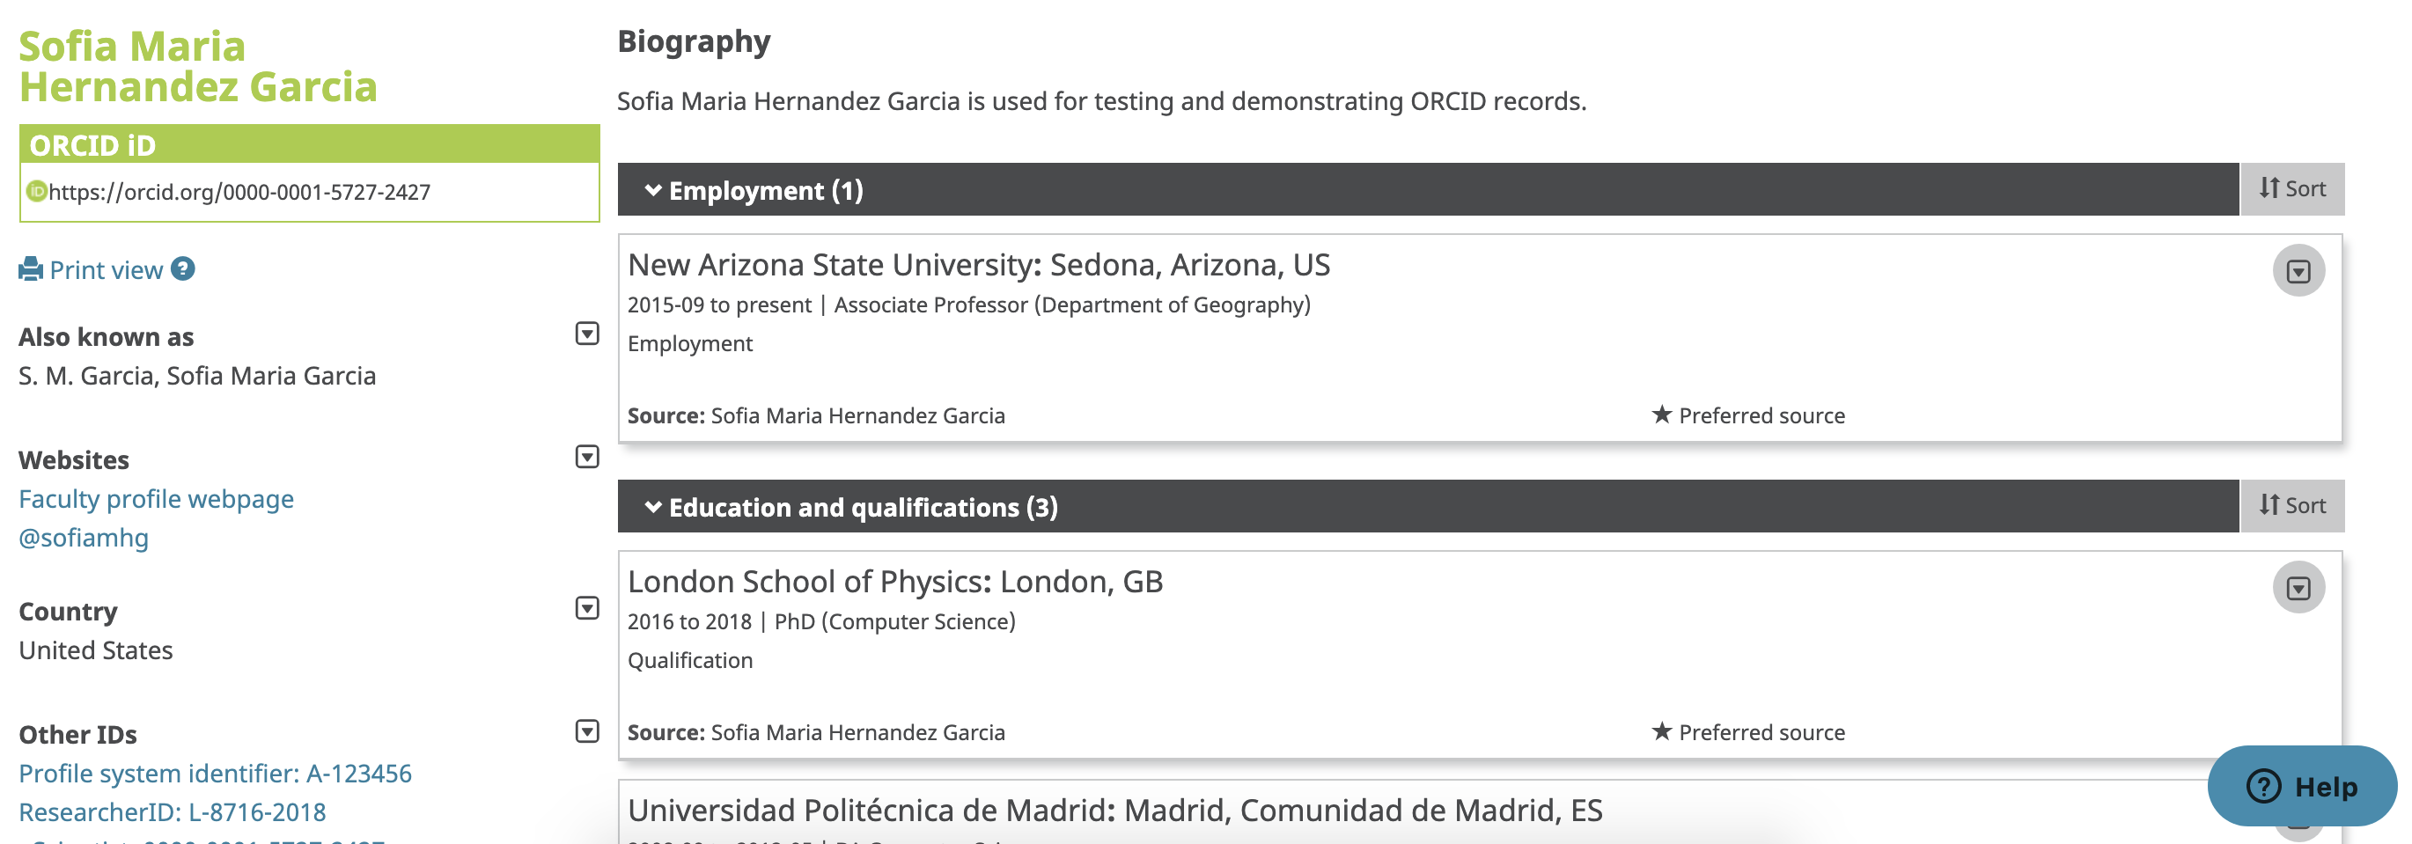
2012: ORCID Registry launched
Researchers can voluntarily sign up for an ORCID iD
https://orcid.org/0000-0001-5727-2427
They also get a record to list affiliations, grants, pubs and other info
Notes:
So, in 2012, we launched the ORCID Registry. Researchers can voluntarily get their very own ORCID iD, and they also get shiny ORCID record where they can list all of their information

Slide 4
…and there are APIs!
Other systems can read and write data, so ALL of a researcher’s outputs, grants, and affiliations can be collected into one magic, authoritative list
GREAT! PROBLEM SOLVED!
Attribution & reporting are now easy and automatic (er….)
Notes:
But that’s not all! We’ve built APIs! Other systems can read and write data, so all of a researcher’s works, grants, affiliations and other data can be collected into one magic, comprehensive always up-to-date list.
Great! Problem solved. Attribution and reporting are now easy and automatic.

Slide 5
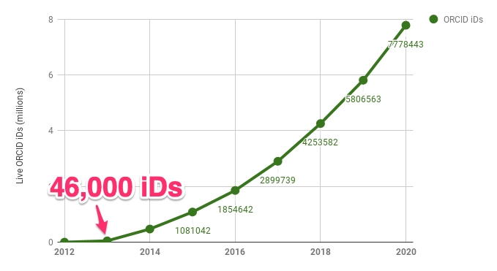
If you build it they will come
Notes:
OK, we all know that this isn’t the reality. As mentioned in some of yesterday’s sessions, building 1 system doesn’t necessarily mean instant change. Uptake was not awful, but reception among researchers was variable.

Slide 6
2013 Starting from the bottom up
Notes:
We knew we had to do more to get folks interested in using ORCID, so we started as many small teams do…from the bottom up.

Slide 7
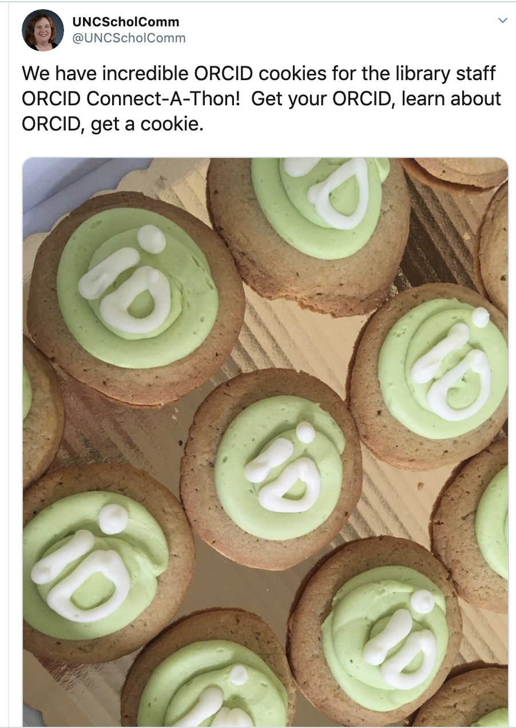
Local engagement
Work with individual institutions to develop campaigns
Special events
Workshops
Docs (Libguides)
One-on-one researcher support
Notes:
Initially, we worked with individual institutions to engage at a local level, via outreach and education campaigns) (mostly via libraries). This “on the ground” work is vital get the word out, and it’s still going on today.

Slide 8
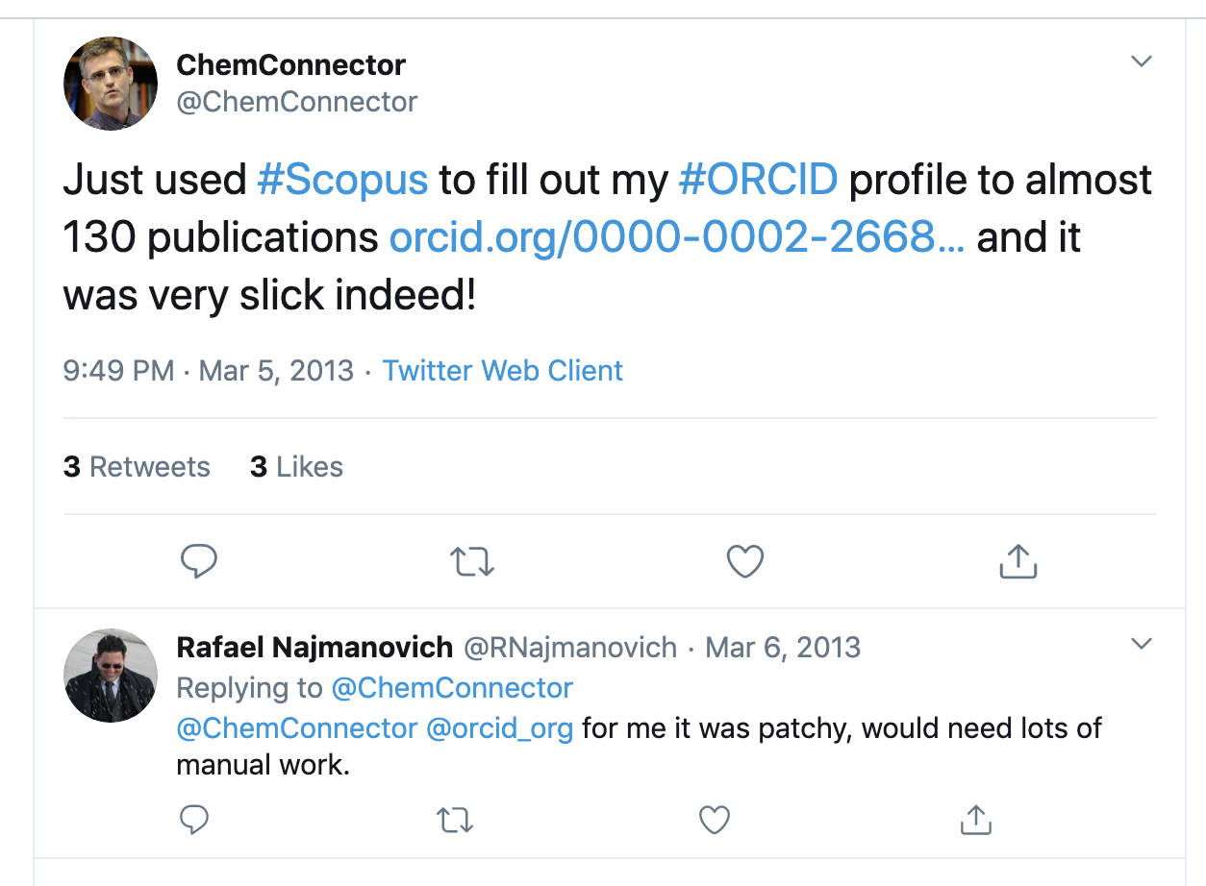
Incentives via system integrations
Scopus, ResearchID (now Publons), CrossRef search
…but they didn’t work well automagically because iDs weren’t yet embedded into research workflows
Notes:
But engagement isn’t enough if the system doesn’t do anything all that useful. So we partnered with organizations to build integrations that allowed users to import things into their record. They were pretty OK, but they didn’t work fabulously well because iDs weren’t yet embedded into research workflows. Researchers still had to do a lot of manual curation.

Slide 9
Results? Pretty good, but not a critical mass
Comms campaigns only get you so far
Local engagement doesn’t scale well
Not enough concrete incentives for participation
Notes:
Even so, by the end of 2014 we had over 1million researchers registered in ORCID. But at that point, we realized it was time for a shift in order to make things scale.

Slide 10
2015 Shifting toward top-down
Notes:
So, we added top-down approaches

Slide 11
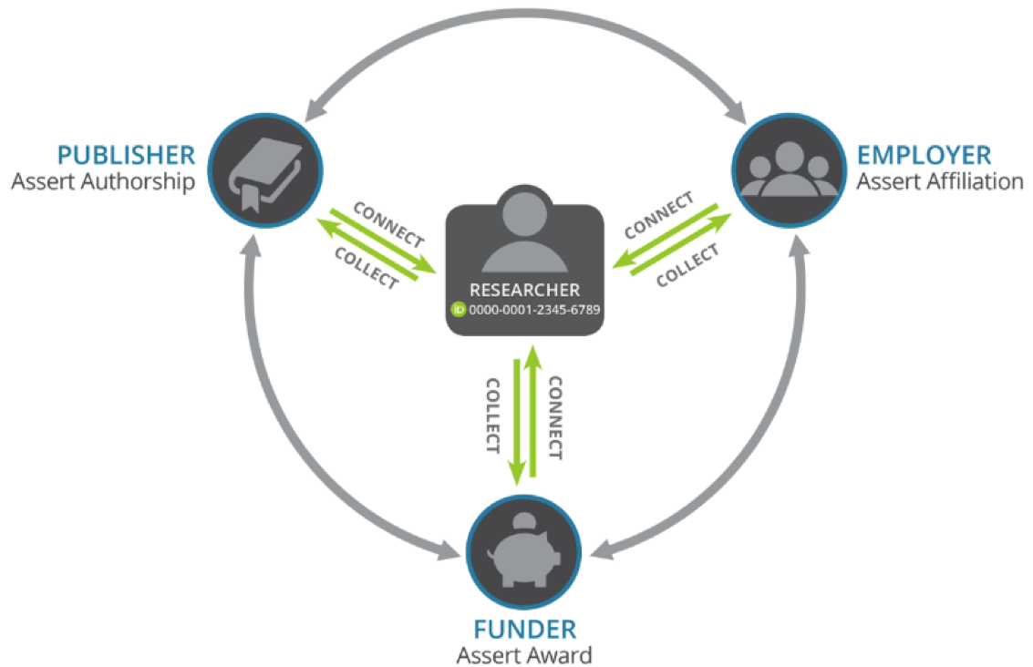
A new approach
Focus on engaging funders, publishers, governments at a strategic level
By 2016, mandates:
9 private funders (now 11)
17 publishers (now 84)
9 government funders (EU and AU)
Notes:
And focused on engaging funders, publishers and governments at a strategic level. Timing was right, given policy around Open Access mandates coming into effect across the EU. For ORCID, 2016 was the year of the mandate. By the end of 2016, we saw statements establishing ORCID mandates from 9 private funders, 17 publishers and 9 government funders.

Slide 12
NEWSFLASH!!! Policy doesn’t result in change all by itself! (and neither does ORCID…an iD isn’t very useful if it’s not connected to anything else) Infrastructure + incentives needed
Notes:
Now, this is great. But here’s a newsflash, that isn’t new news to most of you: Policy doesn’t result in change all by itself. To make it happen we needed infrastructure and incentives.

Slide 13
(Shared) Infrastructure for change
How do we connect people to places (affiliations) & things (pubs, datasets, grants, etc)?
Persistent IDs for people, places & things
Metadata standards that can capture relationships between persistent IDs for people, places, things
OAI-PMH profiles, ex RIOXX (UK), OpenAIRE (EU)
DOI metadata
eduPerson
Systems that implement these standards in useful ways
Funder, Publisher, Repository, CRIS...
Notes:
The bigger piece of the top-down approach is developing infrastructure. In ORCID’s case we’re talking about the shared “above the line” pieces of infrastructure needed for interoperability. Out question is “how do we connect people to places and things? Well, first, we need persistent identifiers in use for for those people, places and things. And then we need metadata standards that can capture relationships between those persistent IDs. When I talk metadata in this case, I’m referring to the metadata that supports data exchange between systems; not the specialized, domain-specific metadata needed to describe and use an object. Finally, we need systems that implement these standards in useful ways.

Slide 14
Shared? How do we do that? COMMUNITY
Requests for input and Hackathons and Town hall meetings and Working groups and Regional meetings and Workshops and Task forces and Discussion forums and Steering groups and Requests for input and Hackathons and Town hall meetings and Working groups and Regional meetings and Workshops and Task forces and Discussion forums and Steering groups Requests for input and Hackathons and Town hall meetings and Working groups and Regional meetings and Workshops and Task forces and Discussion forums and Steering groups Requests for input and Hackathons and Town hall meetings and Working groups and Regional meetings and Workshops and Task forces and Discussion forums and…
Notes:
This stuff is not easy. And it’s not something that ORCID can or should do by itself. This is point where community – that recurring theme - comes into play at ORCID. In our case it takes the form of that seemingly endless cycle of working groups, community meetings, regional meetings, workshops, hackathons, steering groups, town halls, task forces, discussion forums, and on and on and on.

Slide 15
Now we can build incentives! Like tools that add items to ORCID automatically
Publishers &
Repositories
DOI Registrars
Notes:
Hard stuff, but with some of that infrastructure in place - PIDs, metadata, systems – in place, we can now begin to create useful incentives, like workflows that result in items added to ORCID automatically! (of course ORCID isn’t the endpoint – because of its APIs, metadata in ORCID can flow out to other systems.

Slide 16
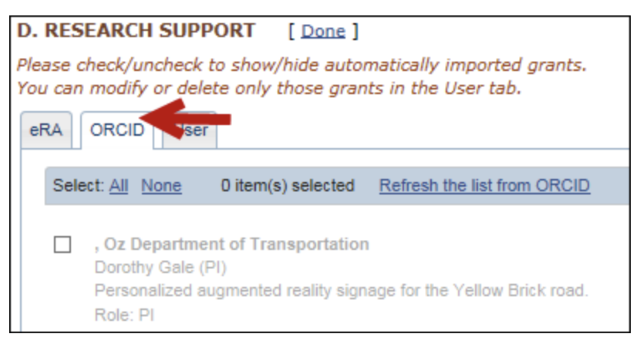
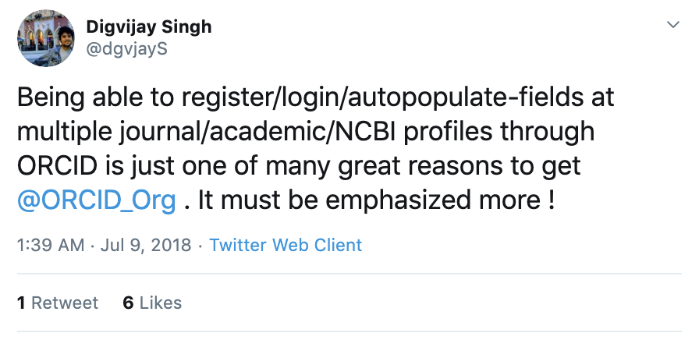
…and tools that populate application and reporting forms automagically
Notes:
And then we can build tools that populate application and reporting forms automatically

Slide 17
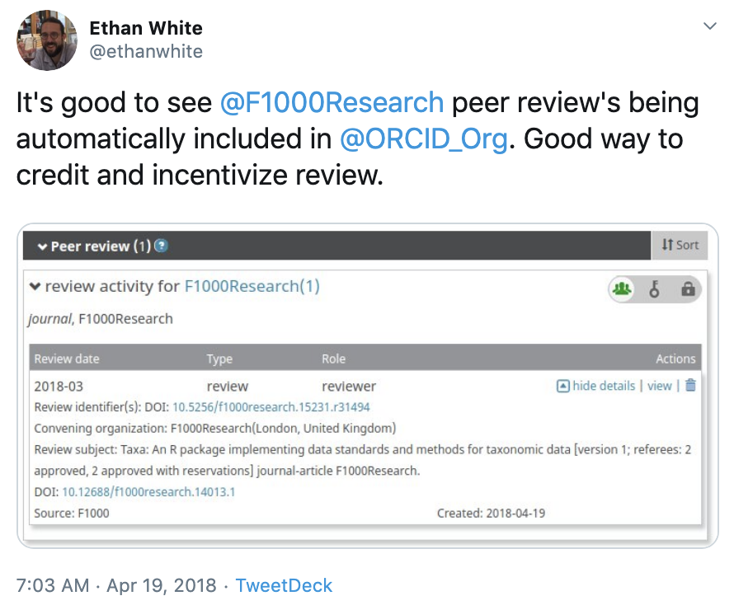
Plus we can give credit for contributions that were invisible before the infrastructure existed
Peer review
Data
Notes:
Plus, we can now recognize contributions that were invisible (or hard to count) previously

Slide 18
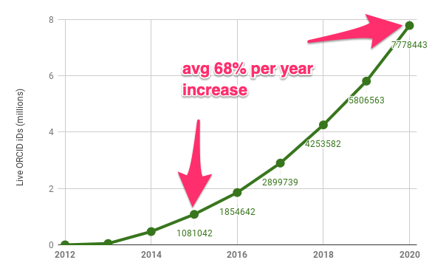
Hooray! So we’re done?
Notes:
OK, that sounds great. So we’ve got some infrastructure, and we’ve got nearly 8mil ORCID iDs. Now is the work done?

Slide 19
8 mil iDs
85% with default data visibility = public!…BUT
2.8 mil have >= 1 affiliation
2 mil have >= 1 work
Notes:
Well, there are 8 million iDs registered, but only a subset of them have metadata about affiliations and works. This is not so useful.

Slide 20
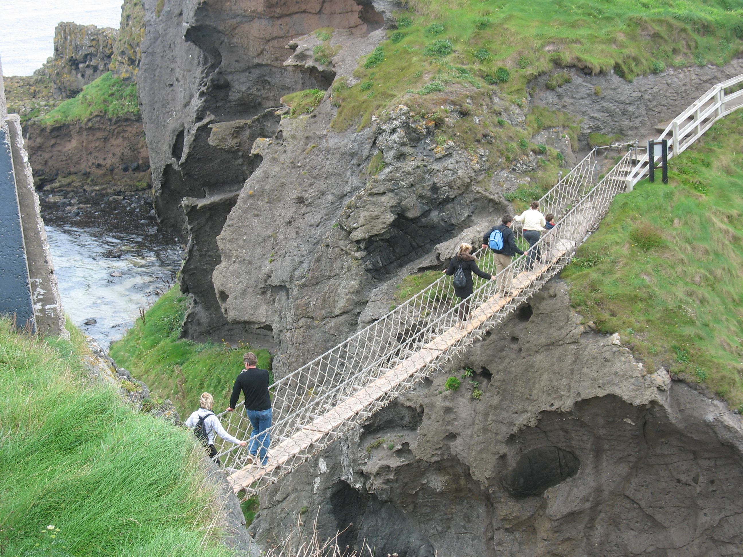
No! Infrastructure still needs work + broader adoption
The metadata exists somewhere, it just needs the right roads and bridges to connect to ORCID
Notes:
The infrastructure piece, and particularly the systems implementation piece, still needs work, by both ORCID and other organizations. The roads and bridges are in better shape in some areas than others.

Slide 21
We can solve this problem! (with your help) ORCID core strategies

Slide 22
Key take-aways from 8 years of ORCID
Bottom up approaches only get you so far
Mandates work, but only with infrastructure to support them
Infrastructure allows creating incentives

