Slide 1
Product Interest Group
Wednesday 10 March 2021
Product Interest Group - March 2021

Slide 2
Agenda
Welcome
Updates since last meeting
Release plan for 2021
Longer term plans
Addressing any outstanding questions from shared document and live chat
Product Interest Group - March 2021

Slide 3
Updates since
last meeting
Product Interest Group - March 2021

Slide 4
Updates
Documentation now live
Member and user surveys underway
Member portal now in beta!
Product Interest Group - March 2021

Slide 5
Documentation refresh
Improved member documentation
List of features available to community
More workflows
Improved integration guides
API tutorials with links to Github tutorials
API and Integrations FAQs
Feedback to support@orcid.org
Product Interest Group - March 2021

Slide 6
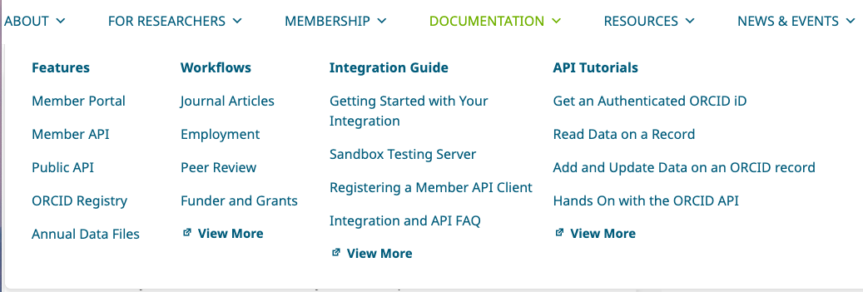
Documentation refresh
Product Interest Group - March 2021

Slide 7
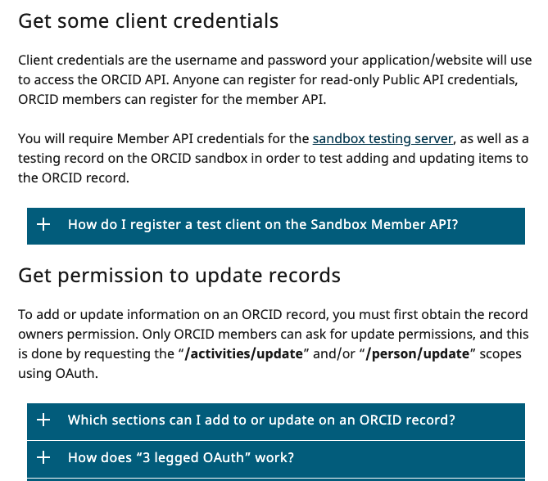
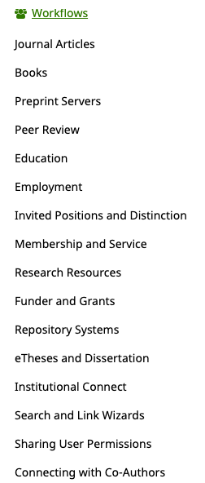
Documentation refresh
Product Interest Group - March 2021

Slide 8
Affiliation Manager
Launched in beta to a small group of consortia members
Beta roll out plan - to increase the usage
Next Up
Fix any issues identified by beta participants
Ability to add, edit and delete affiliations via the CSV upload
Add translation support
Product Interest Group - March 2021

Slide 9
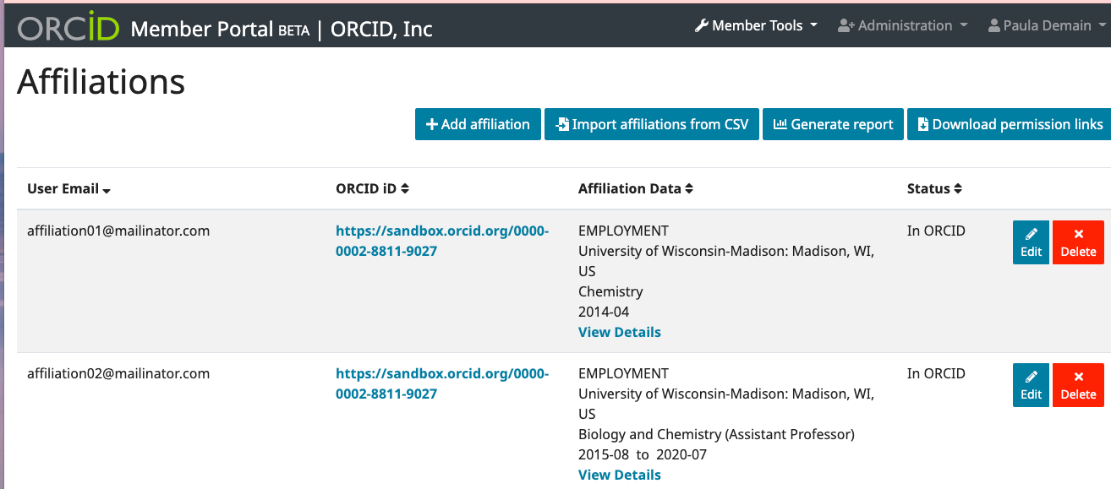
Affiliation Manager
Product Interest Group - March 2021

Slide 10
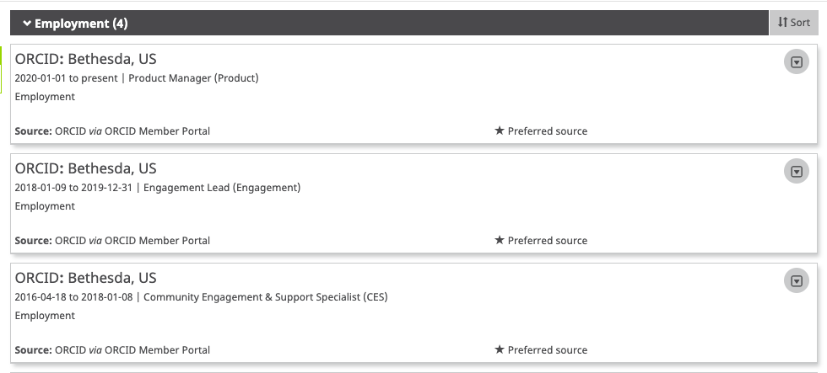
Affiliation Manager

Slide 11
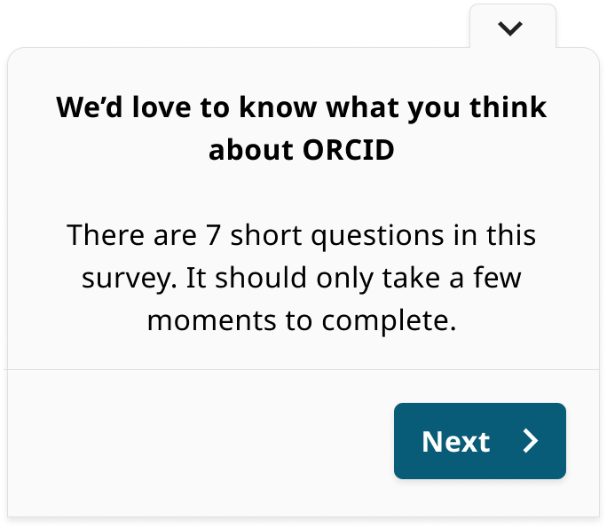
User Survey
Goals
Gather general user data
Set some baselines for key UX metrics
Get a feel for what people think about ORCID
Structure
7 multi-choice or ranged questions
1 free text comment field
Minimal disruption - Subtle and optional
Product Interest Group - March 2021

Slide 12
User Survey - Key UX metrics
Set some baselines for some of our key UX metrics
Net Promoter Score (NPS) Would you recommend ORCID?
Customer Effort Score (CES) How hard is it to use ORCID?
Customer Satisfaction Score (CSAT) How satisfied with ORCID are you?
Usefulness/utility to customer How useful is ORCID to you?
Product Interest Group - March 2021

Slide 13
User Survey - Results
The user survey ran from the 27th of January to the 1st of March.
Users signing in to ORCID during this period will have seen the survey at least once. Sampling was used to spread surveys across a 24hr period.
Just under
Just under
45,000
responses
3,500
comments
Product Interest Group - March 2021

Slide 14
User Survey - Results
NPS
CSAT
CES
Utility/Value
49
81.4%
70.9%
79.4%
These scores are all pretty positive. However, there’s always room for improvement - especially with regards to ORCID’s usability.
Product Interest Group - March 2021

Slide 15
User Survey - Results
The free text field has also delivered some fascinating feedback.
Some positive…
“Use ORCID iD, save the world”
“ORCID increases my career visibility and the discoverability of my research”
Some not so much…
“As a first time visitor I found it very difficult to navigate the site”
“ORCID promises to increase the impact of our academic work. I don’t see this happening”
Product Interest Group - March 2021

Slide 16
User Survey - Results
Some initial, very rough, sentiment analysis suggests that the top 5 things on our users’ minds are:
Usability - Make the ORCID experience easier, faster and smoother
Styling/design - Bring the app up-to-date
Automation - Reduce manual entry and maintenance, improve automated import/export
Syncing - Better syncing with other services and tools
Metrics - Adding bibliographic metrics to ORCID
ORCID users are also keen on reliable DOI recognition and import, improving contributor and co-author info, app performance and better search/filtering. Also profile photos crop up a few times.
Product Interest Group - March 2021

Slide 17
User Survey - Next steps
Report on January 2021 survey
Incorporate findings into our roadmap planning
Relaunch user survey in May/June for round 2
Product Interest Group - March 2021

Slide 18
Release plan
2021
Product Interest Group - March 2021

Slide 19
Objectives
Raise the proportion of active users who have populated their records or have had their record updated by a member
Raise the proportion of members performing updates, or otherwise enjoying the benefits of their membership
Raise the quality (completeness) of the data we deliver to members via our APIs.
Product Interest Group - March 2021

Slide 20
Release plan 2021
Q1 Funded-by, CredIT, Affiliation manager
Q2 Enabling delete for revoked permissions, improved member reporting
Q3
Integrate ROR, new my-orcid release
Q4
Improved member self service, new accessibility statement, ROR becomes default
Product Interest Group - March 2021

Slide 21
Q1 - CRediT
Implement CRediT in Q1
Add CRediT roles to the existing list of contributor roles
Just roles - no degree of contributions
Available for members using API v3.0
Visible in the UI
Impact to integrations?
Mapped CRediT roles to existing roles
No direct map - null will be returned
Product Interest Group - March 2021

Slide 22
Q1 - Link funding to works
Ability to link funding identifiers to work items
New relationship type for works ‘funded by’
Available with API v3.0
Available in the UI
Product Interest Group - March 2021

Slide 23
Q2 - Delete still an option
Ability to delete items even when the user has revoked permission
Privacy policy updated to reflect change
Allow organizations to remove inaccuracies
Trusted organizations UI will be amended
Revocation is rare and very few records will be impacted
Product Interest Group - March 2021
Notes:
This is an edge case, but an important one to address in order to reassure members they can remove inaccurate data relating to their organizations.

Slide 24
Q2 - Improved Member reporting
Building improved member reporting into the member portal is our next task now the affiliation manager is on our production servers
The reports will provide insight into how your integrations are performing, the number of iDs they’ve connected to, the number of records updated, user geography and more.
As well as new features, we’ve incorporate the most used features of our old reporting, e.g. email domain stats.
Reports have been well received by beta testers
Product Interest Group - March 2021

Slide 25
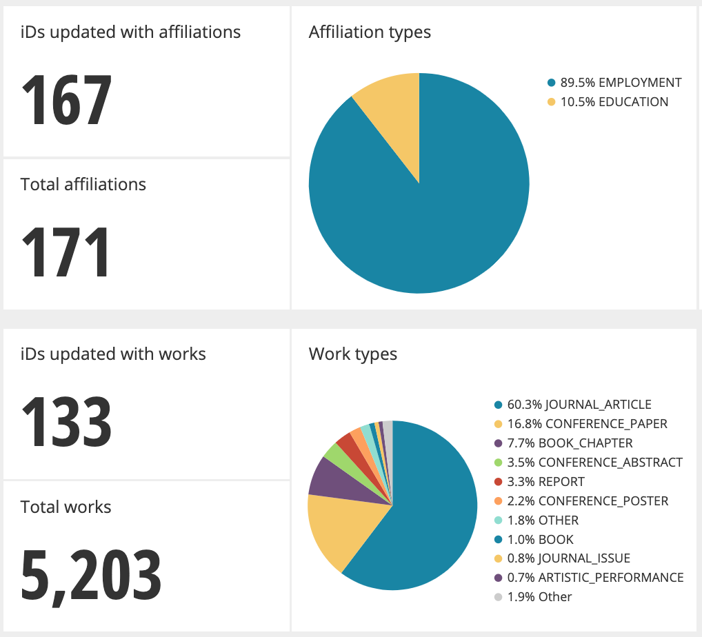
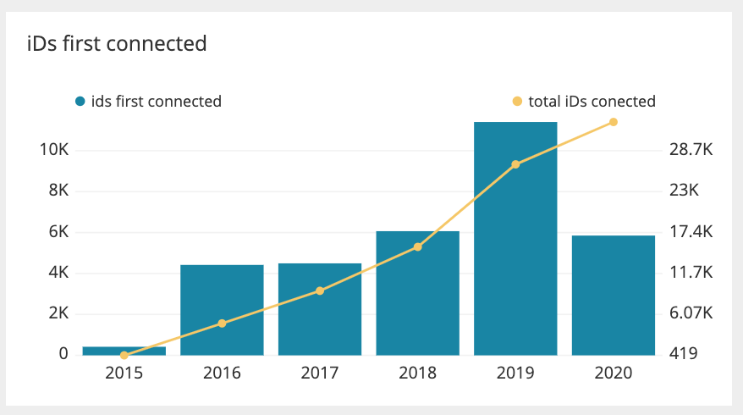
Q2 - Improved Member reporting
Product Interest Group - March 2021

Slide 26
Q3 - Integrate ROR
Adding ROR IDs to the list of supported Organization IDs
ROR IDs will be able to be used alongside GRID, FUNDREF and RINGGOLD IDs
ROR will become the preferred ID for all user interface items
Product Interest Group - March 2021

Slide 27
Q3 - UI refresh
Notifications and inbox nearing release in late Q1
Public record on track for delivery in Q2
Activities - Works, affiliations, employment etc. - in active development (Q2/Q3)
Account settings design approved
Internal tools in initial stages of design
Aiming to have this all done for Q3.
Sections and features released as they are completed over the coming months.
Product Interest Group - March 2021

Slide 28
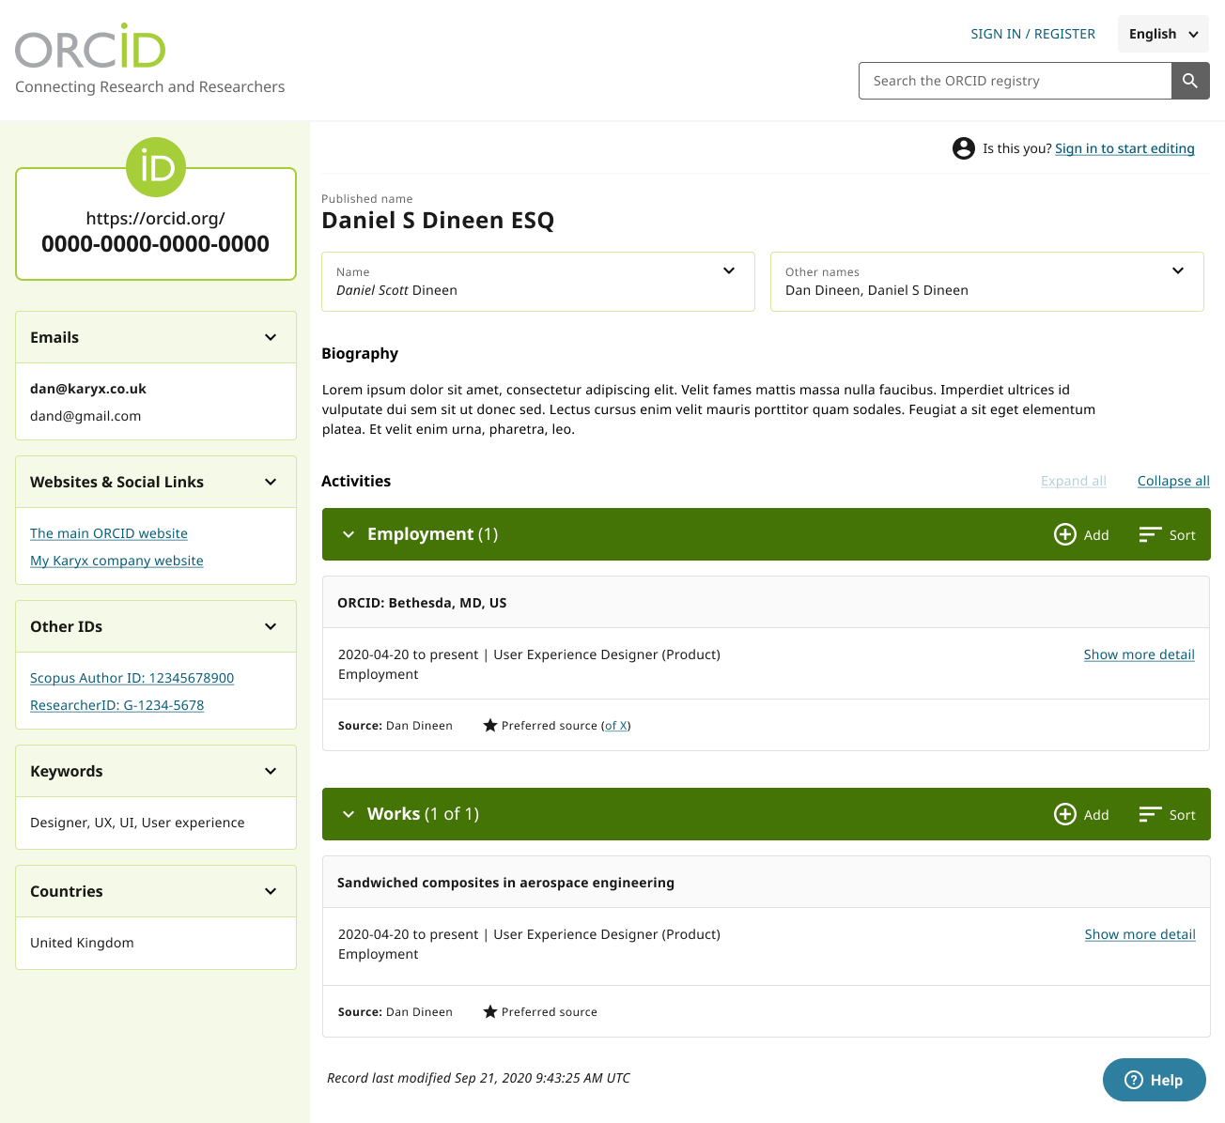
Product Interest Group - March 2021

Slide 29
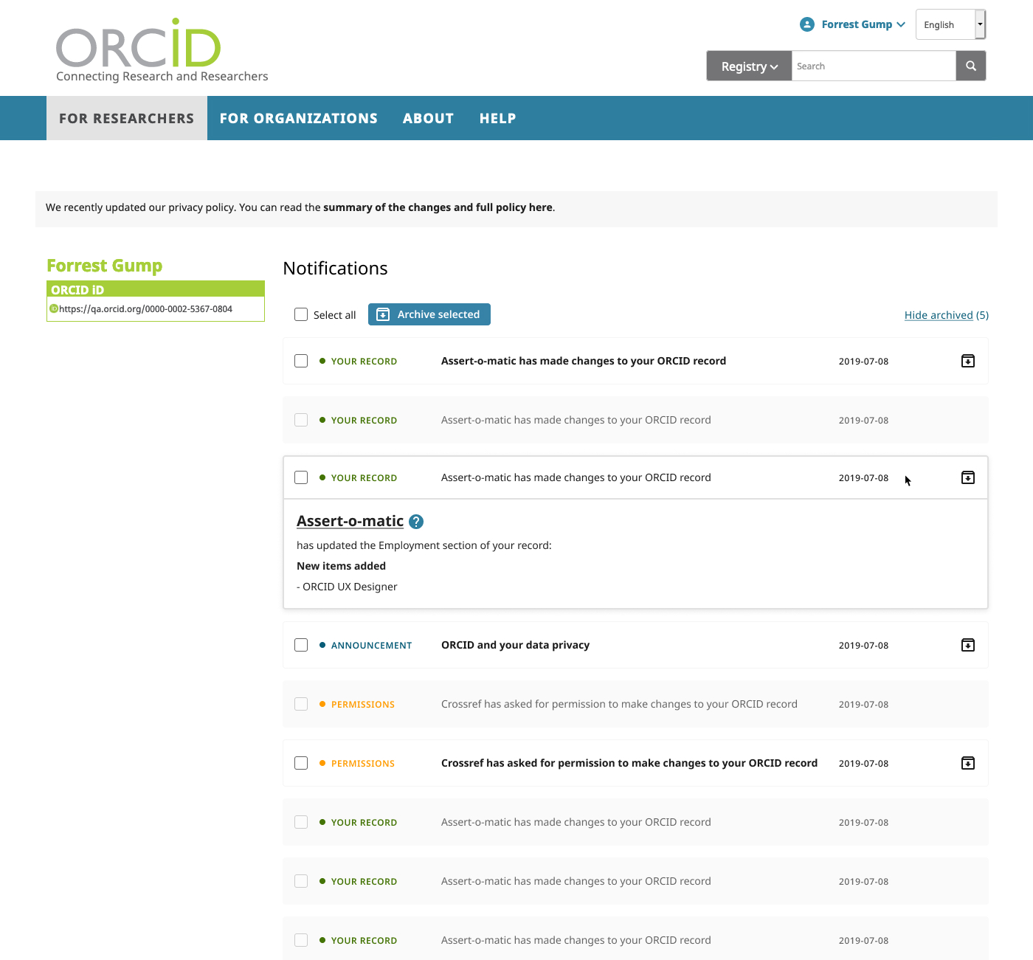
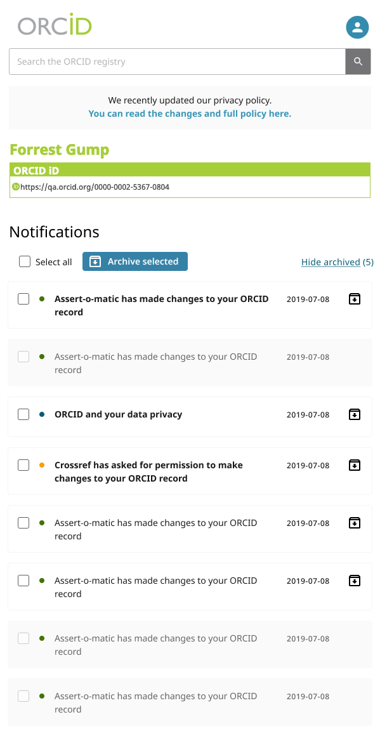
Product Interest Group - March 2021

Slide 30
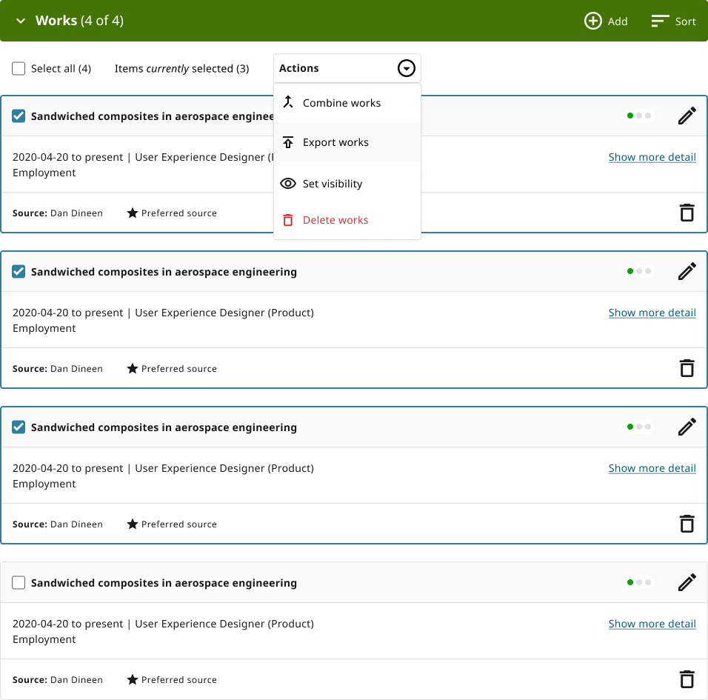
Product Interest Group - March 2021

Slide 31
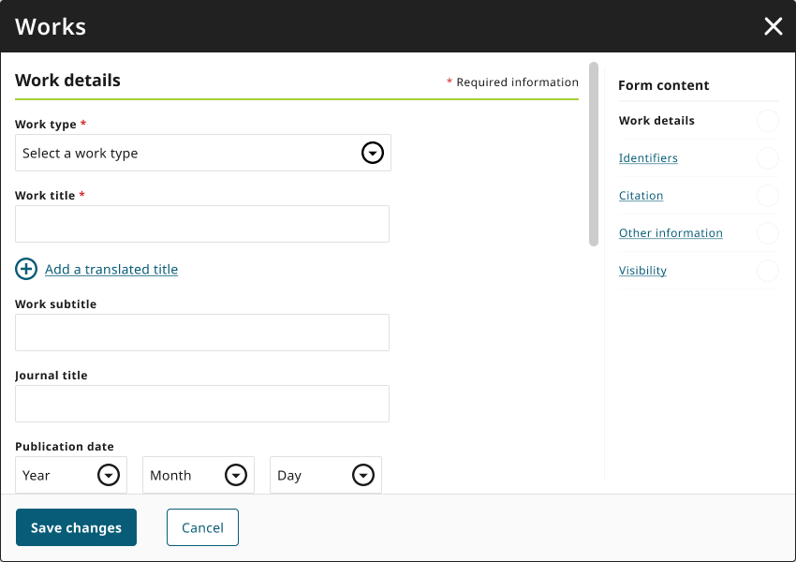
Product Interest Group - March 2021

Slide 32
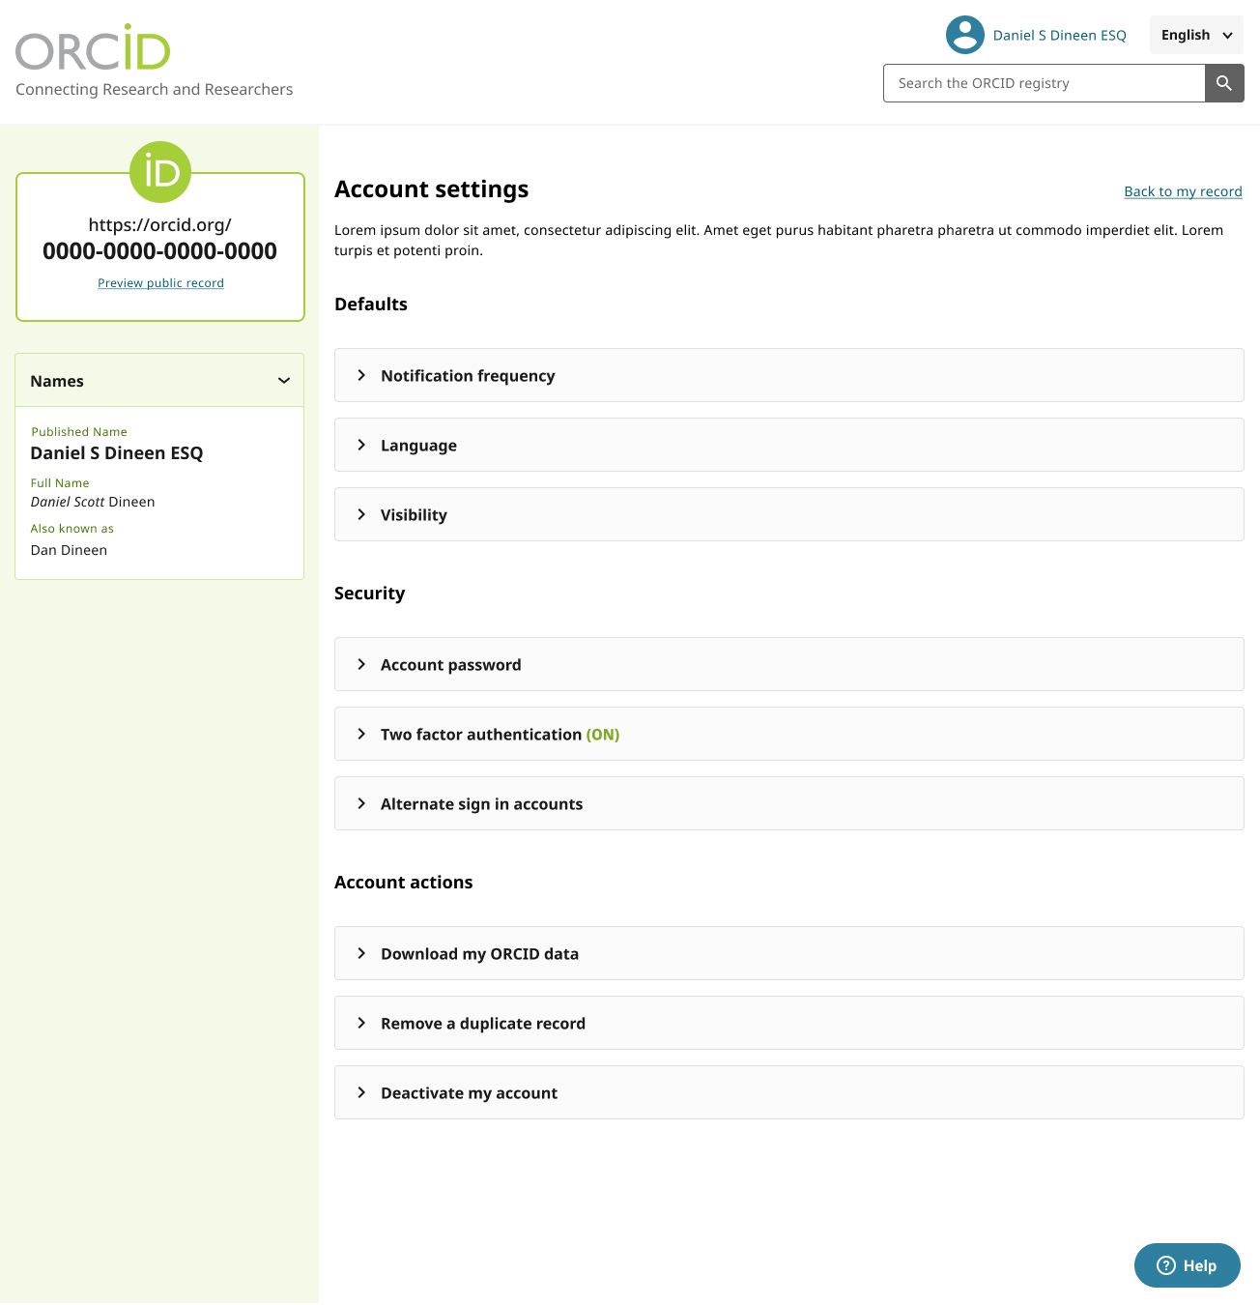
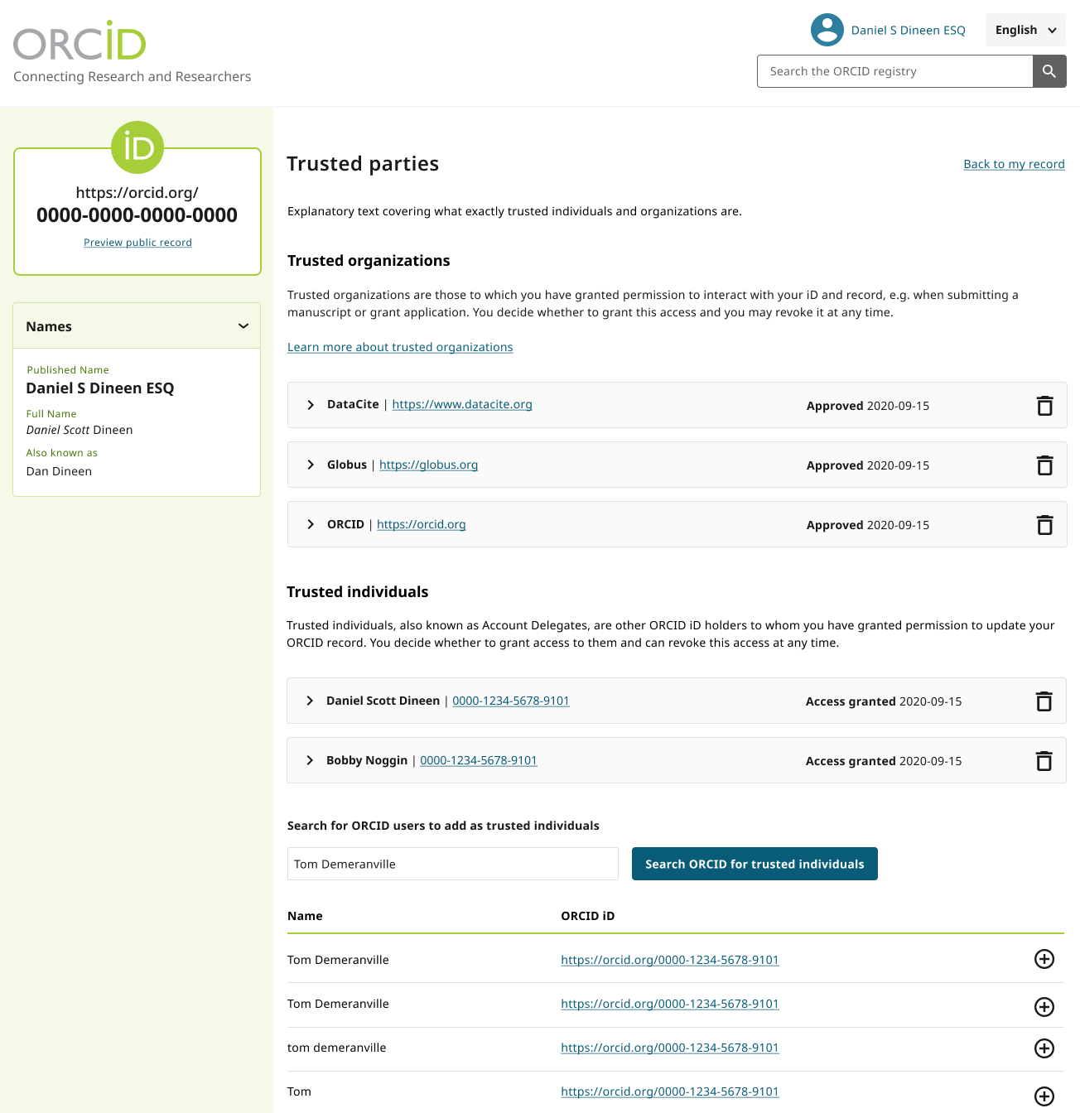
Product Interest Group - March 2021

Slide 33
Q4 - Removing barriers
More than just accessibility
Building on (and continuing to improve) our new accessibility statement
Making ORCID a joy to use, regardless of context, device, input method or ability
Make the ORCID experience better on every device
Design for a culturally-diverse global audience
Look beyond our current membership and user base
Issue new improved accessibility statement
Product Interest Group - March 2021

Slide 34
Q4 - Member Self Service
Start migrating existing functionality from the registry to the member portal
Manage public information
Organization Display name
Website
Organization contact
Contact information
Consortia Leads
Same as above
Consortium membership ordering
Product Interest Group - March 2021

Slide 35
Q4 - Member Self Service
Proposed new functionality
Consortia Leads managing consortium members contacts
Manage API Credentials for production and sandbox
Suggestions are welcome!
Product Interest Group - March 2021

Slide 36
Q4 - Rationalize Organization IDs
At the same time as implementing ROR, we’re hoping to restructure the way we deal with organization IDs internally so that we are able to match IDs from different providers if they represent the same organization
Hopefully this will result in:
Richer organization metadata in our API responses and data file
Richer organization metadata in our user interface
Easier searching via our search API. A search for GRID will return records with the equivalent RORs, Crossref funder IDs and RINGOLDS too
Simpler user experience. Each org only appears once in the dropdown
Product Interest Group - March 2021

Slide 37
Long Term Plan
Product Interest Group - March 2021
Notes:
The key takeaway from the board Scaling discussion in May was this: “ORCID should focus on its foundational value proposition - creating connections between people and their contributions for the benefit of ALL who participate in research.”. The product 2021 goal is to increase the number of connections between people, places and things.

Slide 38
Improve the new user journey
Guidance and support during those early stages
A clear path for progression. No more “What do I do now?”
Avoid over-explanation, hand-holding or aggressive railroading
The researcher is always in charge
Product Interest Group - March 2021

Slide 39
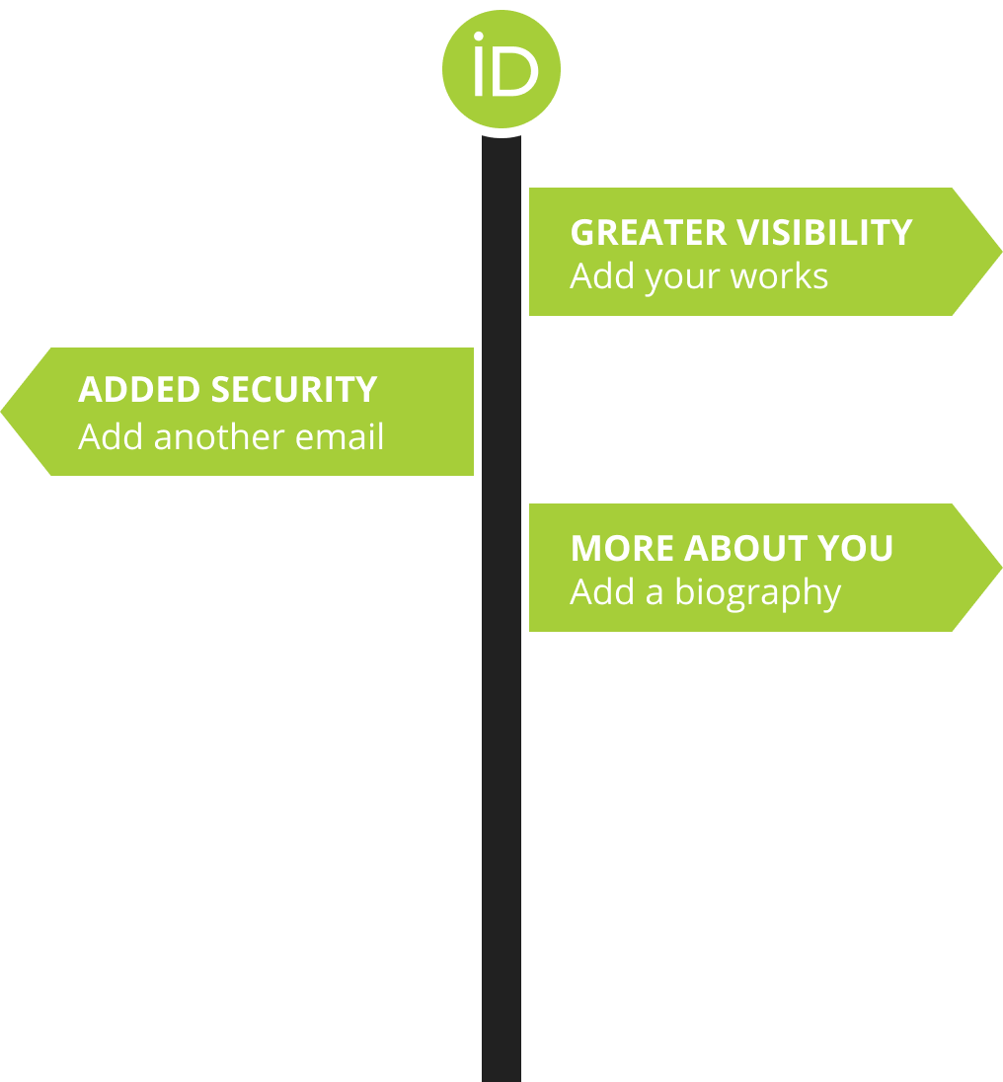
Encouragement toolkit
A series of features designed to provide a little ‘push’ when needed
Use real language where we can
Clarification on complex terms or service jargon
Hints, guides and ‘helpers’ to keep people moving
Stay out of the way unless we’re needed
Help is always available
Product Interest Group - March 2021

Slide 40
Provide enriched data
Works in the registry are sometimes missing relevant data, like co-authors or ISSN numbers
Traditionally, we’ve expected members to look these data up using work identifiers, like DOIs or Pubmed IDs.
We’re going to investigate doing this for members and incorporating the enriched data within our own API responses, so that members have access to it without complex, multi-provider integrations.
We’re going to enrich existing works, not discover new ones.
In the end, what we do will depend on what we find out during our investigation and prototyping. It’s a complex problem.
Product Interest Group - March 2021

Slide 41
Have a question?
Raise your hand and we’ll unmute you
Raised Hands graphic Democracy by Wichai Wi from the Noun Project
Product Interest Group - March 2021

Slide 42
Product Interest Group
Thanks for listening
Product Interest Group - March 2021

